Slide 1
Volume E

Slide 2
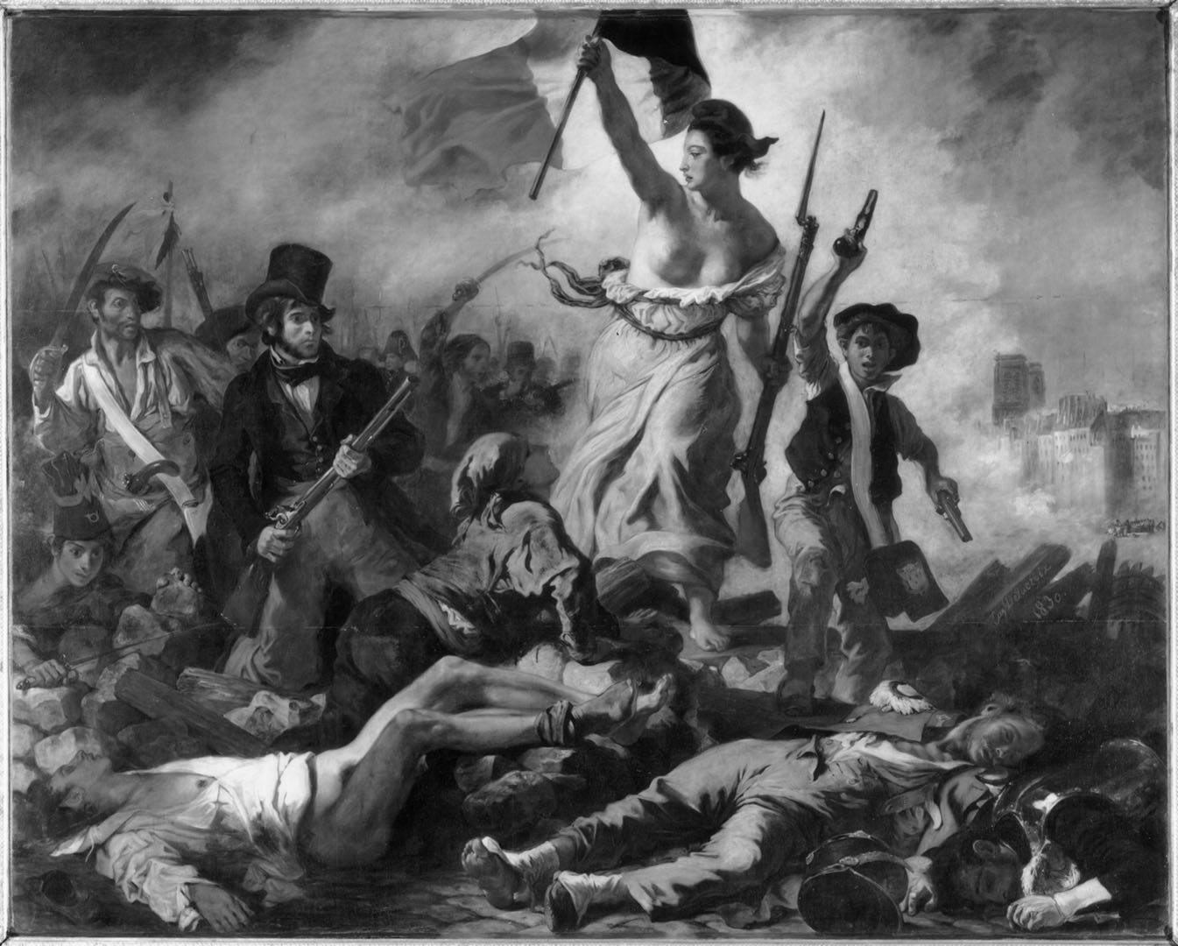
Notes:
Liberty Leading the People, 1830, Eugène Delacroix.

Slide 3
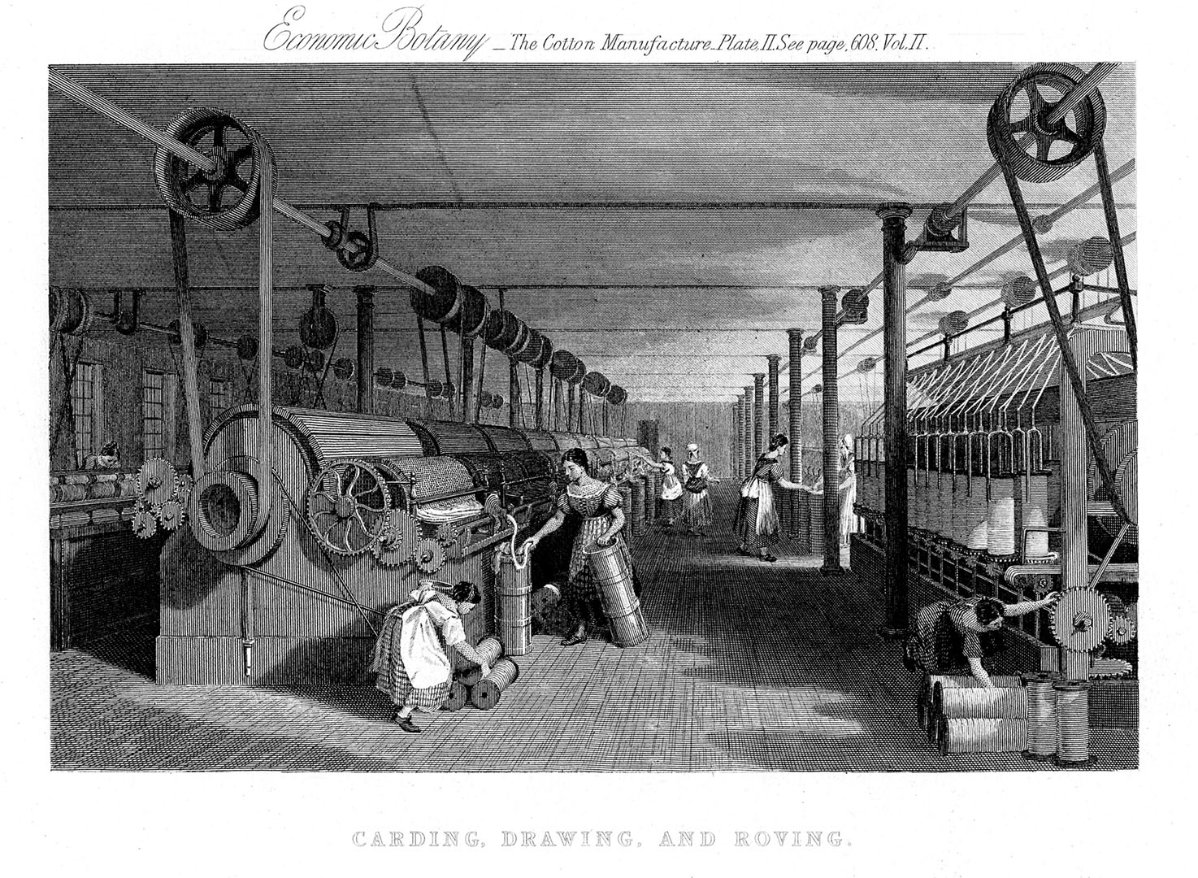
Notes:
An engraving depicting the interior of the Swainson & Birley Mill in Lancashire, England, ca. 1830.

Slide 4
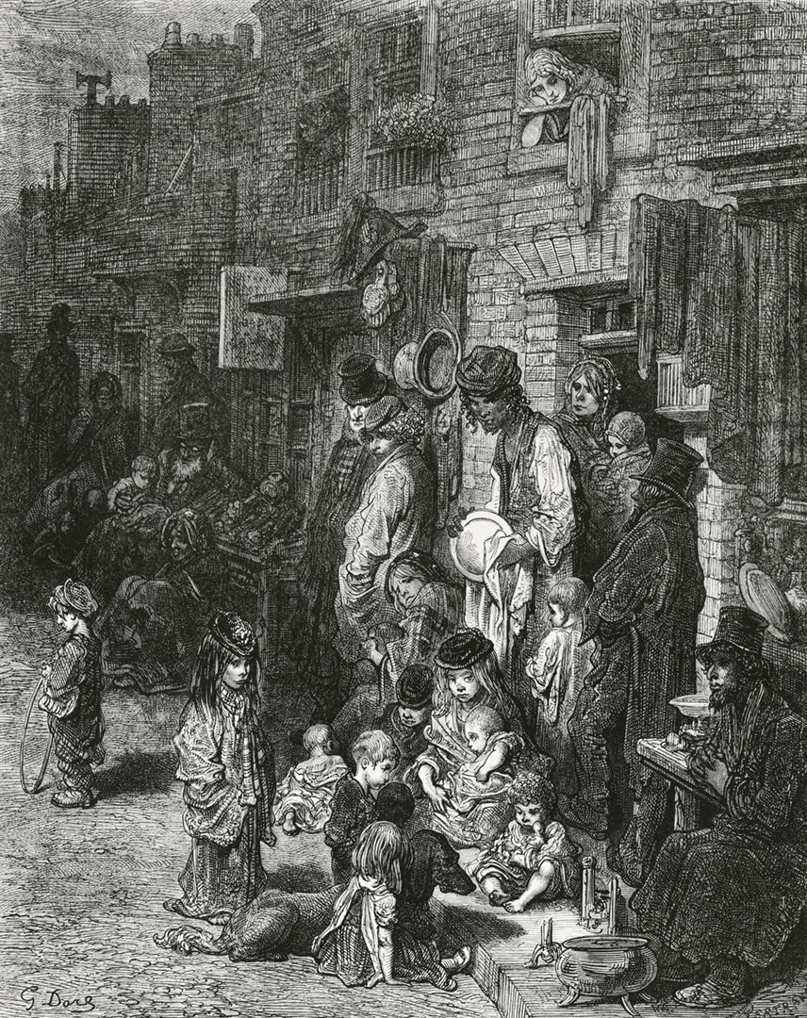
Notes:
Wentworth Street, Whitechapel, 1872, Gustave Doré. A late 19th-century depiction of the squalor in London’s slums.

Slide 5
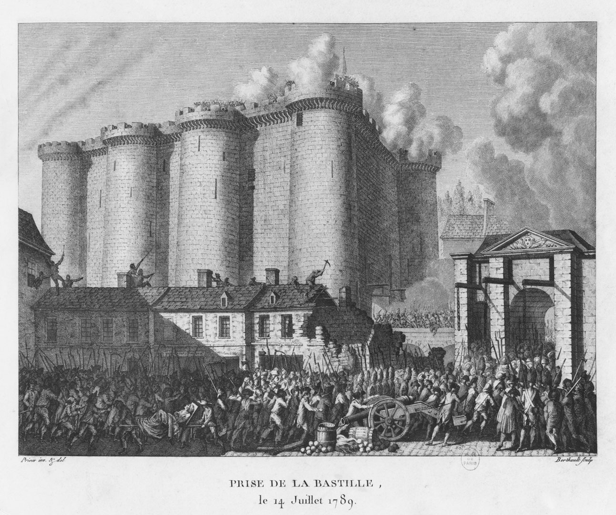
Notes:
The siege of the Bastille, July 1789.

Slide 6
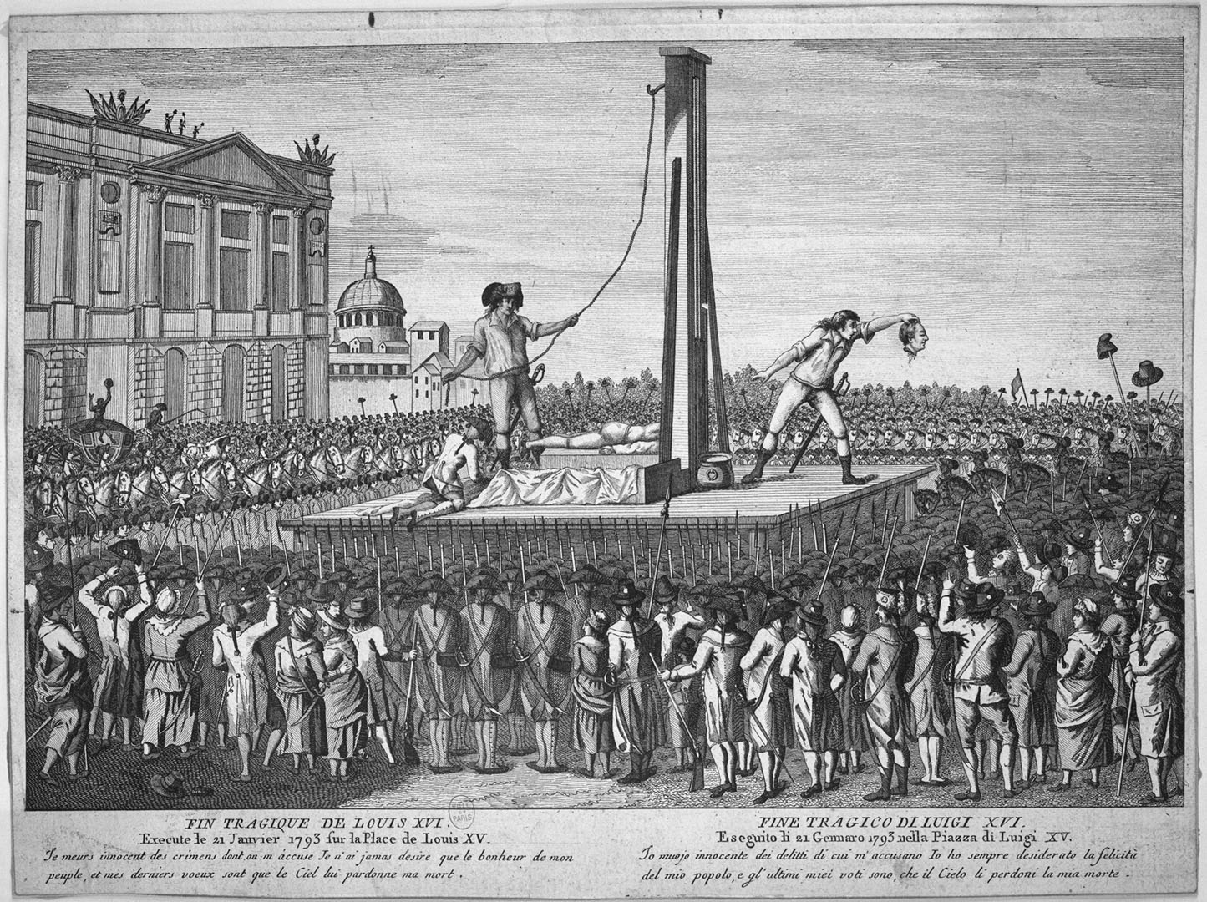
Notes:
The execution of Louis XVI on January 21, 1793, intensified the political divisions in France that followed the revolution. Later in the year, and into 1794, the “Reign of Terror” was responsible for the execution of thousands of “enemies of the revolution.”

Slide 7
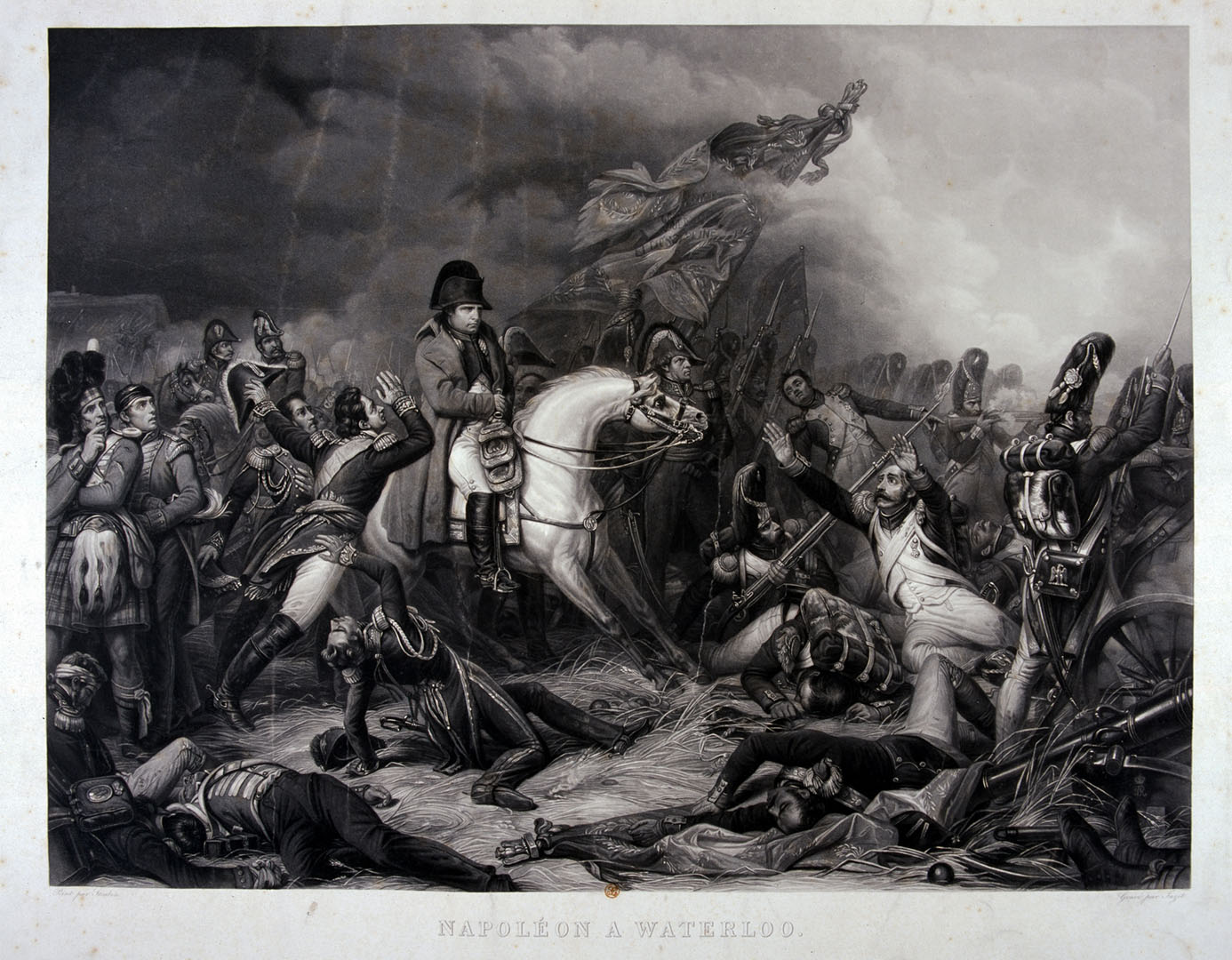
Notes:
Napoleon at the Battle of Waterloo, 1815, Charles Auguste Steuben. Most artists’ portrayals of Napoleon, even in defeat (as here, where he is shown during the Battle of Waterloo), reinforced a romanticized, heroic ideal.

Slide 8
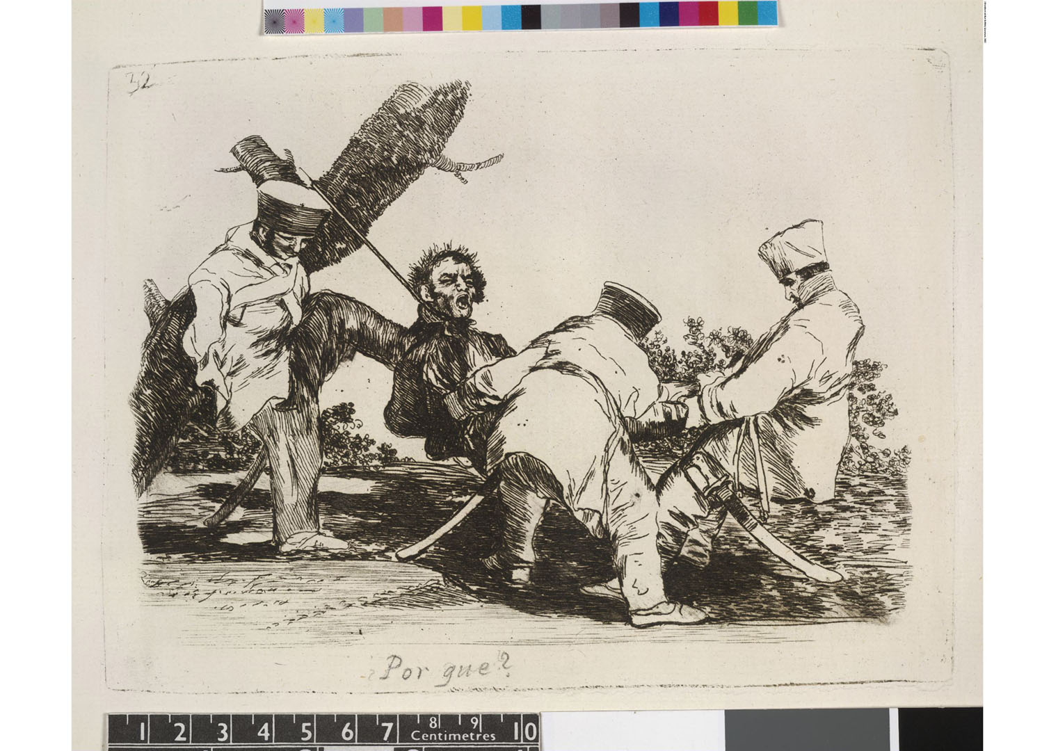
Notes:
The artist Francisco Goya, whose life spanned the years covered in this section of the anthology, spent most of his career as a portraitist for the wealthy. But late in his career, he also privately devoted his art to chronicling the horrors of war during and after Napoleon’s siege of Spain in the early 1800s. The series of prints that resulted—called The Disasters of War (Los Desastres de la Guerra)—hinted at the stylistic upheavals that would follow later in the century. In this image, called simply Why? (Porqué?), French soldiers garrotte a Spanish prisoner.

Slide 9
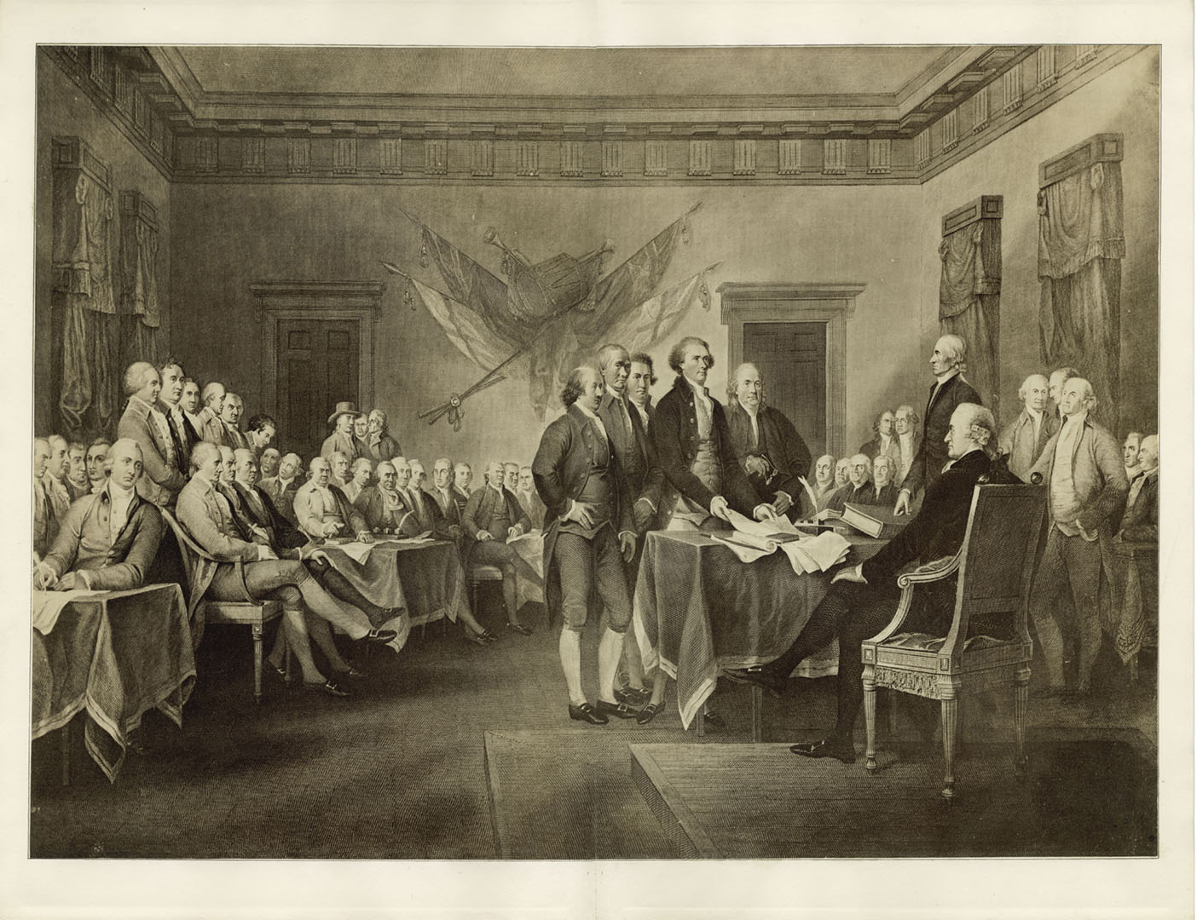
Notes:
Cluster: Revolutionary Contexts: The Declaration of Independence, July 4, 1776, engraving based on a painting by John Trumbell.

Slide 10
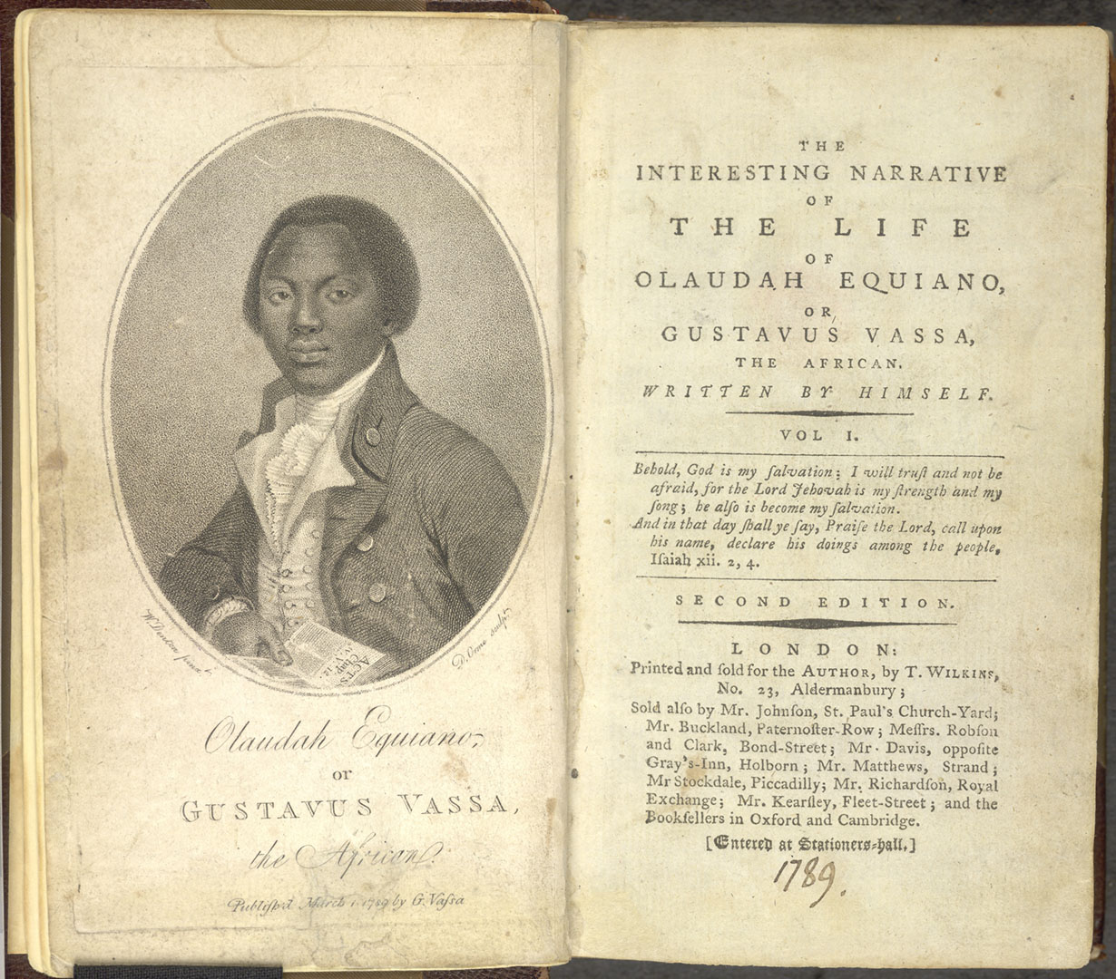
Notes:
The frontispiece and title page of The Interesting Narrative of the Life of Olaudah Equiano, or Gustavus Vassa, the African, Written by Himself (1789).

Slide 11
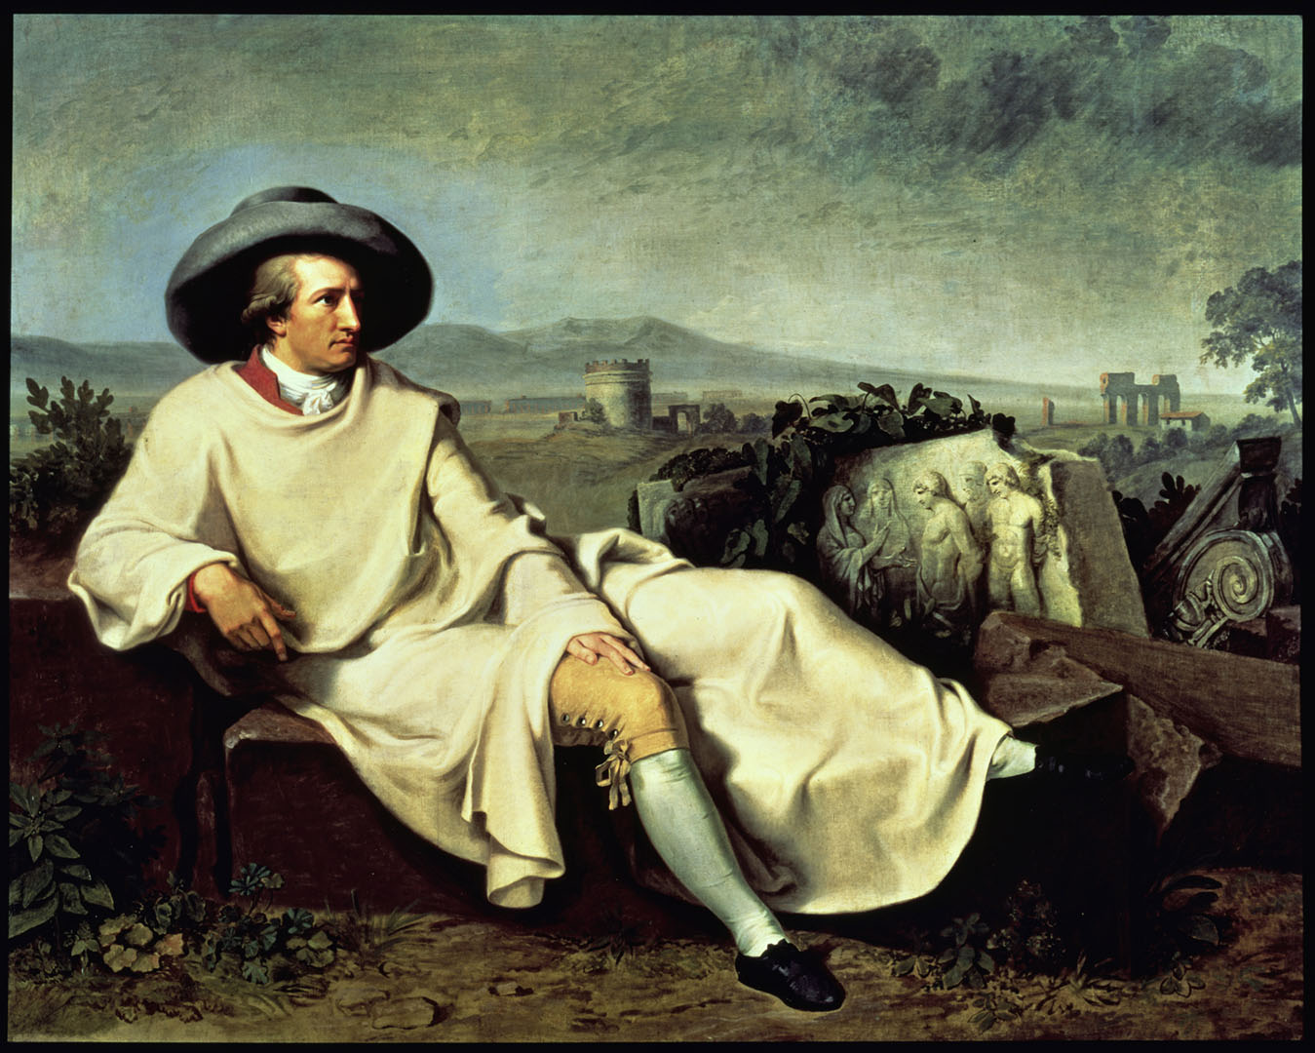
Notes:
Goethe in the Roman Campagna, 1786–1787, Johann Heinrich Wilhelm Tischbein.

Slide 12
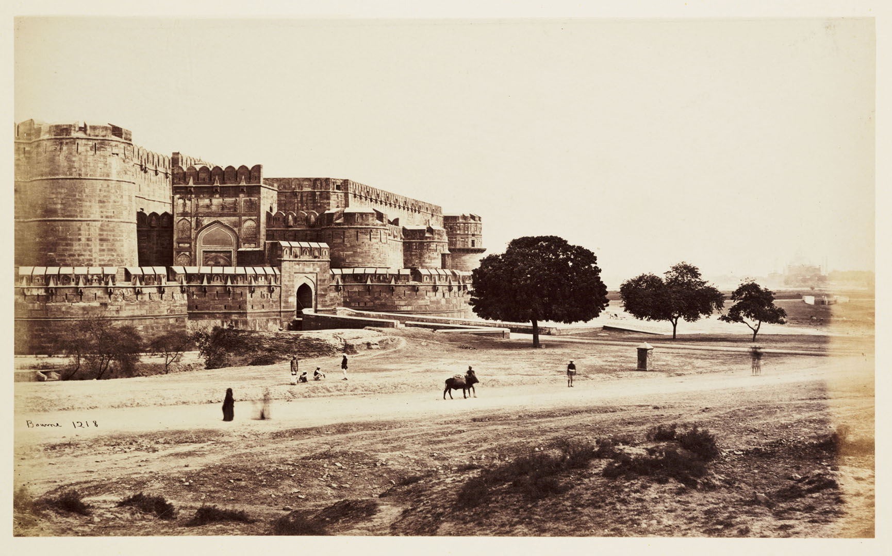
Notes:
The Amar Singh Gate of the Agra Fort, India; picture taken by British photographer Samuel Bourne in 1865.

Slide 13
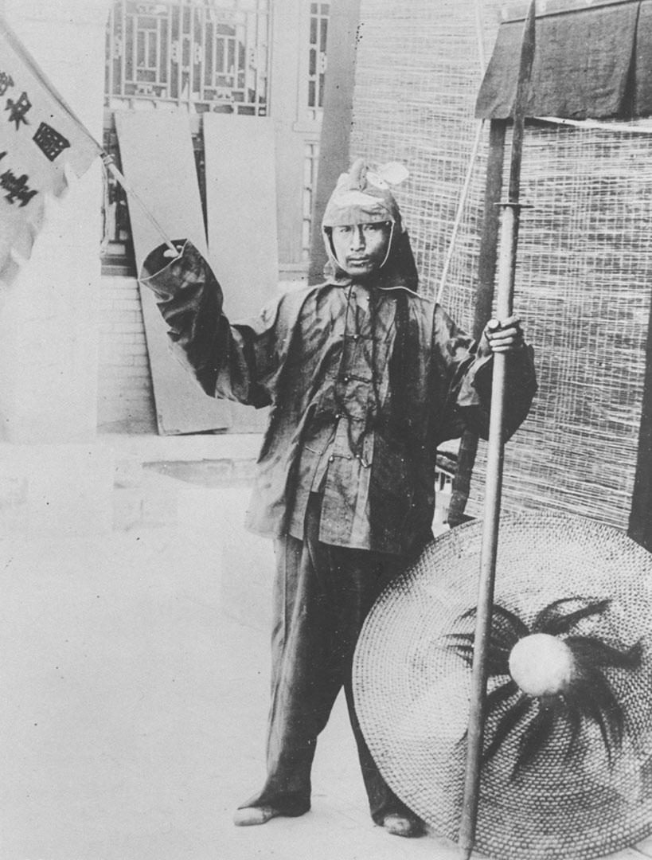
Notes:
A Chinese fighter in the Boxer Rebellion poses with a flag and spear, ca. 1900.

Slide 14
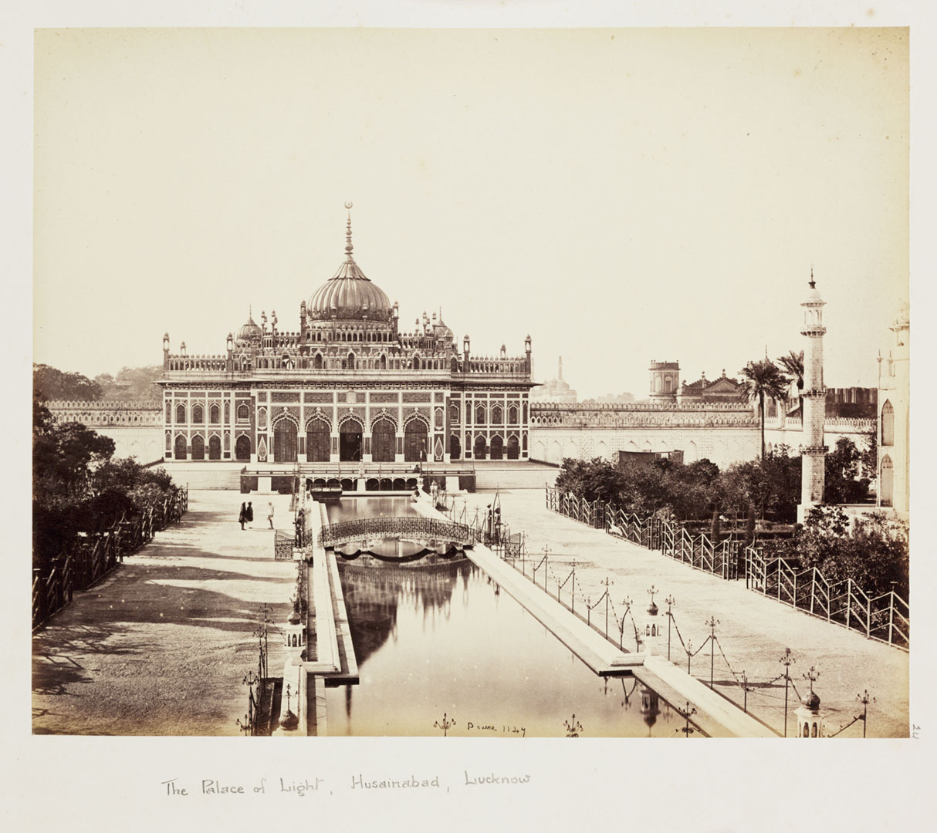
Notes:
The “Palace of Light,” built in 1837 by Mohammed Ali Shah as a mausoleum for himself, photographed by Samuel Bourne in 1865. A splendid example of the cultural grandeur of the Muslim ruling elite during the first half of the nineteenth century.

Slide 15
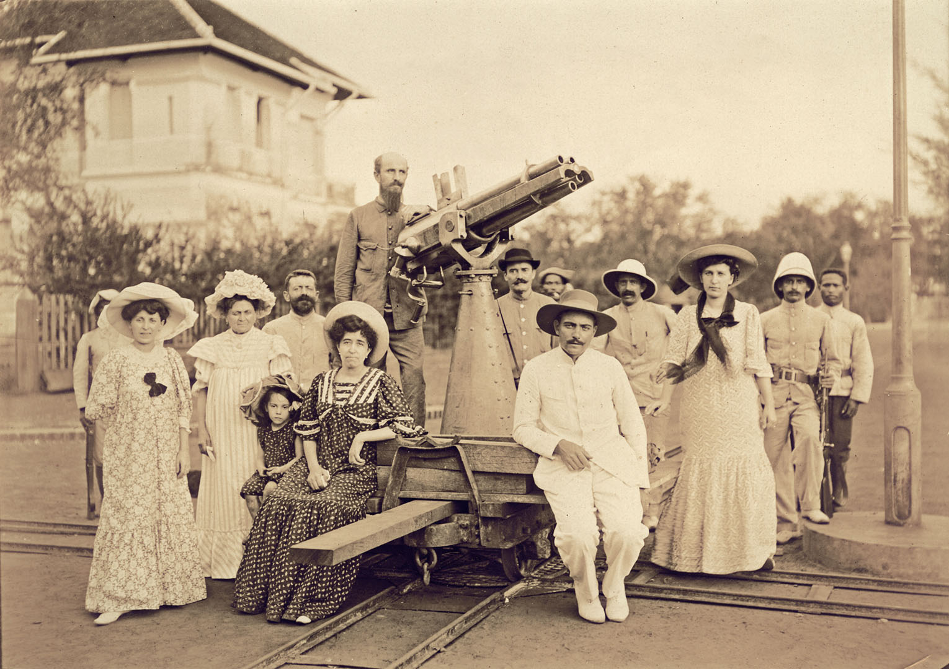
Notes:
A colonial French family in Vietnam with a machine gun, ca. 1900.

Slide 16
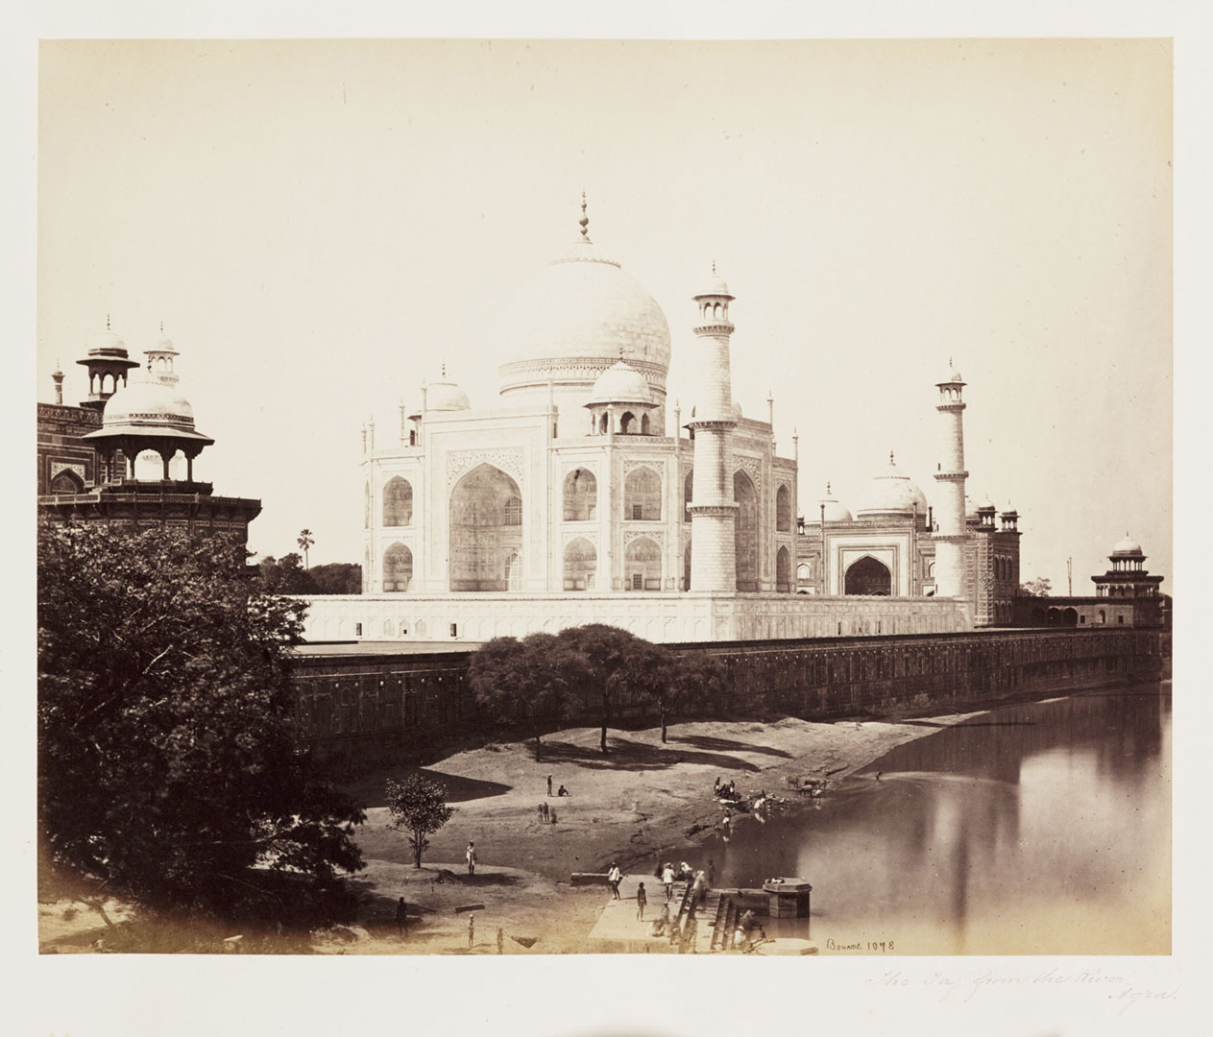
Notes:
The Taj Mahal, as photographed by Samuel Bourne in 1865, with the Yamuna River in the foreground.

Slide 17
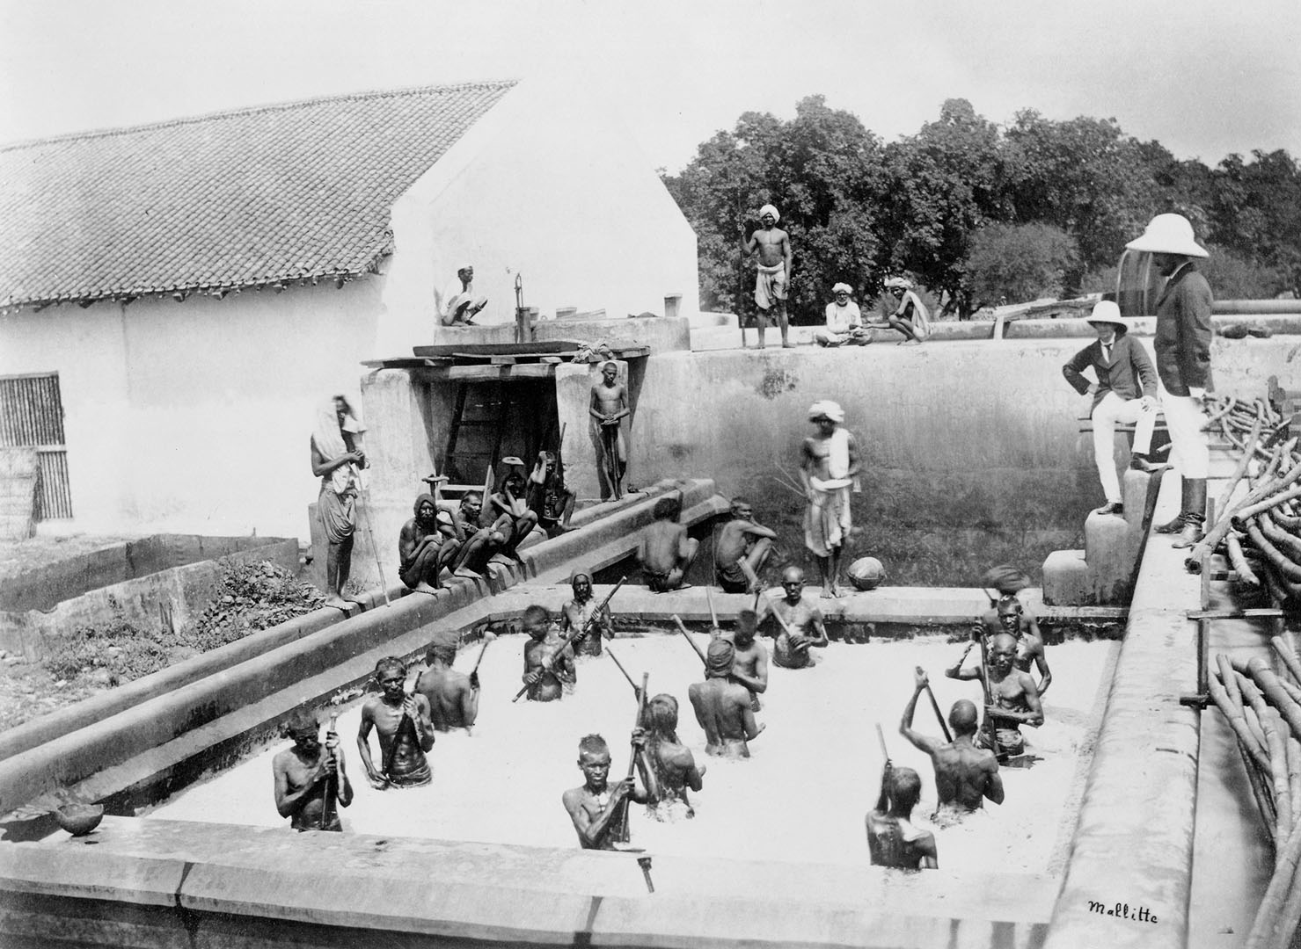
Notes:
Indian laborers stand waist-high in an indigo vat, stirring the dye by hand, as British supervisors look on. Photographed by Samuel Bourne in 1877 in Allahabad, India.

Slide 18
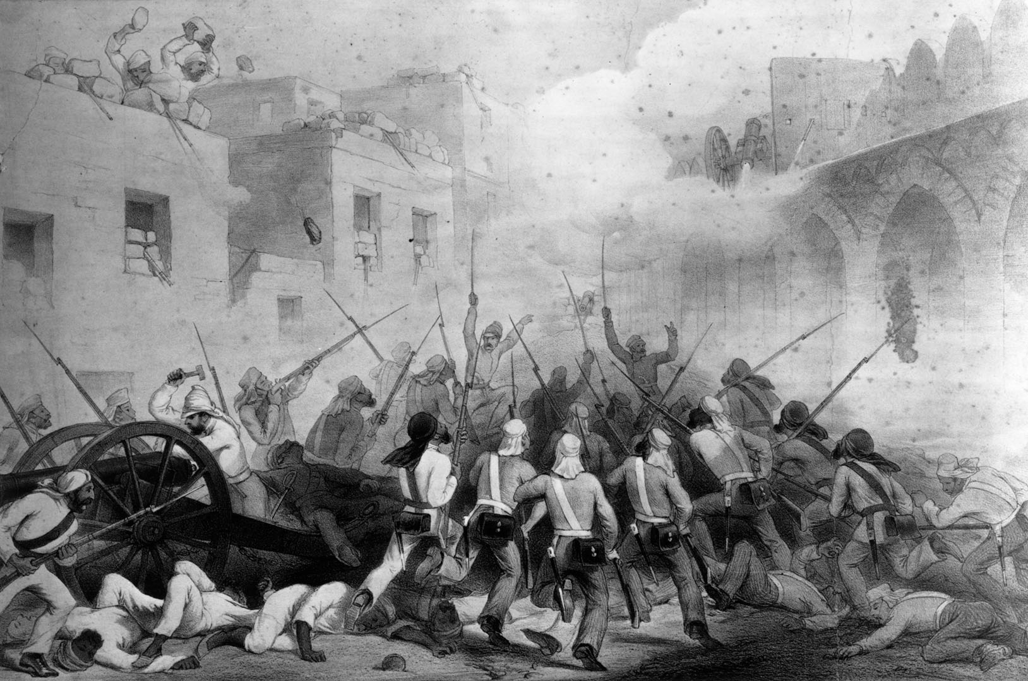
Notes:
An illustration depicting British soldiers storming Delhi during the 1857 Indian Rebellion.

Slide 19
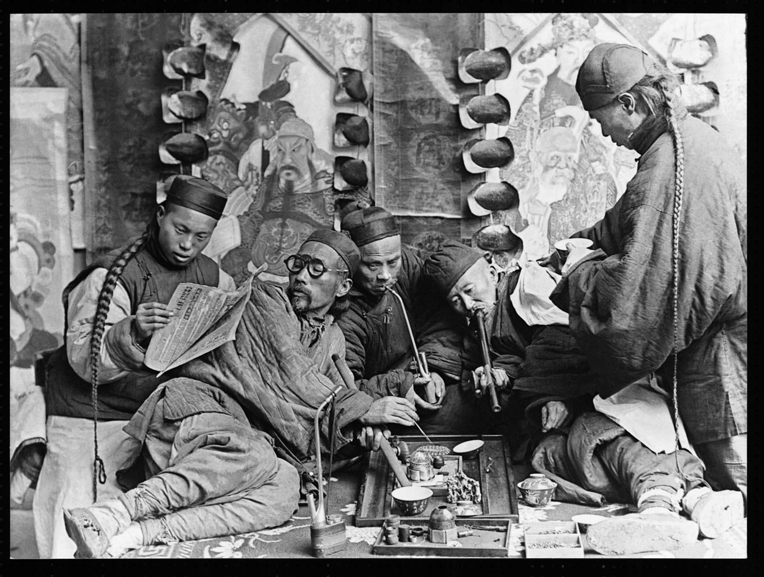
Notes:
A photograph of men in a Chinese opium den, ca. 1900.

Slide 20
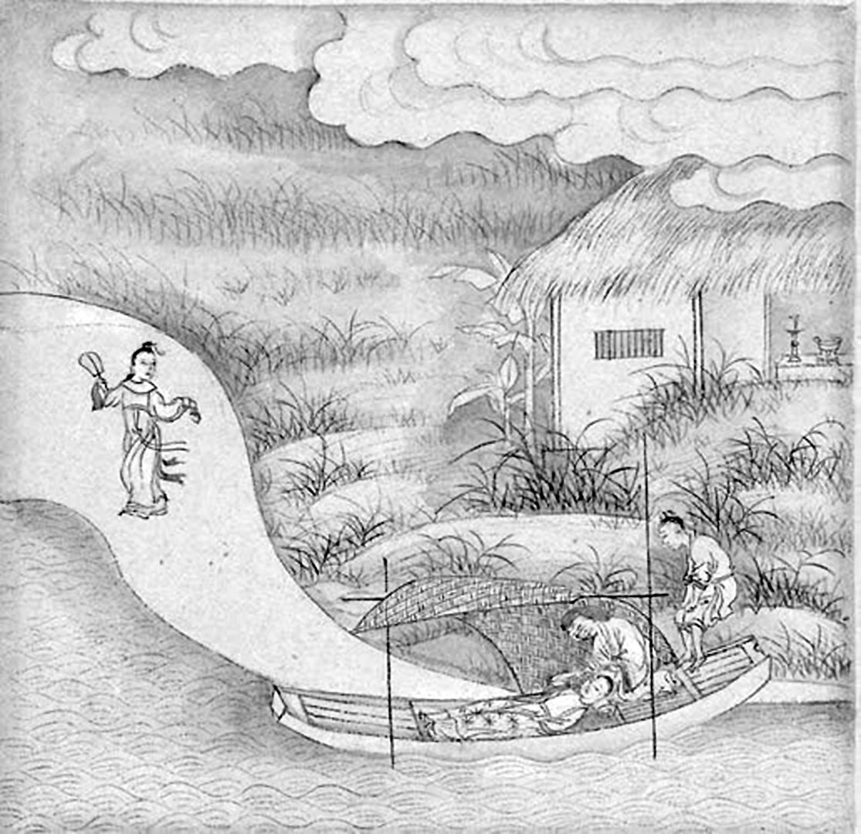
Notes:
An illustration from a late nineteenth-century manuscript of The Tale of Kiêu.

Slide 21
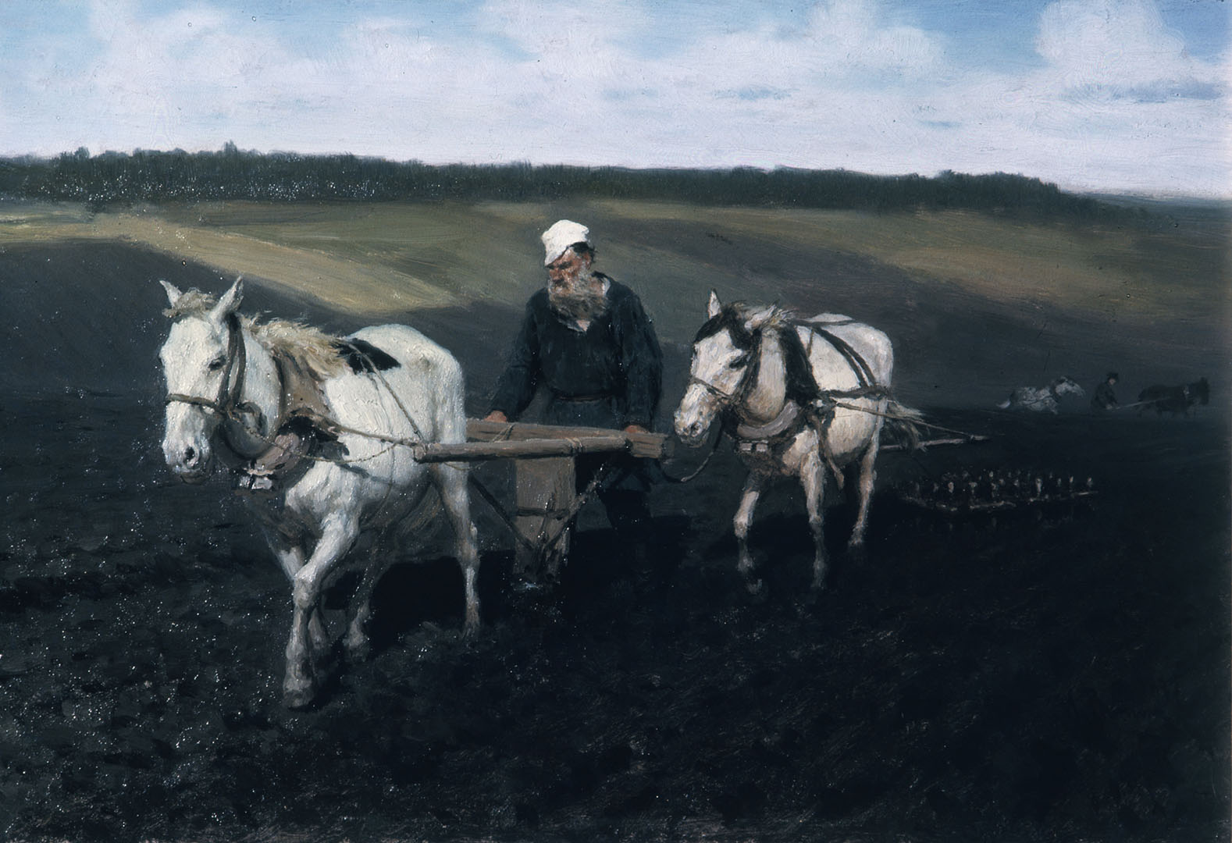
Notes:
Leo Tolstoi Ploughing a Field, 1882, by Ilya Yefimovich Repin.

Slide 22
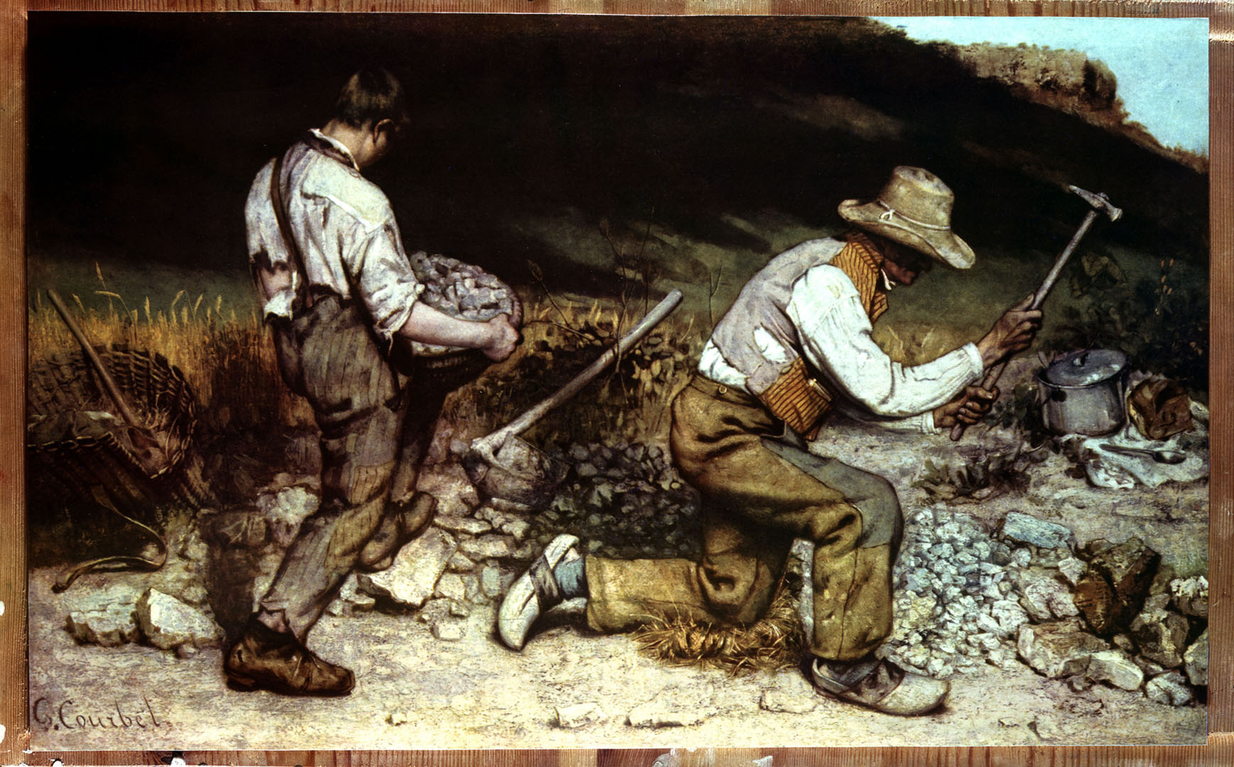
Notes:
The Stonebreakers, 1848, by Gustave Courbet. A realist masterpiece that was destroyed in the Allied bombing of Dresden during World War II, this painting now exists only in reproductions and photographs.

Slide 23
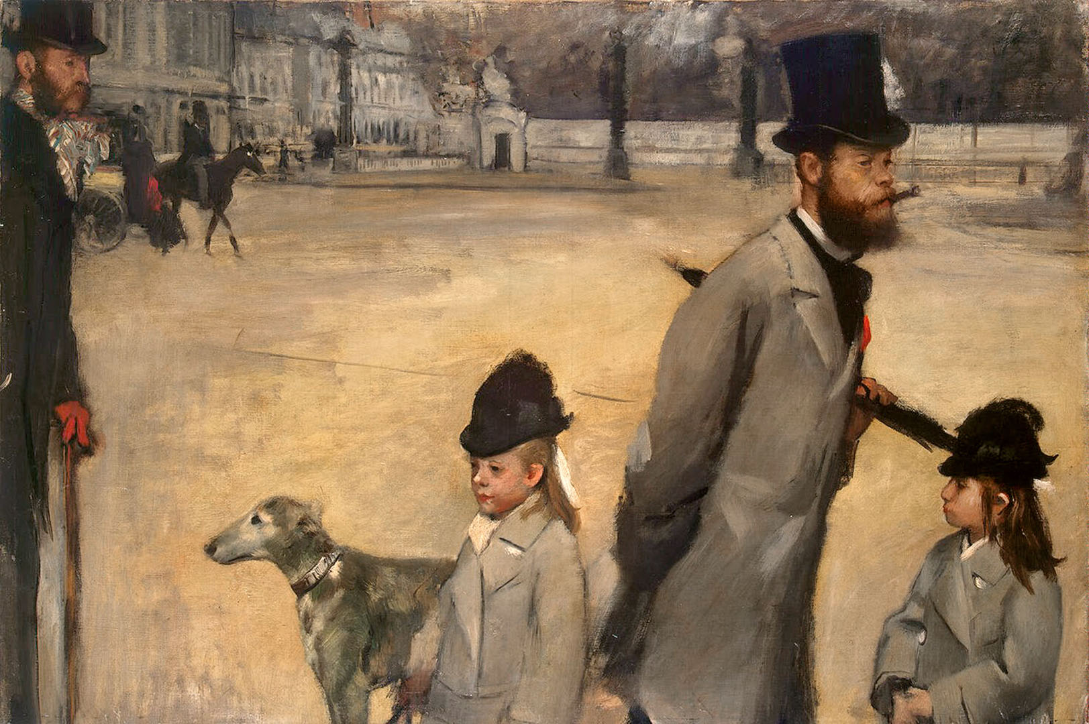
Notes:
Place de la Concorde, 1875, by Edgar Degas. A portrait of a moment in the lives of the well-to-do.

Slide 24
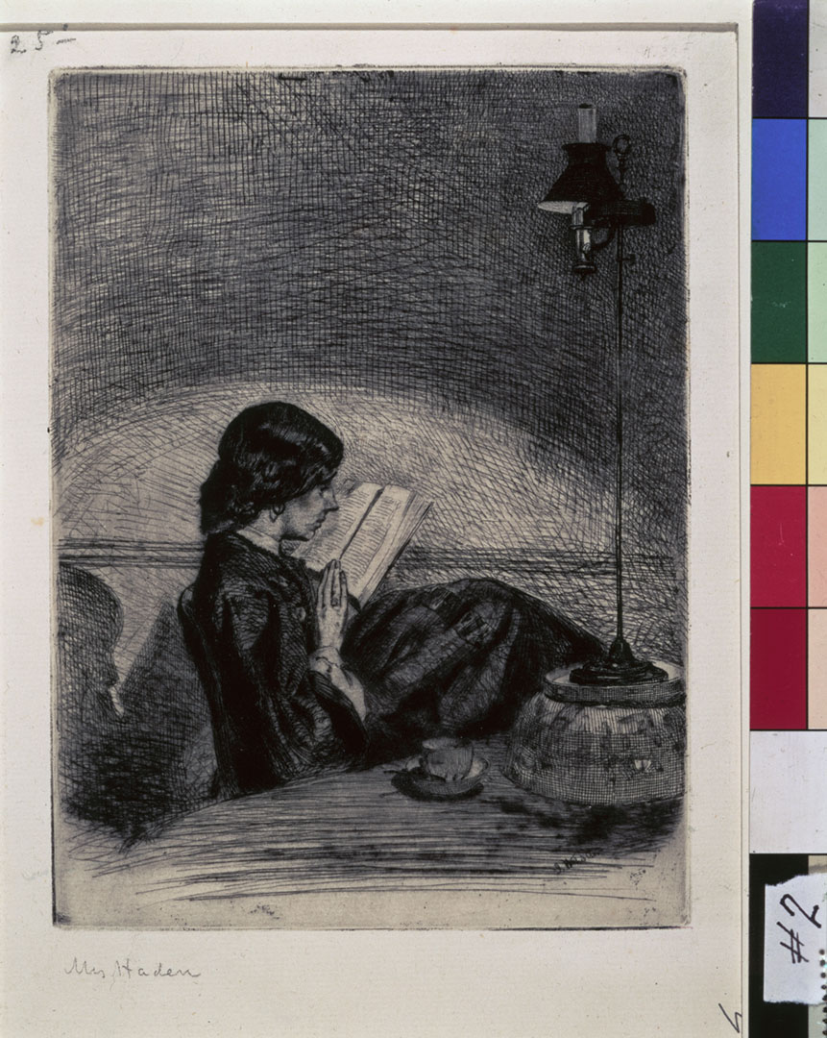
Notes:
Reading by Lamplight, 1858, by James Abbott McNeill Whistler.

Slide 25
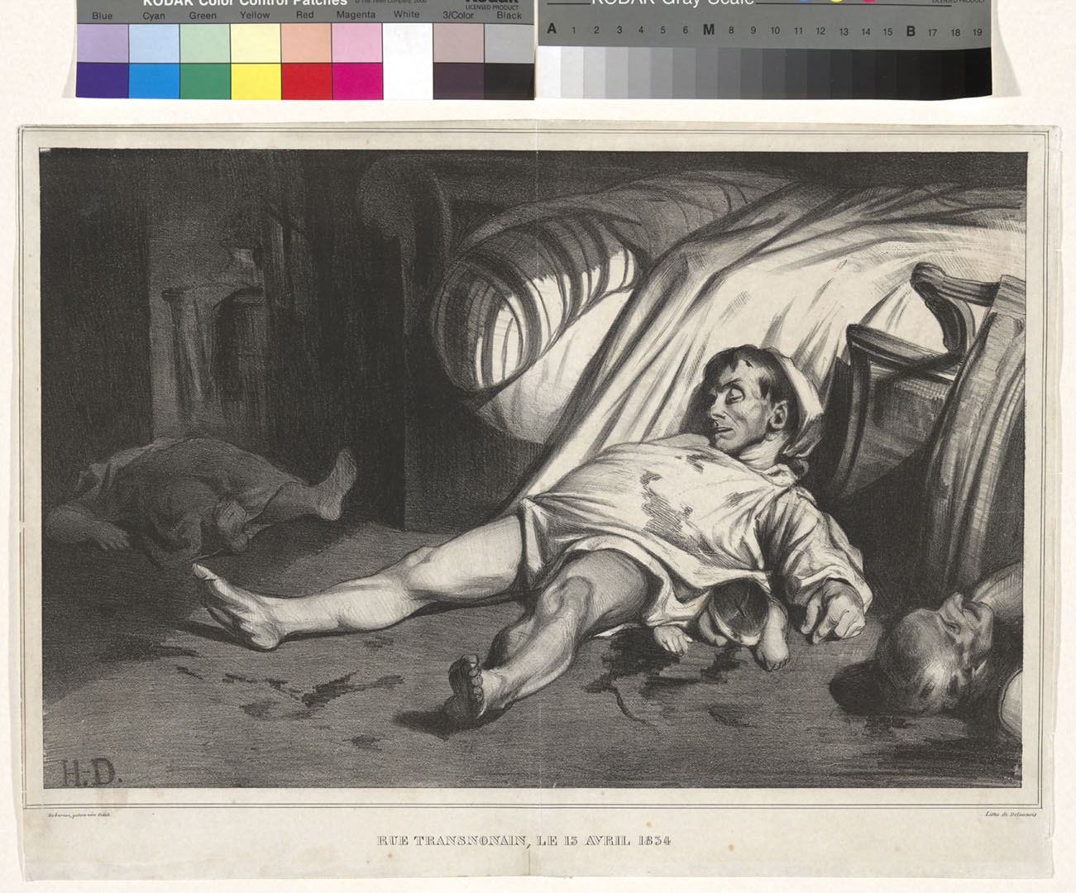
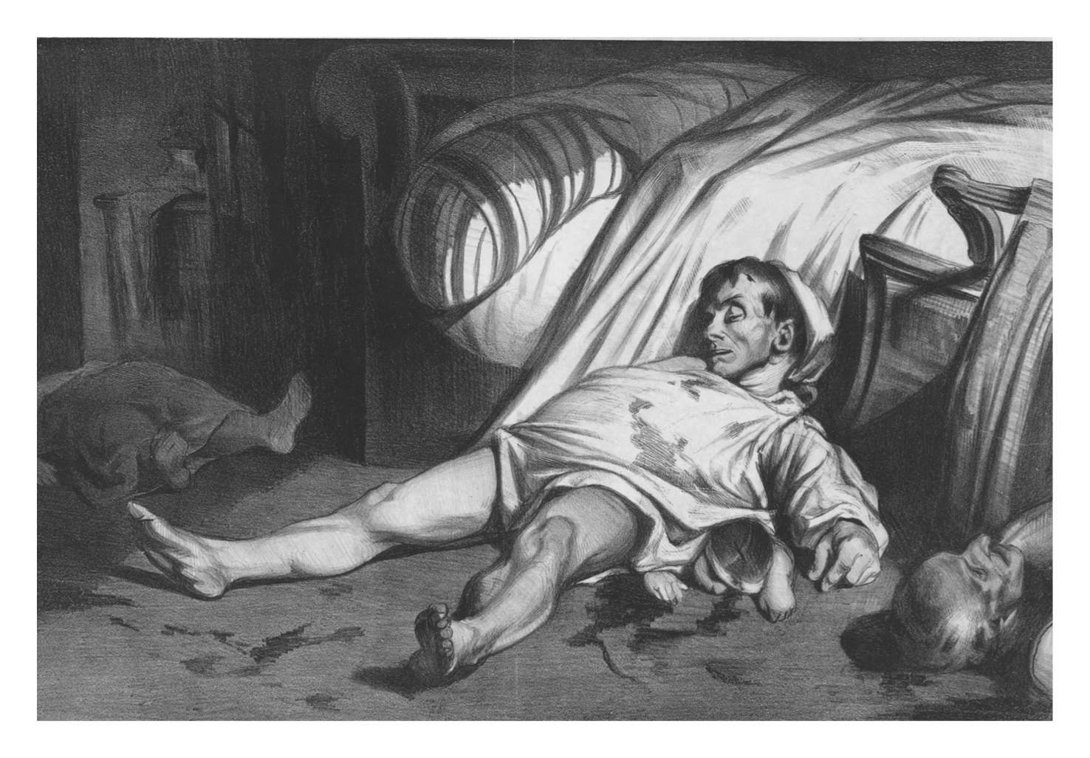
Notes:
Rue Transnonain, 1834, by Honore Daumier. This lithograph was Daumier’s attempt to document the massacre of nineteen people, including women and children, by the French National Guard on April 14, 1834, in response to a strike of silk weavers in Lyon, France.

Slide 26
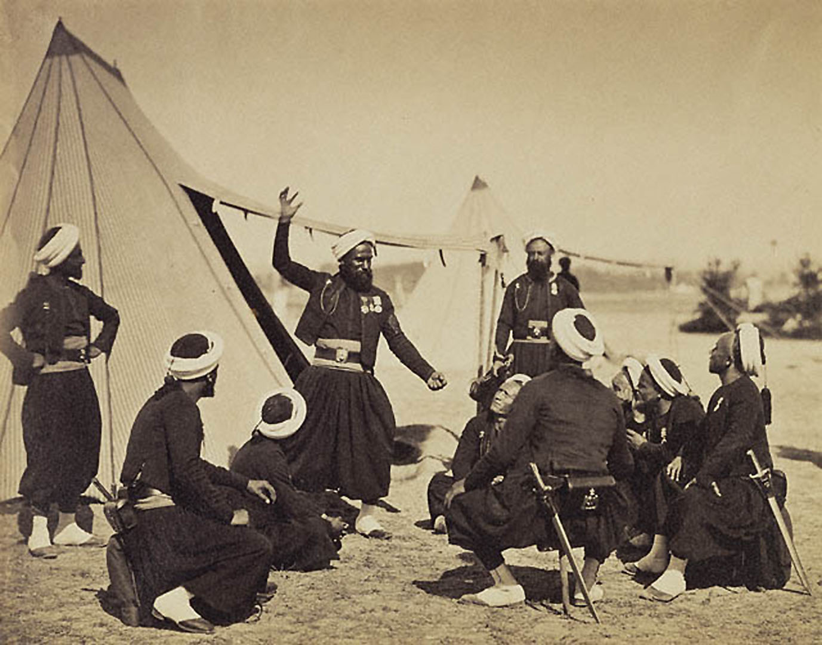
Notes:
Cluster: Orature: Zovave storyteller (North Africa, 1857). Photograph by Gustave le Gray.

Slide 27
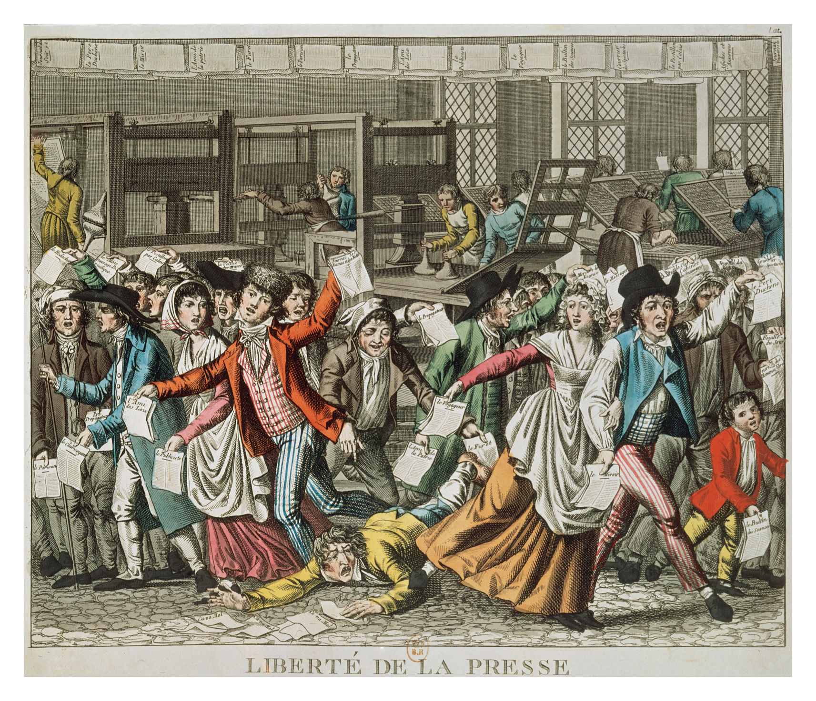
Notes:
This French colored print celebrates freedom of the press (“Liberté de la Presse”), one of the principles of popular sovereignty declared in the Declaration of the Rights of Man and of the Citizen (1793), the core document of the French Revolution.

Slide 28
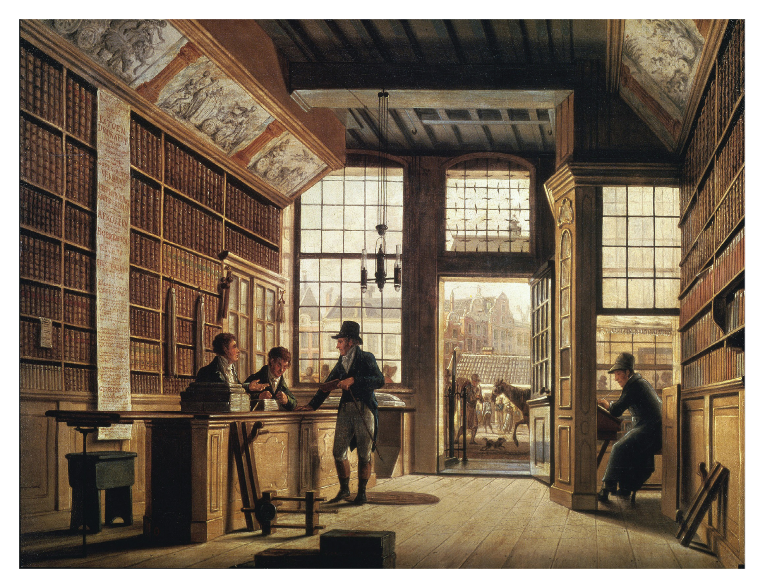
Notes:
This 1820 oil painting by Dutch artist Johannes Jelgerhuis (1770–1836) of the bookshop of Pieter Meijer Warnars in Amsterdam provides a wonderfully detailed portrait of early nineteenth-century middle-class book selling.

Slide 29
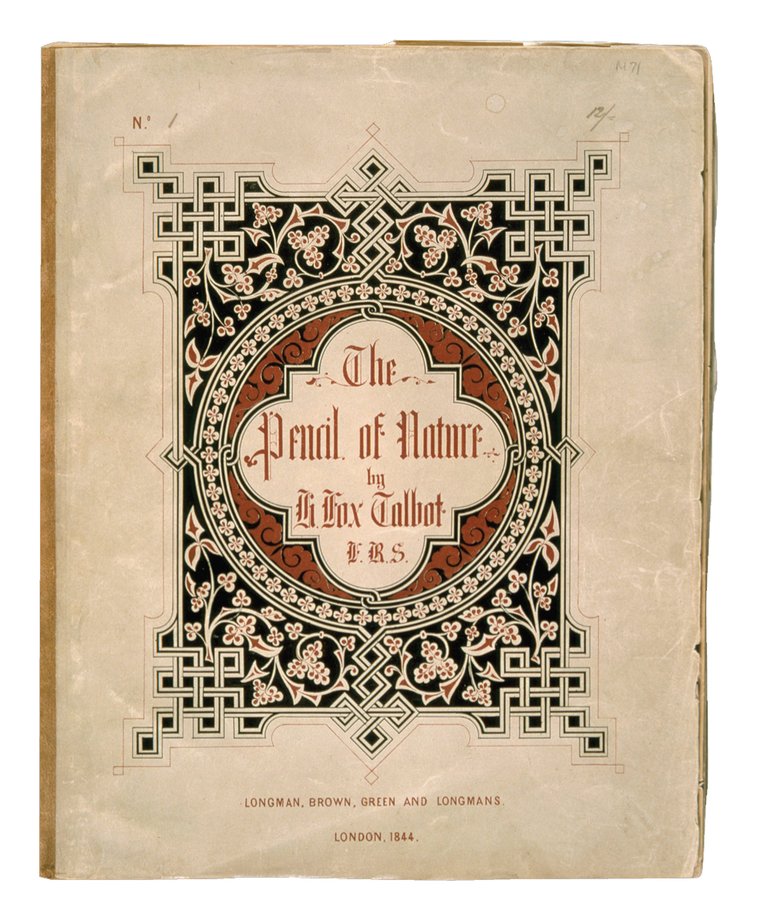
Notes:
The Pencil of Nature, assembled and published in 1844 by William Henry Fox Talbot (1800–1877), was the first commercially available book illustrated with photographs. Shown here are the cover of the first issue (it was published in six installments) and one of the “plates” inside that issue: Fox’s 1841 photograph “Bust of Patroclus.”

Slide 30
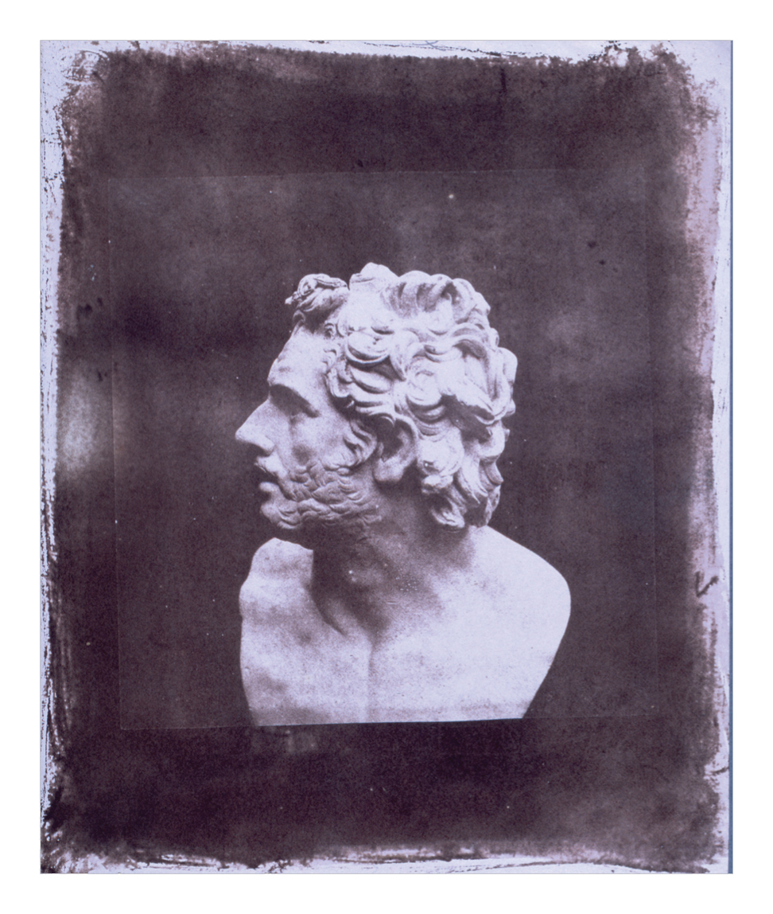
Notes:
The Pencil of Nature, assembled and published in 1844 by William Henry Fox Talbot (1800–1877), was the first commercially available book illustrated with photographs. Shown here are the cover of the first issue (it was published in six installments) and one of the “plates” inside that issue: Fox’s 1841 photograph “Bust of Patroclus.”

Slide 31
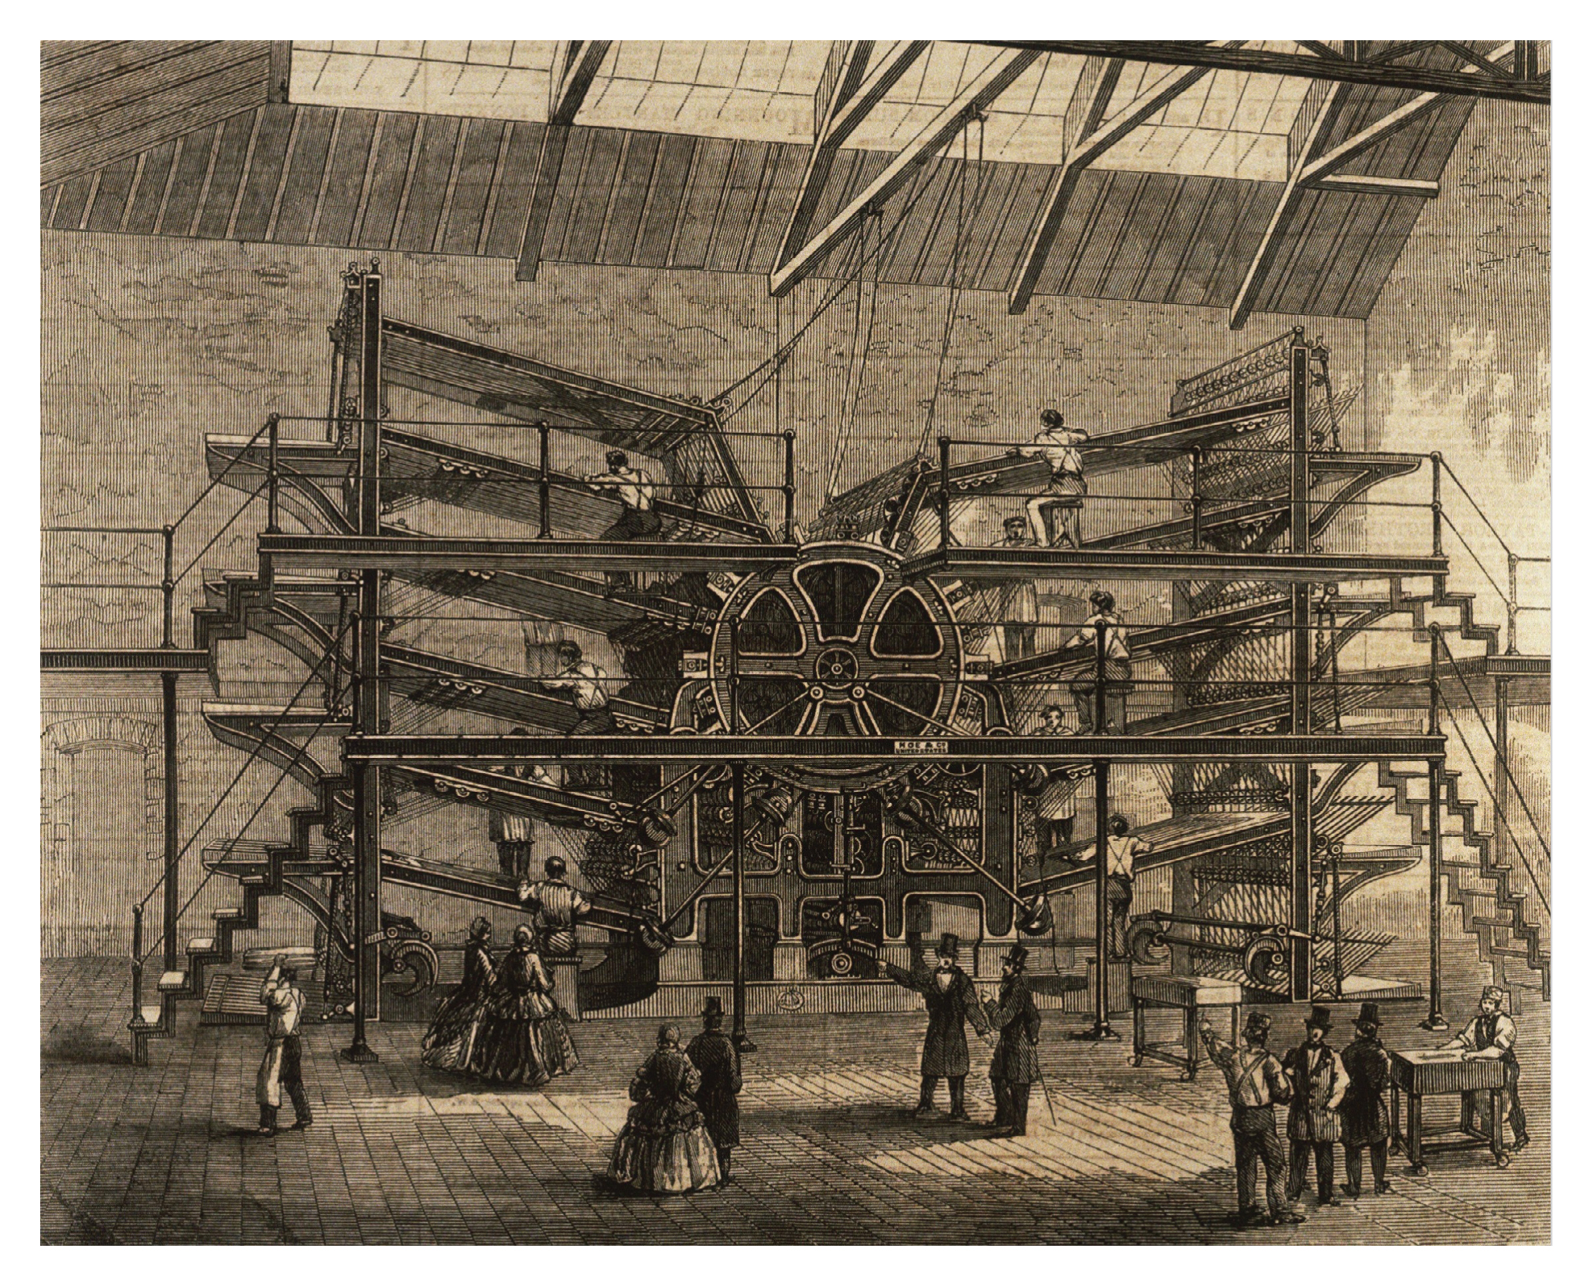
Notes:
During the nineteenth century, inventors raced to improve the speed and output of printing technologies. Richard Hoe, an American inventor, pushed the technology significantly forward with his design in 1847 of the lithographic rotary press. The version of Hoe’s printing machine pictured here was used to produce The Daily Telegraph newspaper in London during the 1860s.

Slide 32
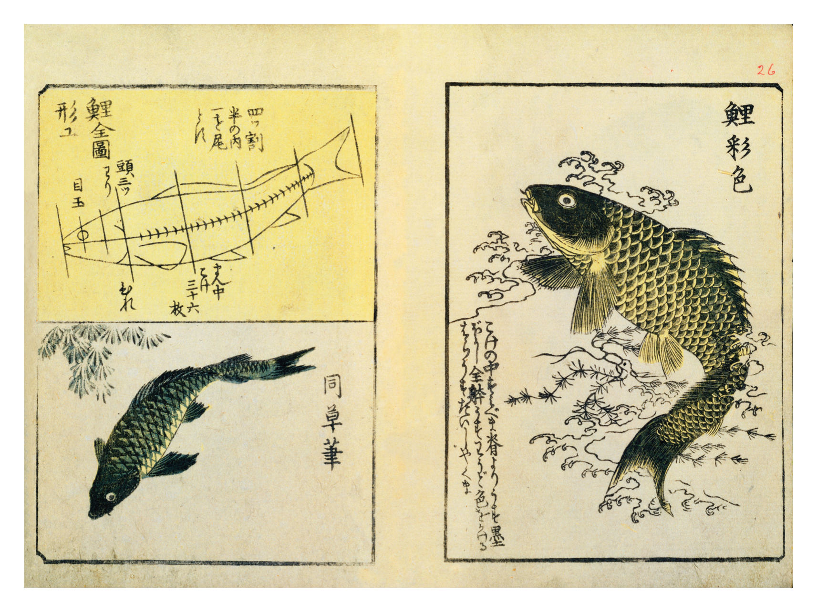
Notes:
Sketches of swimming carp from A Picture Book Miscellany (1849), a book by the Japanese ukiyo-e artist Utagawa Hiroshige (1797–1858) that displays his commitment to realistic renderings of subjects from nature.

Slide 33
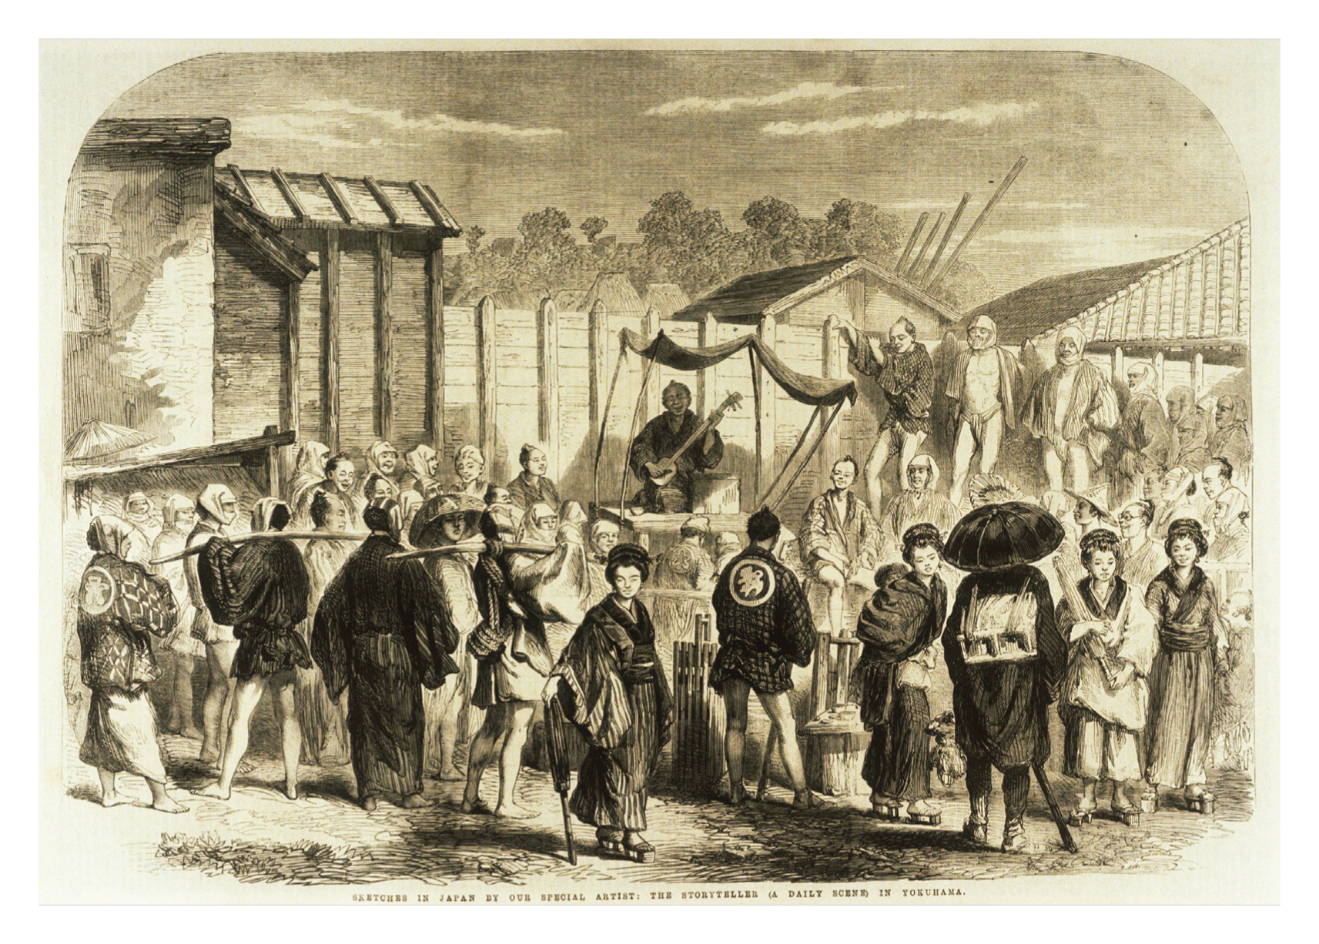
Notes:
A street scene from 1861 in Yokohoma, Japan, shows a storyteller (center, seated on small stage) accompanying himself with a stringed instrument.

Slide 34
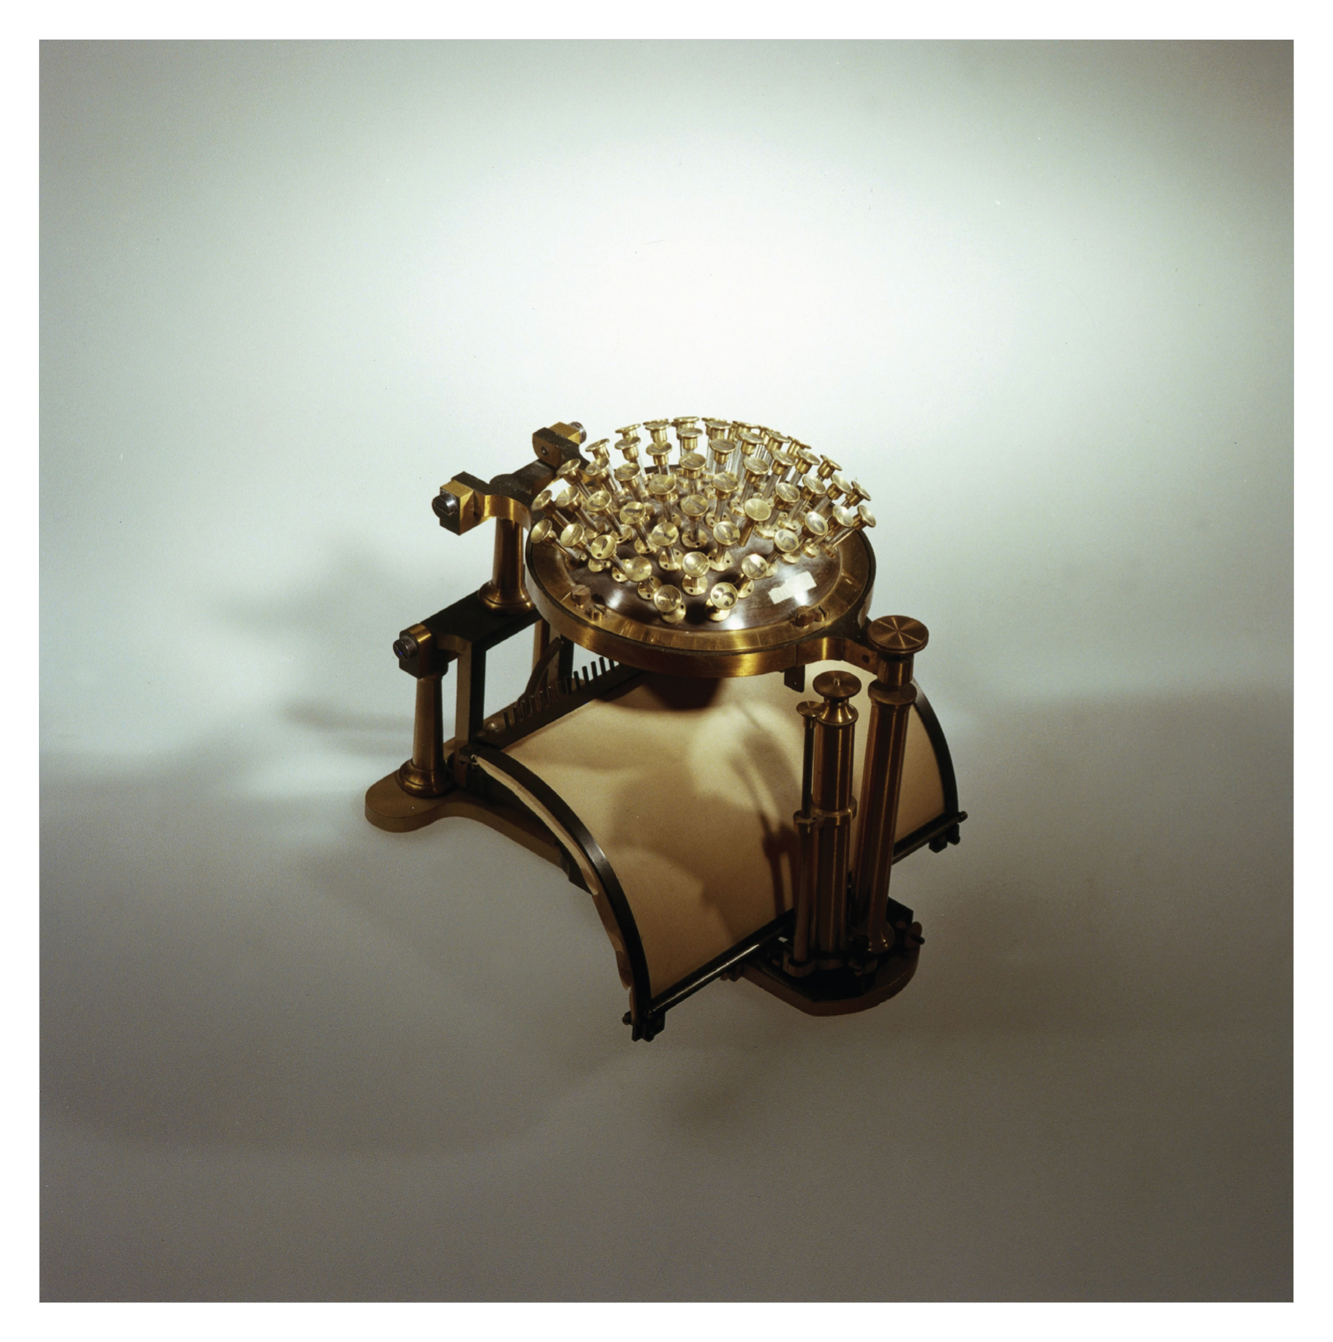
Notes:
The world’s first commercially produced typewriter: the Hansen Writing Ball designed by Rasmus Malling-Hansen (1835–1890), minister and principal at the Danish Royal Institute for the Deaf. First designed in 1865 and improved over the next fifteen years, Hansen’s machine would eventually be overshadowed by late nineteenth-century typewriters that allowed one to see the result on paper as one typed (rather than operating ‘blind,’ as with the writing ball).

Slide 35
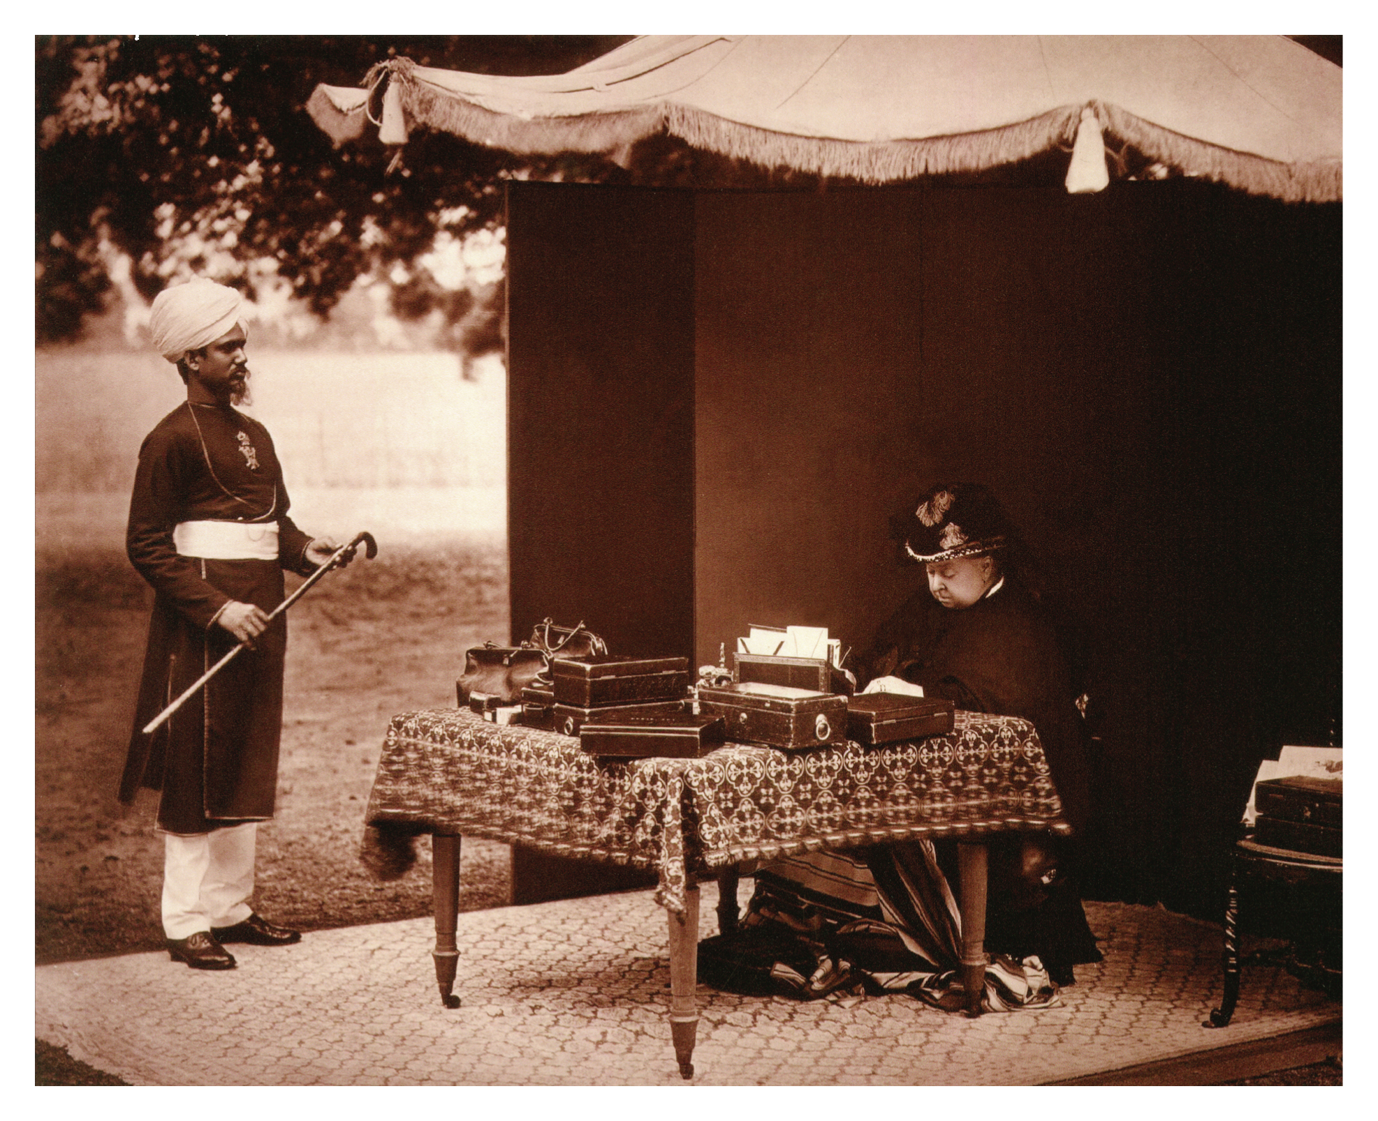
Notes:
A photograph of Queen Victoria (1819–1901) in July 1893 accompanied by her Indian “Munshi” (personal secretary and attendant), Abdul Karim, who was one of her closest confidants during the final fifteen years of her reign. The queen was an early adopter of the typewriter, which she used for her official correspondence.

Slide 36
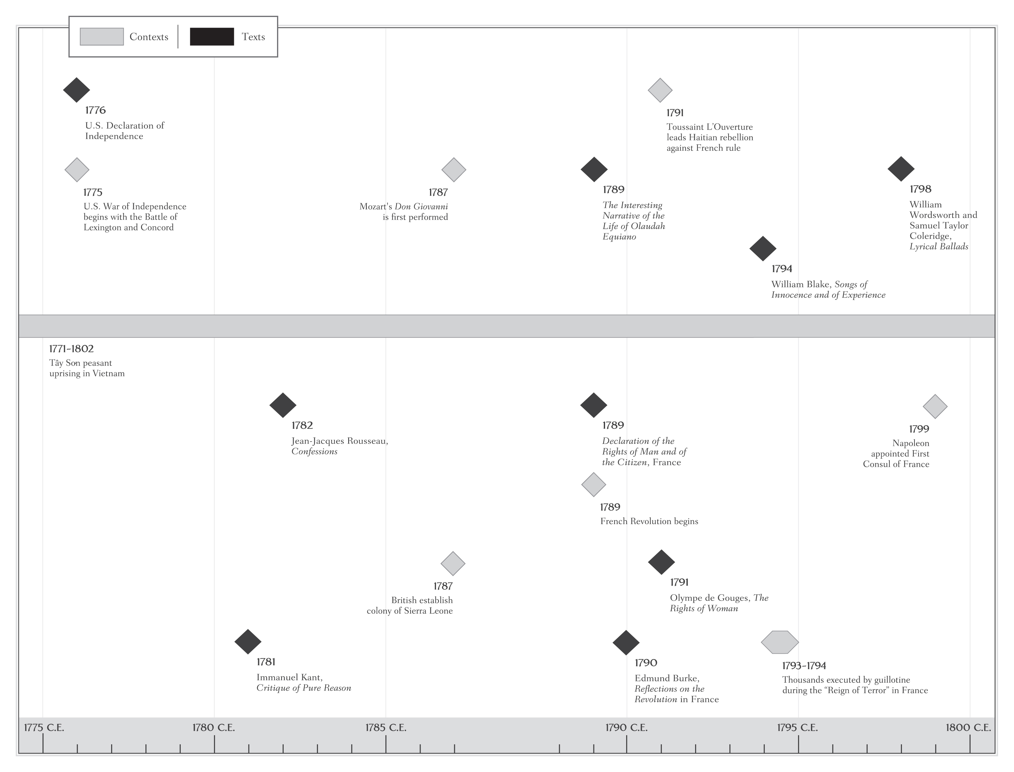

Slide 37
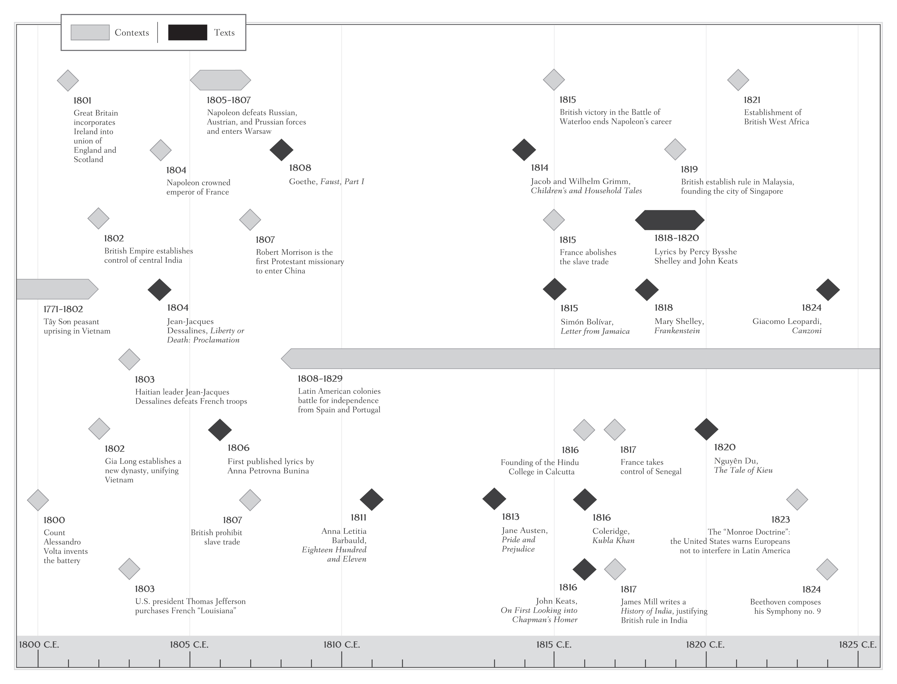

Slide 38
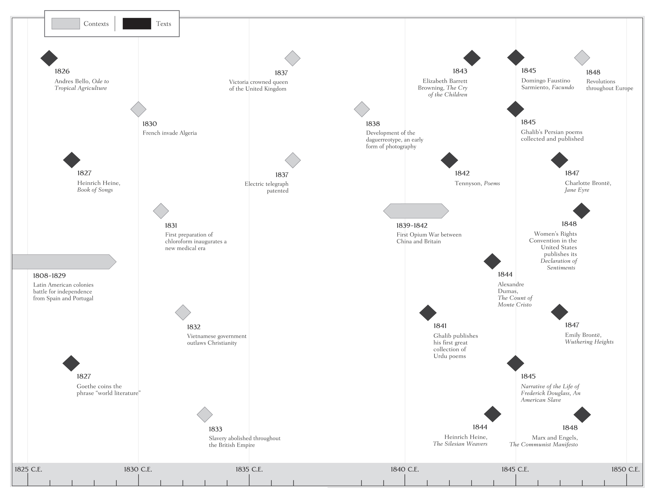

Slide 39
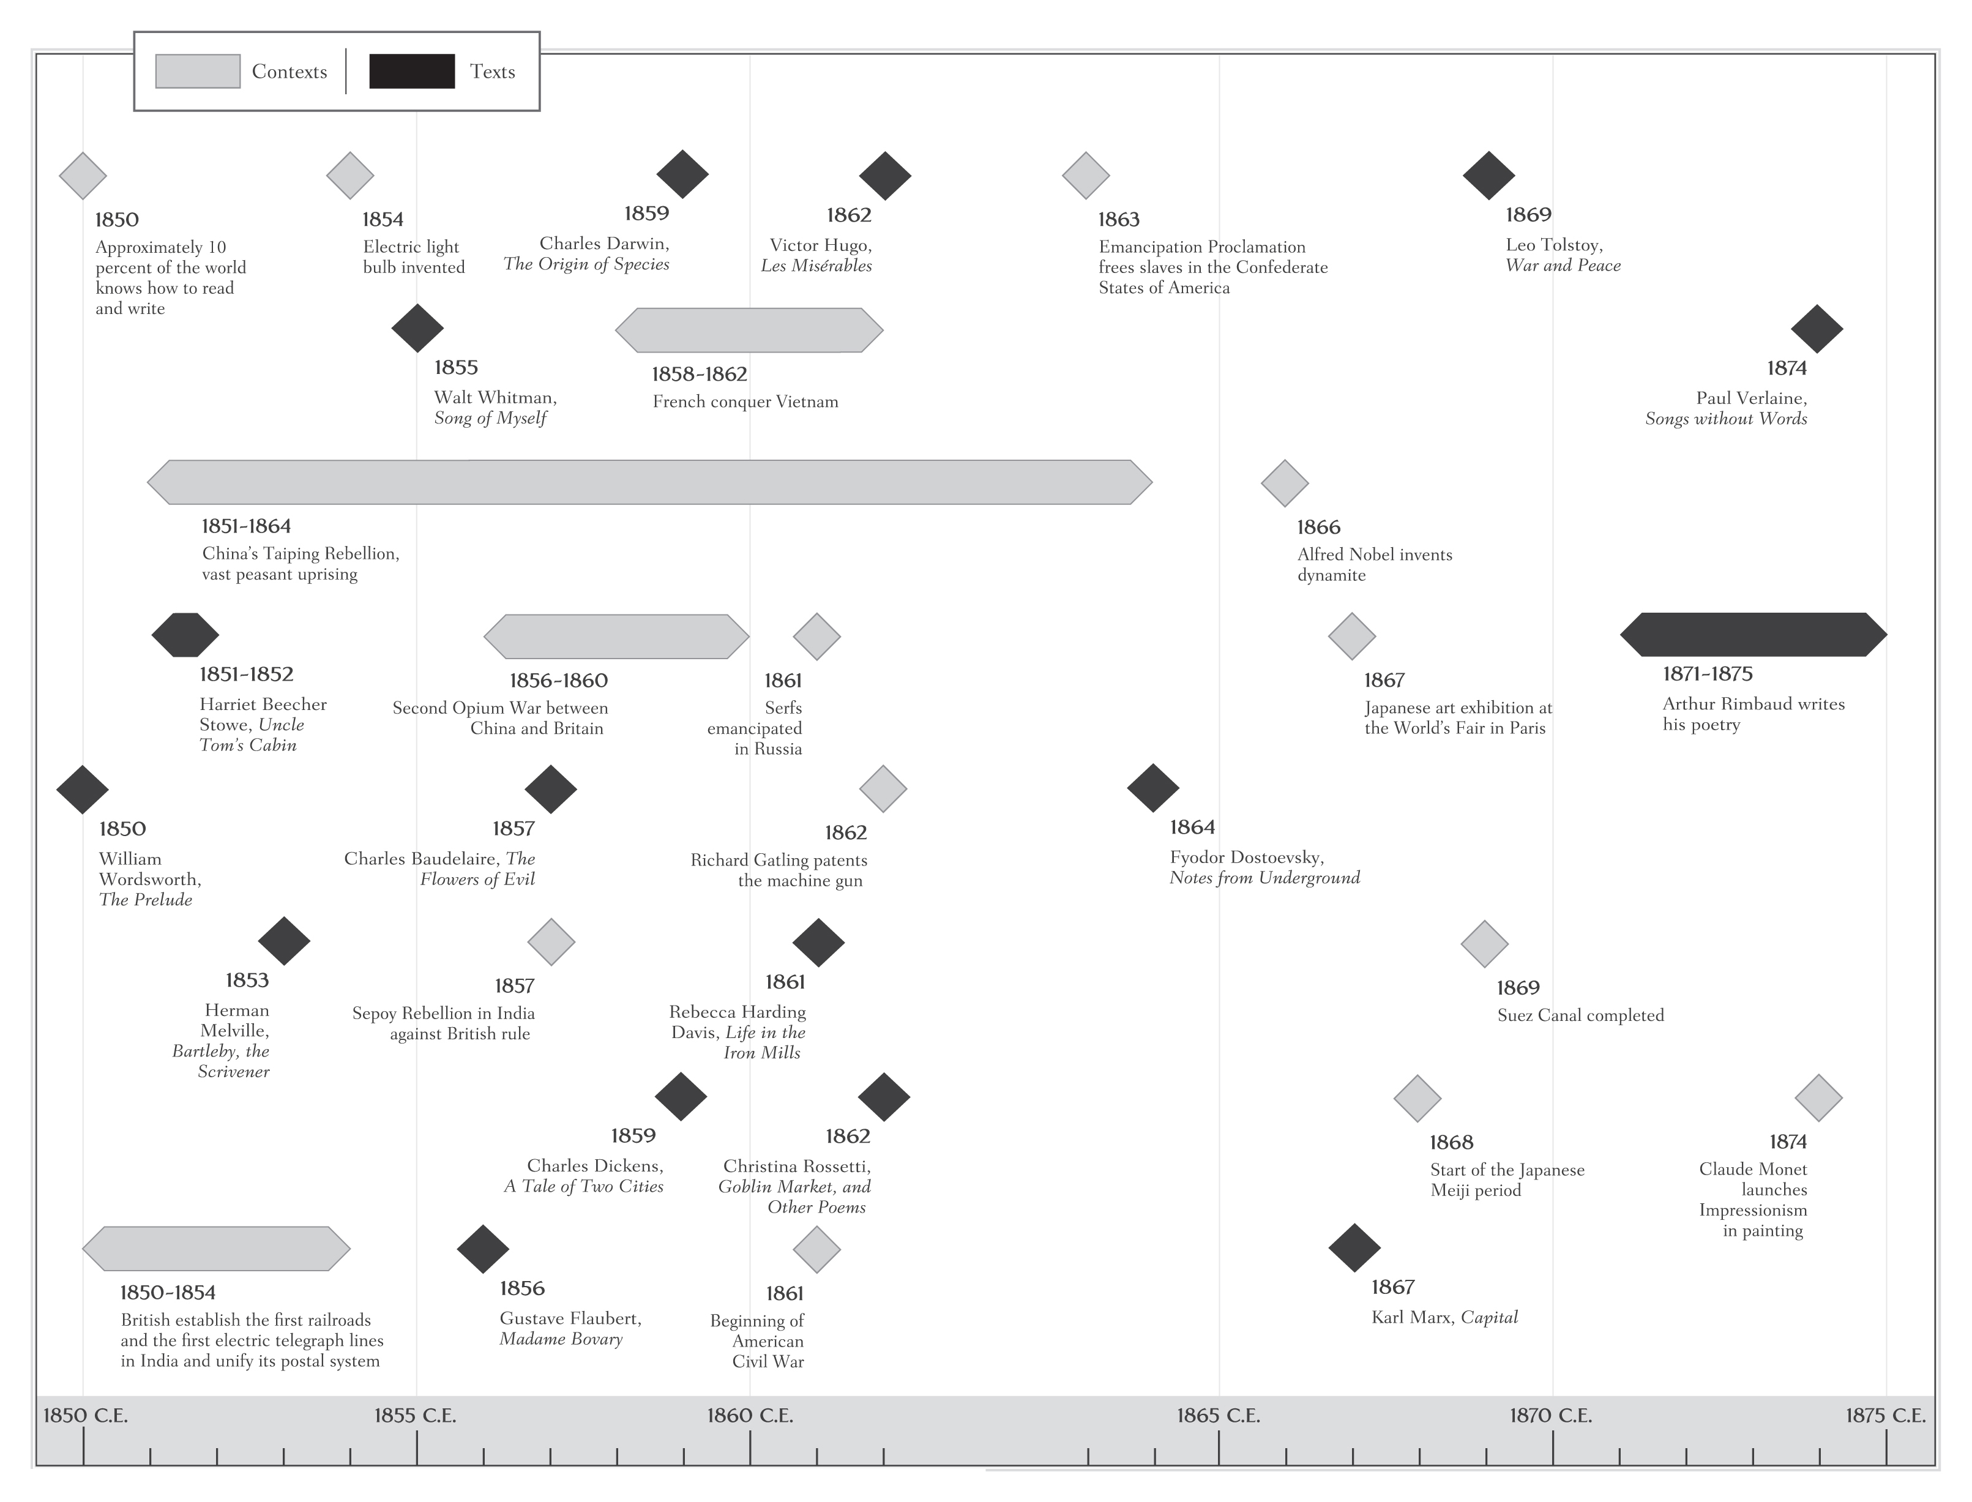

Slide 40
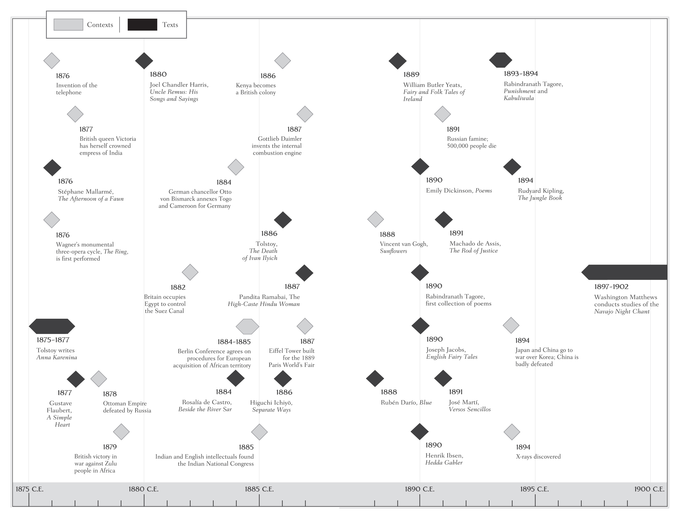

Slide 41
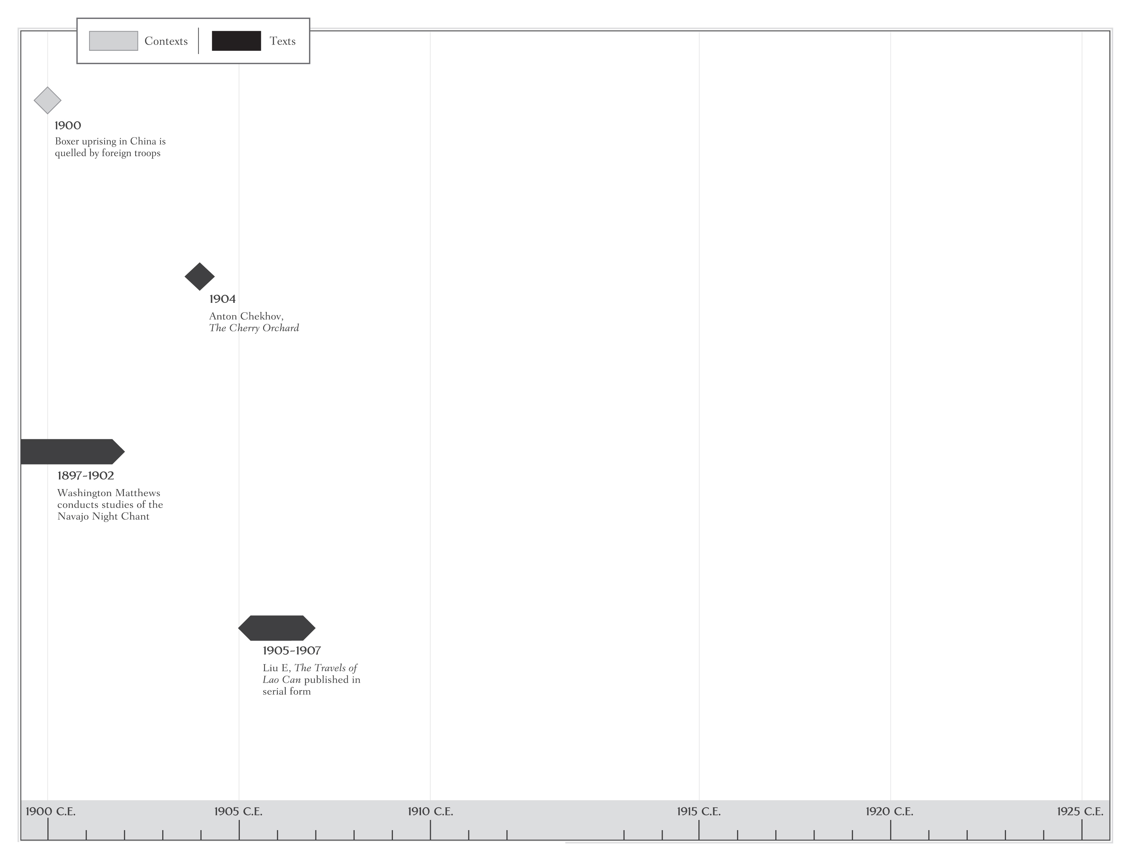

Slide 42
This concludes the PowerPoint presentation for Volume E

