Slide 1
Volume F

Slide 2
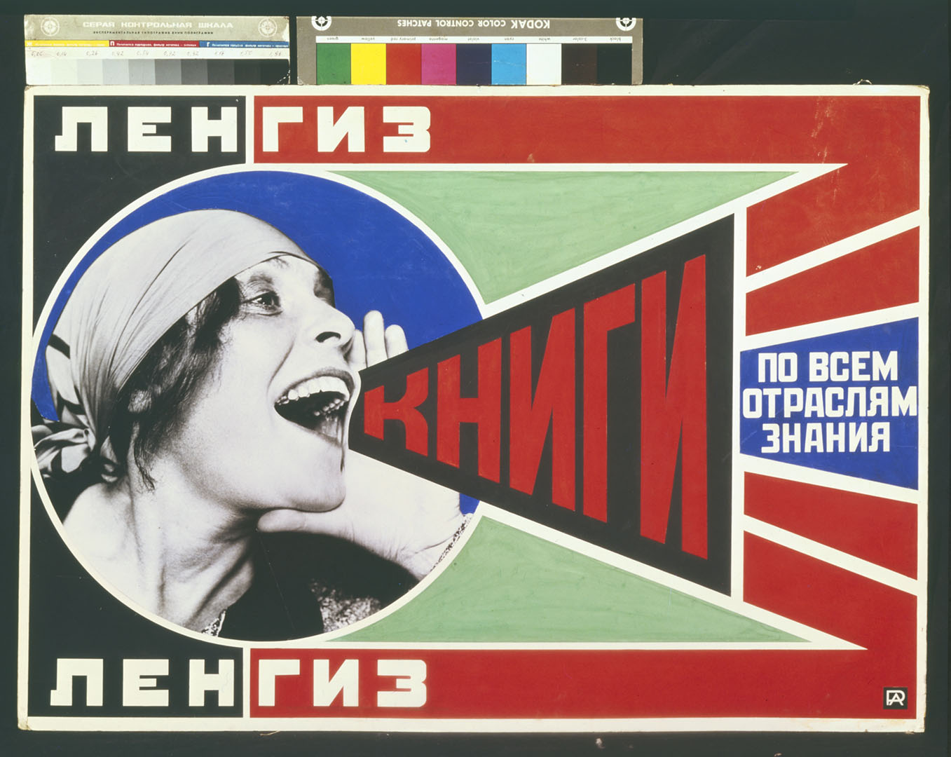
Notes:
“Books!” (1925), a promotional poster by the Russian artist Alexander Rodchenko (1891–1956).

Slide 3
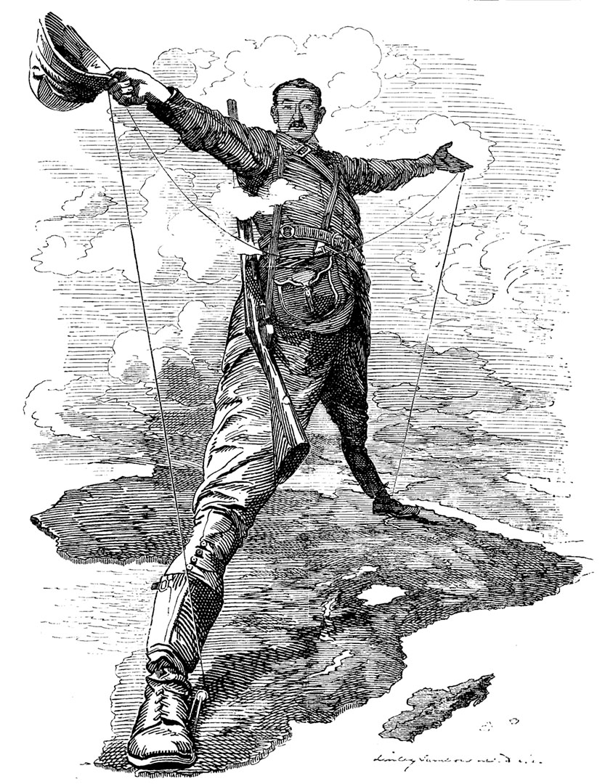
Notes:
A caricature of Cecil John Rhodes, perhaps the most famous supporter of British colonialism and imperialism in the late nineteenth century, here straddling the continent of Africa. The wires in his hands are telegraph cables. The cartoon was drawn soon after Rhodes announced his intention to connect Cape Town, South Africa, with Cairo, Egypt, by telegraph and rail.

Slide 4
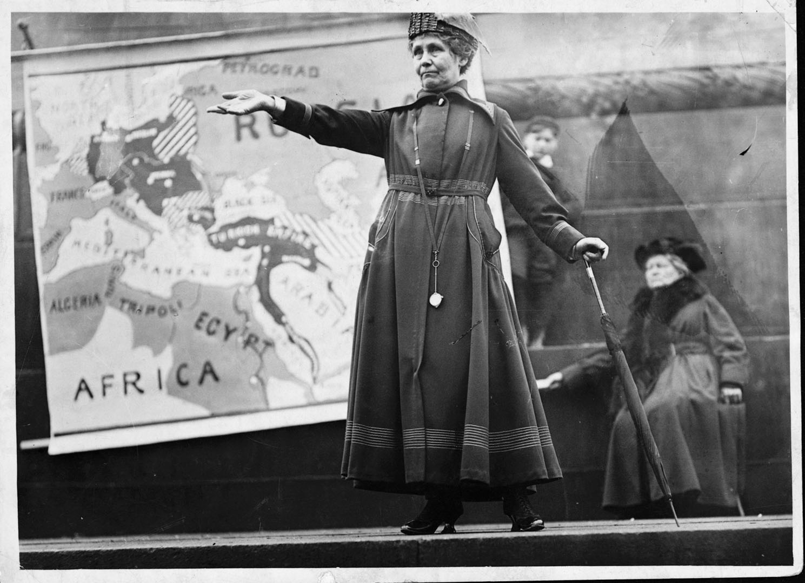
Notes:
Emmeline Pankhurst, a leading British suffragette, is shown here speaking in the early 1920s, several years after passage of the 1918 Representation of the People Act, which acknowledged the right of women over thirty to vote. In the 1920s, Pankhurst devoted herself to speaking out against Bolshevism and in favor of British imperialism.

Slide 5
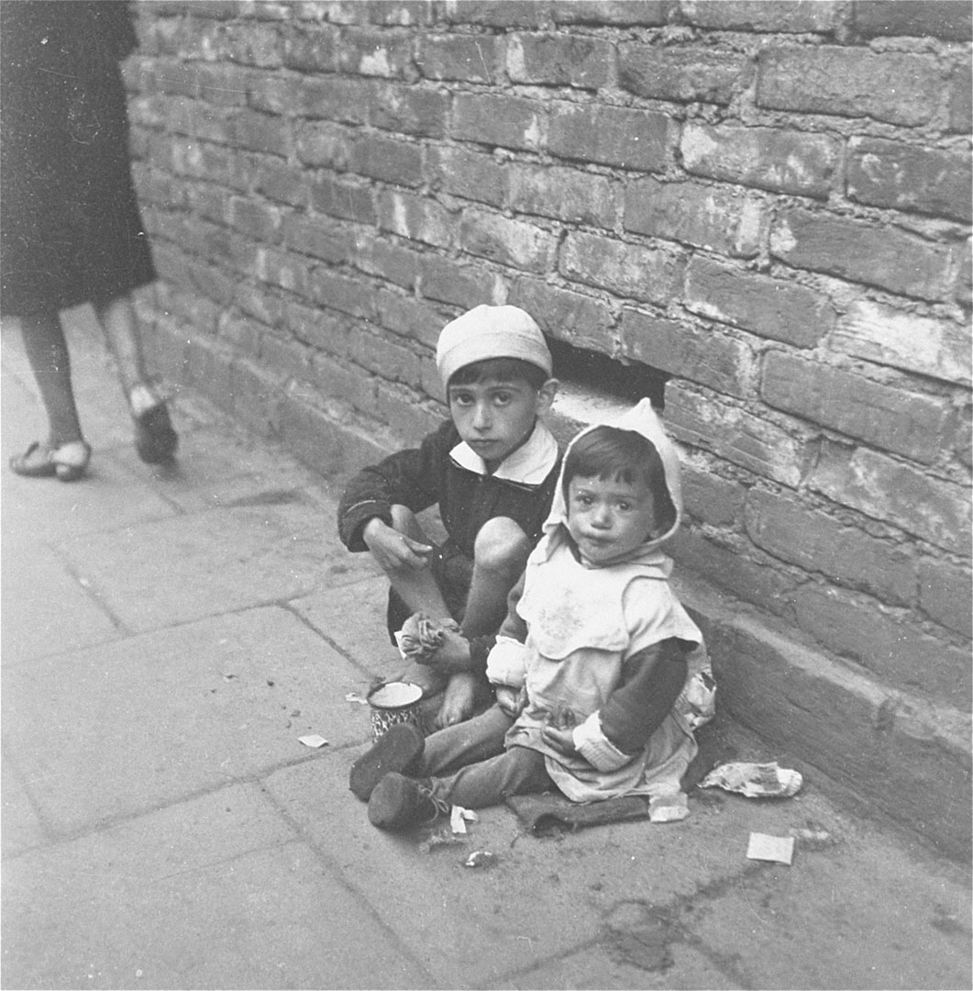
Notes:
In November 1940, the Nazis closed off a portion of Warsaw, Poland, and designated it a Jewish ghetto— essentially condemning 400,000 people to an urban prison. Predictably, nearly 100,000 of the people in the ghetto died of disease and starvation over the next year and a half. Among those trapped behind the wall were these two children, begging for food.

Slide 6
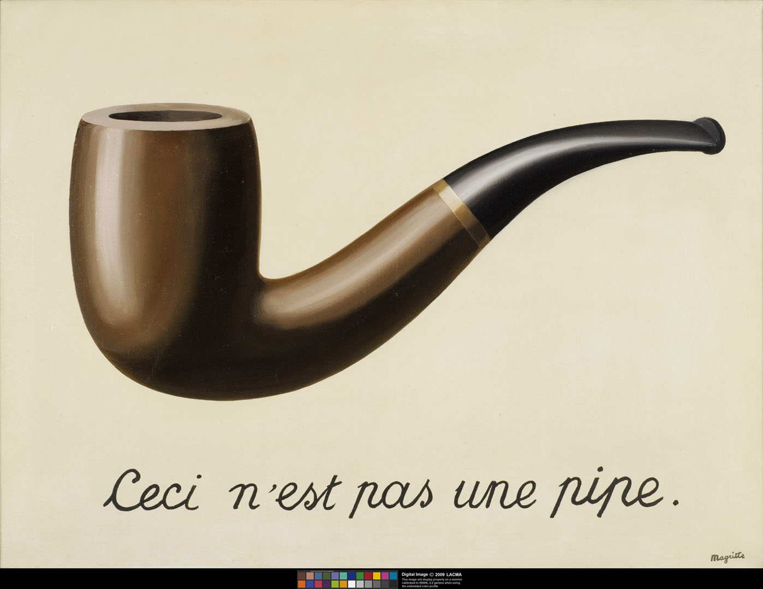
Notes:
The title of this work by the Belgian painter René Magritte (1898–1967), La Trahison des Images (1929), translates as The Treason of Images. “Cecin’est pas une pipe” means “This is not a pipe.”

Slide 7
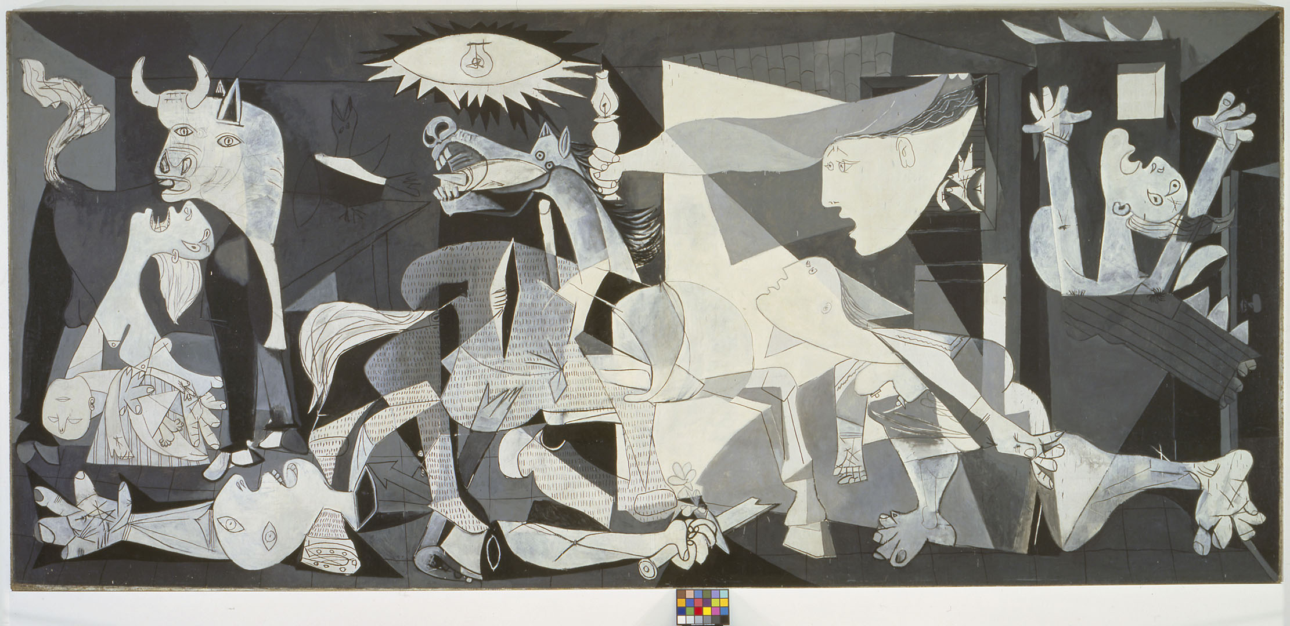
Notes:
Although Pablo Picasso’s Guernica (1937) memorializes a historical event— the bombing of Guernica, in the Basque region of Spain, in April 1937, during the Spanish Civil War— the painting stresses the psychological horror, rather than the physical appearance, of the event.

Slide 8
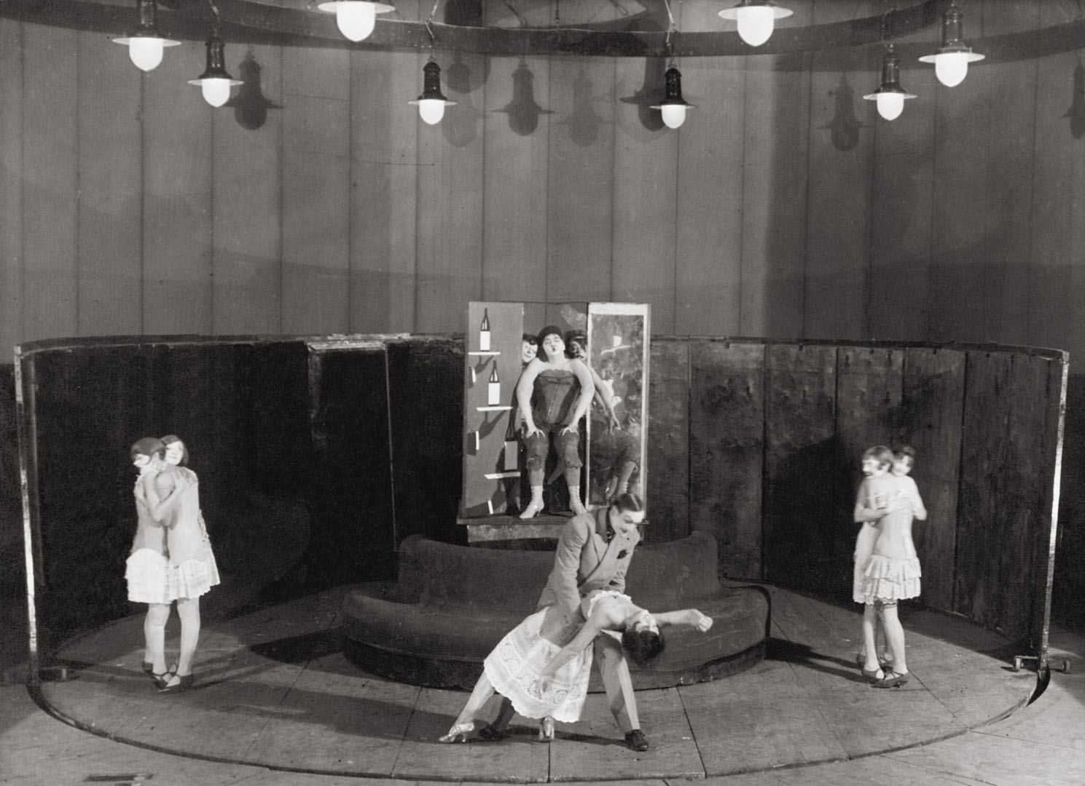
Notes:
Bertolt Brecht and Kurt Weill’s The Threepenny Opera, staged at the Kammer (Chamber) Theater, Moscow, in 1930.

Slide 9
Notes:
A self-portrait, circa 1939, of Tsuguharu Foujita (1886–1968), a Tokyo-born artist who applied traditional Japanese printing, painting, and coloring techniques to works that were otherwise modernist in style.

Slide 10
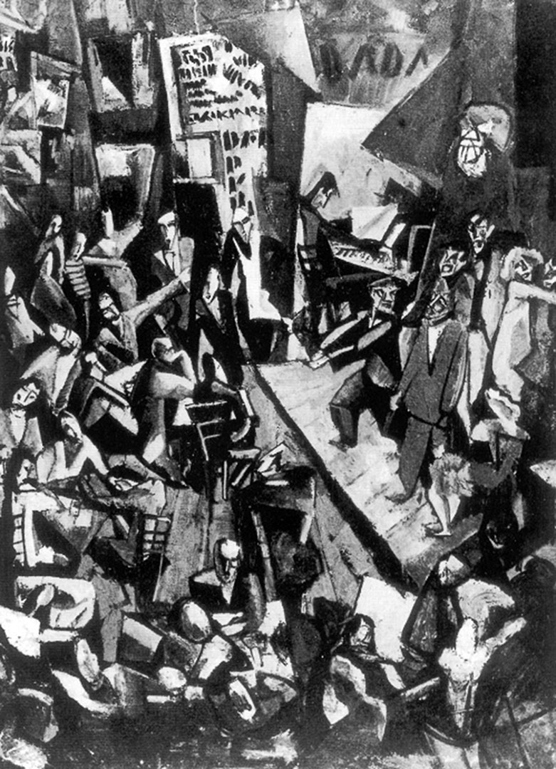
Notes:
Cluster: Manifestos: Cabaret Voltaire, 1916, by Marcel Janco. The raunchy birthplace of the radical Dada movement in Zurich.

Slide 11
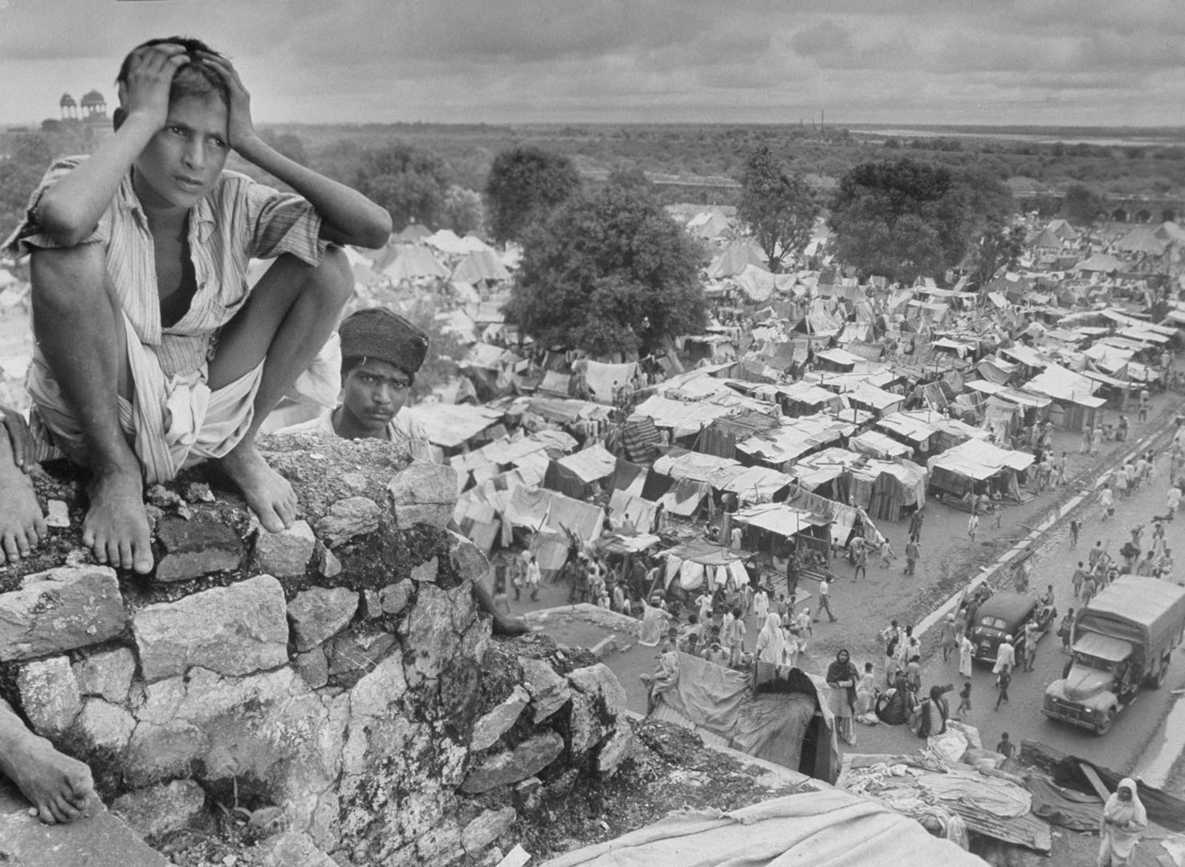
Notes:
A photograph from October 1947 by Margaret Bourke- White (American, 1904–1971) of a refugee camp in Delhi. The picture was taken a month before British-ruled India was partitioned into two nations, India and Pakistan.

Slide 12
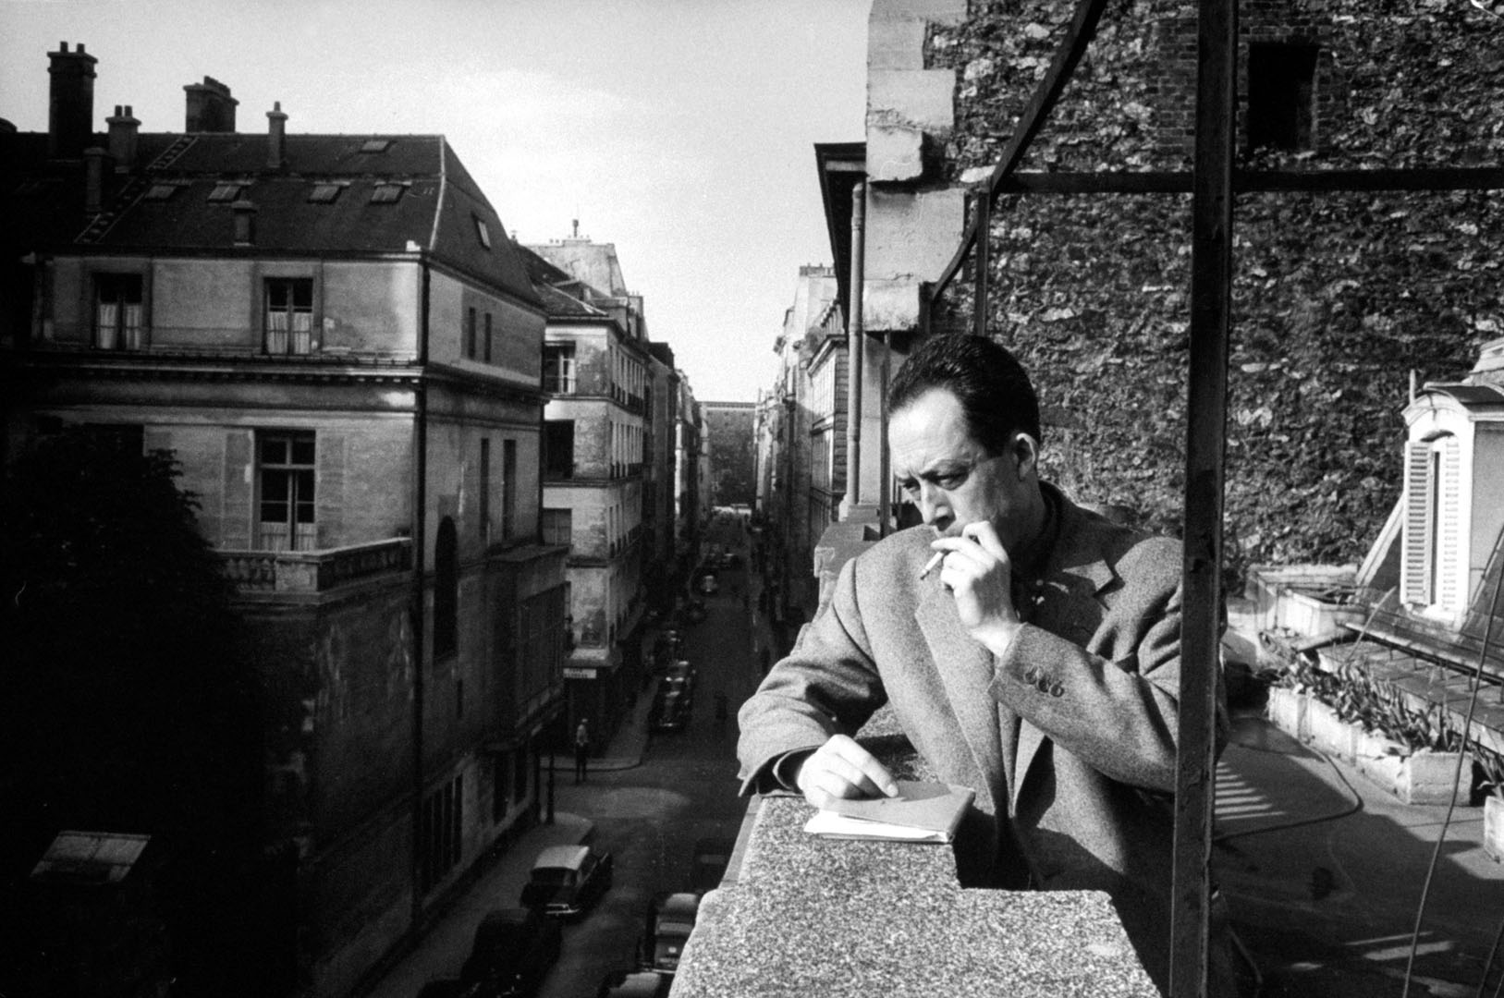
Notes:
The Algerian writer Albert Camus (1913–1960), on the balcony of his Paris publisher’s office in 1955.

Slide 13
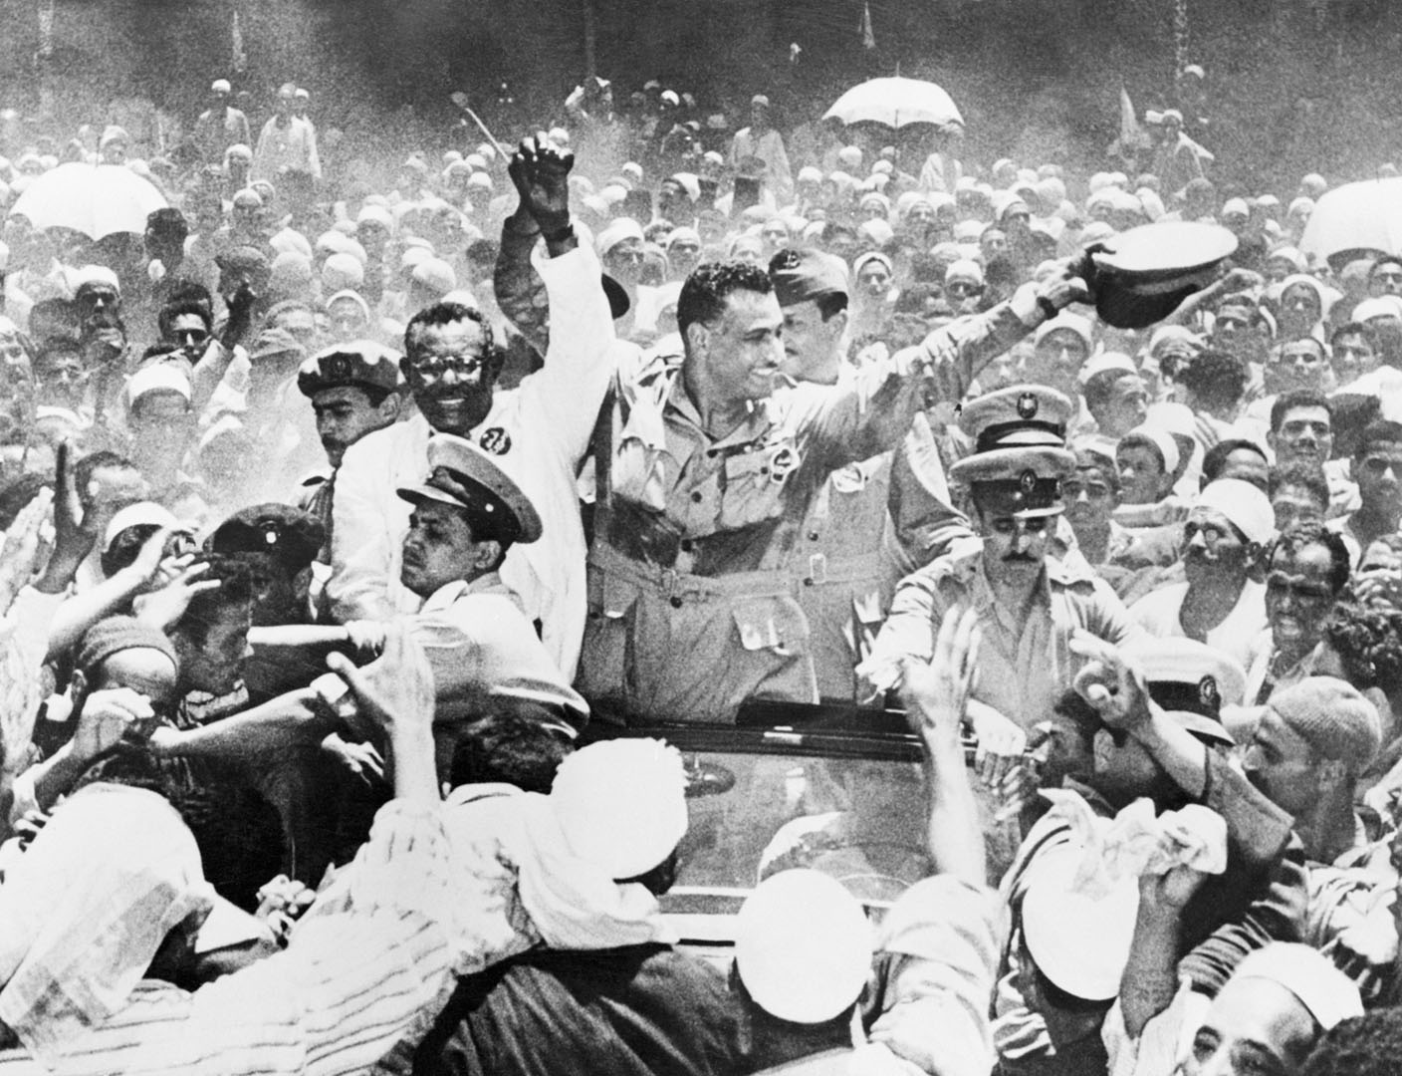
Notes:
Egyptian premier Gamal Abdel Nasser Hussein (right) and the prime minister of the Sudan, Ismail Al Azhari, clasp hands among a crowd of supporters in Egypt in July 1954. Nasser, a central figure in the Egyptian revolution of 1952, which overthrew the monarchy of Egypt and Sudan, became Egypt’s president in 1956.

Slide 14
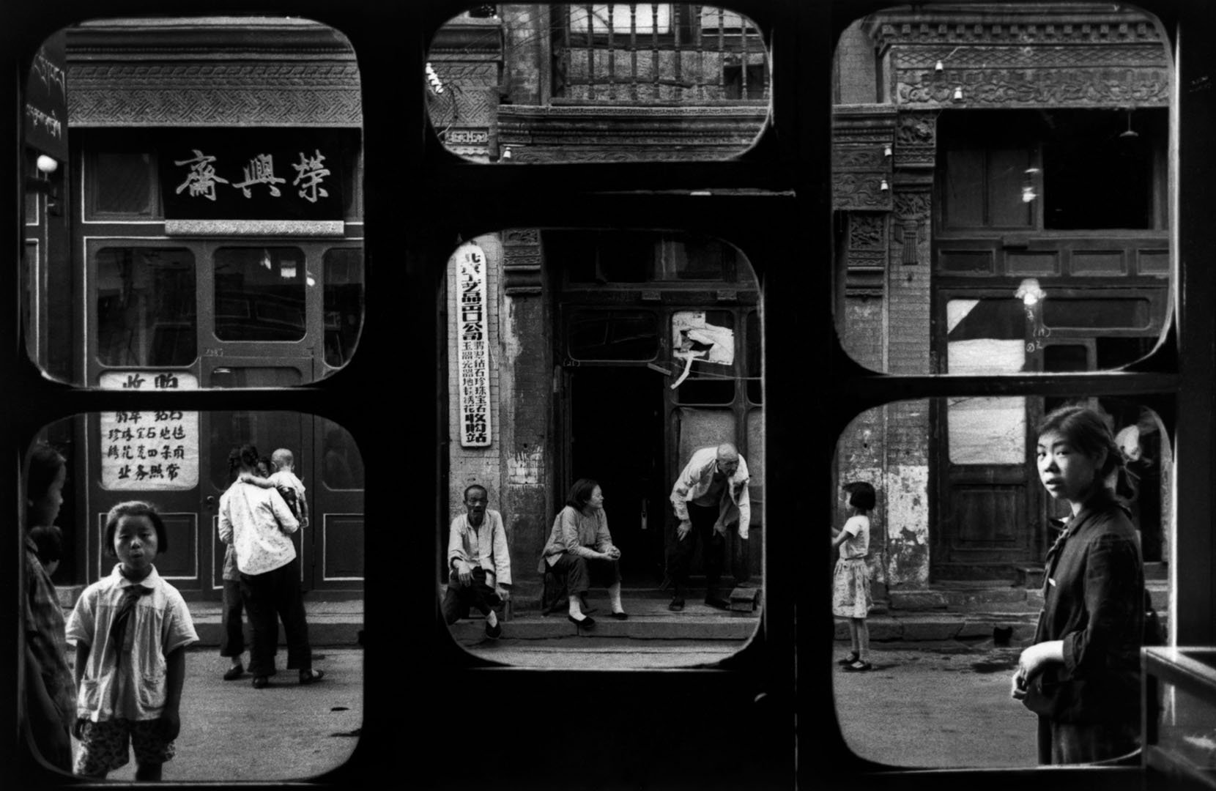
Notes:
A 1965 photograph by Marc Riboud of a street in Beijing as seen from inside an antique dealer’s shop.

Slide 15
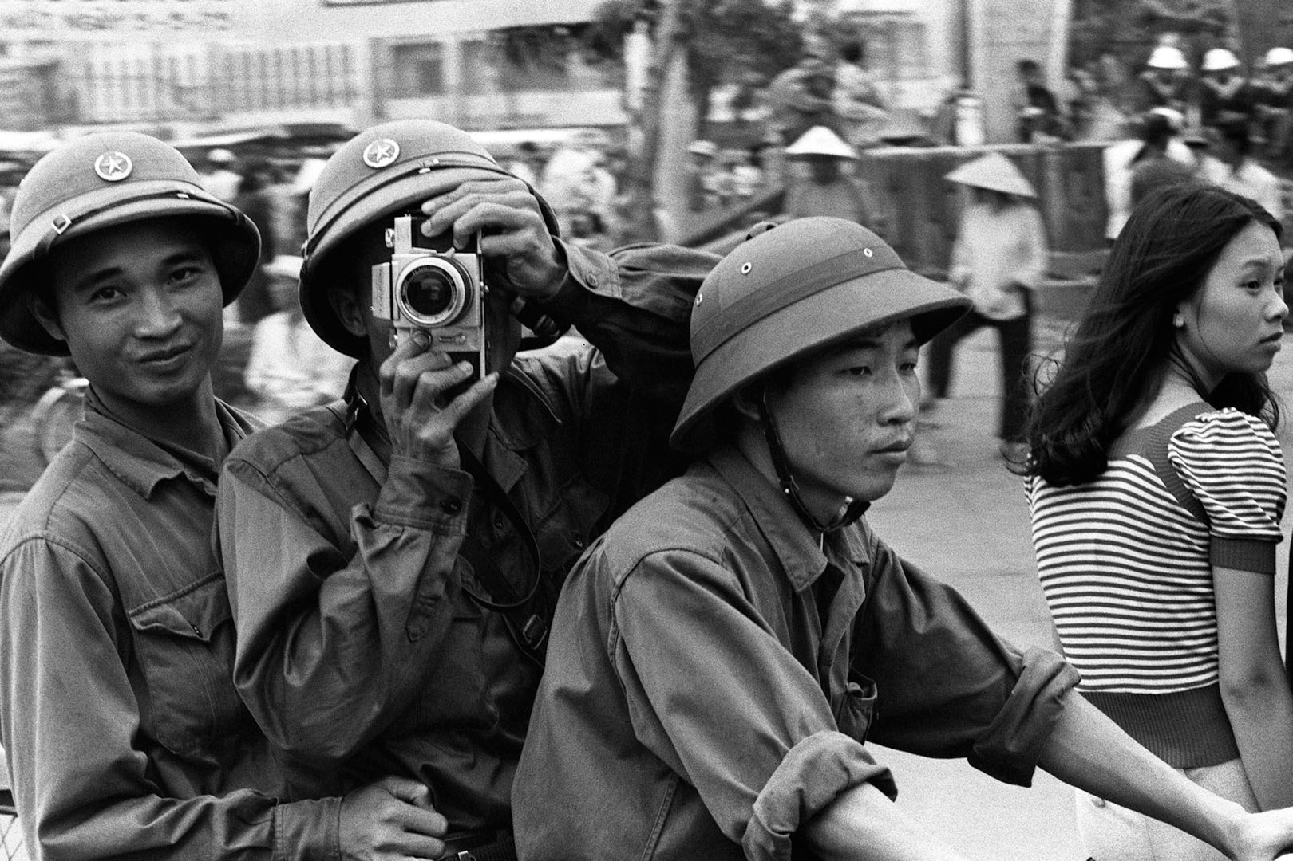
Notes:
Young men in Ho Chi Minh City (formerly Saigon, the capital of South Vietnam), in 1975, after “Liberation Day.”

Slide 16
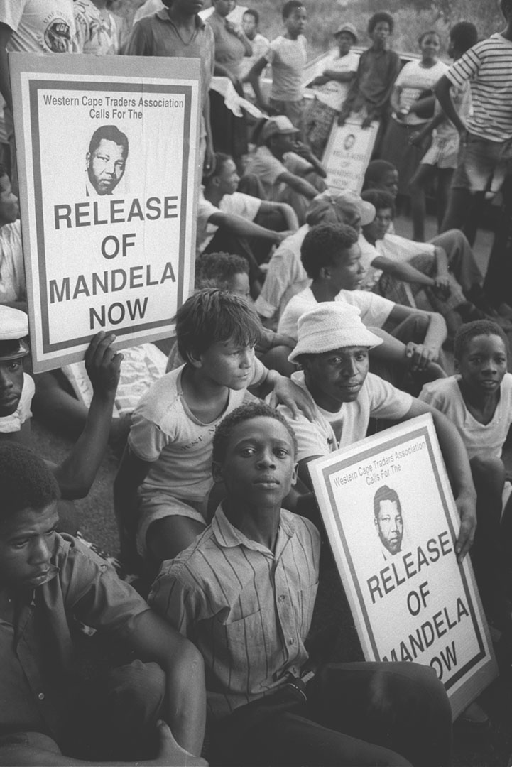
Notes:
Supporters of antiapartheid activist Nelson Mandela gather outside the Victor Verster prison in Cape Town, South Africa, demanding his freedom. After twenty-seven years of confinement, Mandela was finally released in 1990. In 1994 he became South Africa’s first black president.

Slide 17
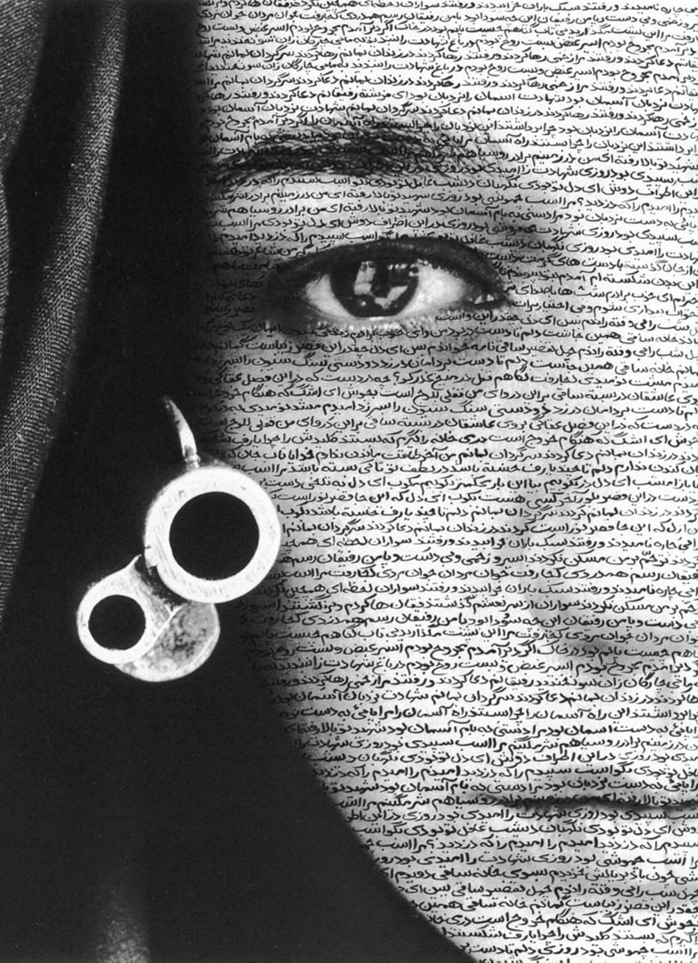
Notes:
Speechless, 1996, by Shirin Neshat.

Slide 18
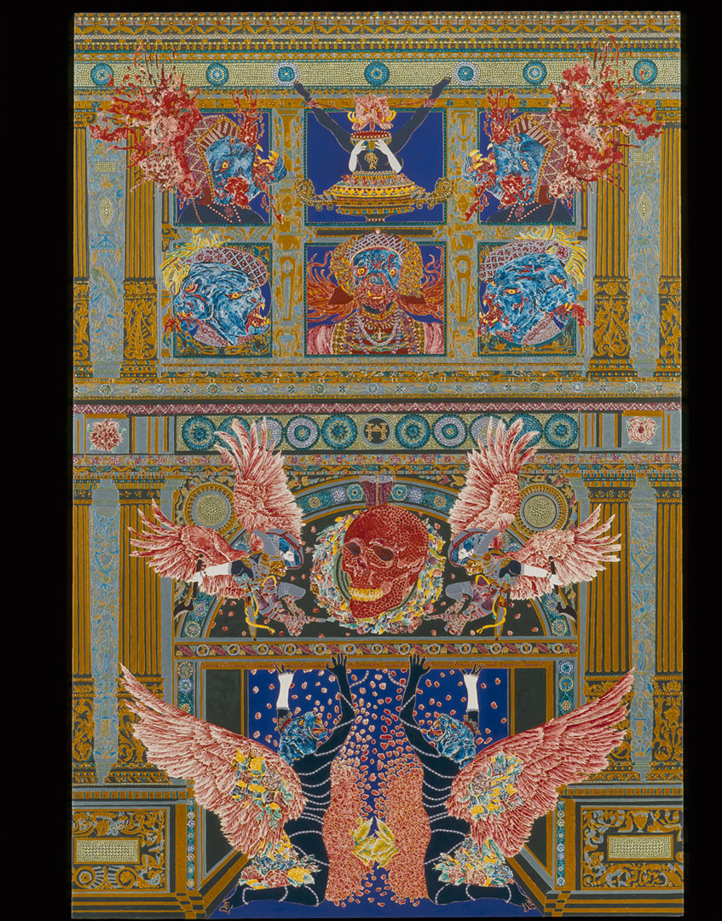
Notes:
Absence of God, 2007, by Raqib Shaw. Born in Calcutta, raised in Kashmir, and currently working in London, Shaw incorporates imagery from multiple sources—as varied as Renaissance painting, Japanese woodblock prints, and Hindu iconography—into his paintings, creating a dreamlike amalgam of the disparate parts.

Slide 19
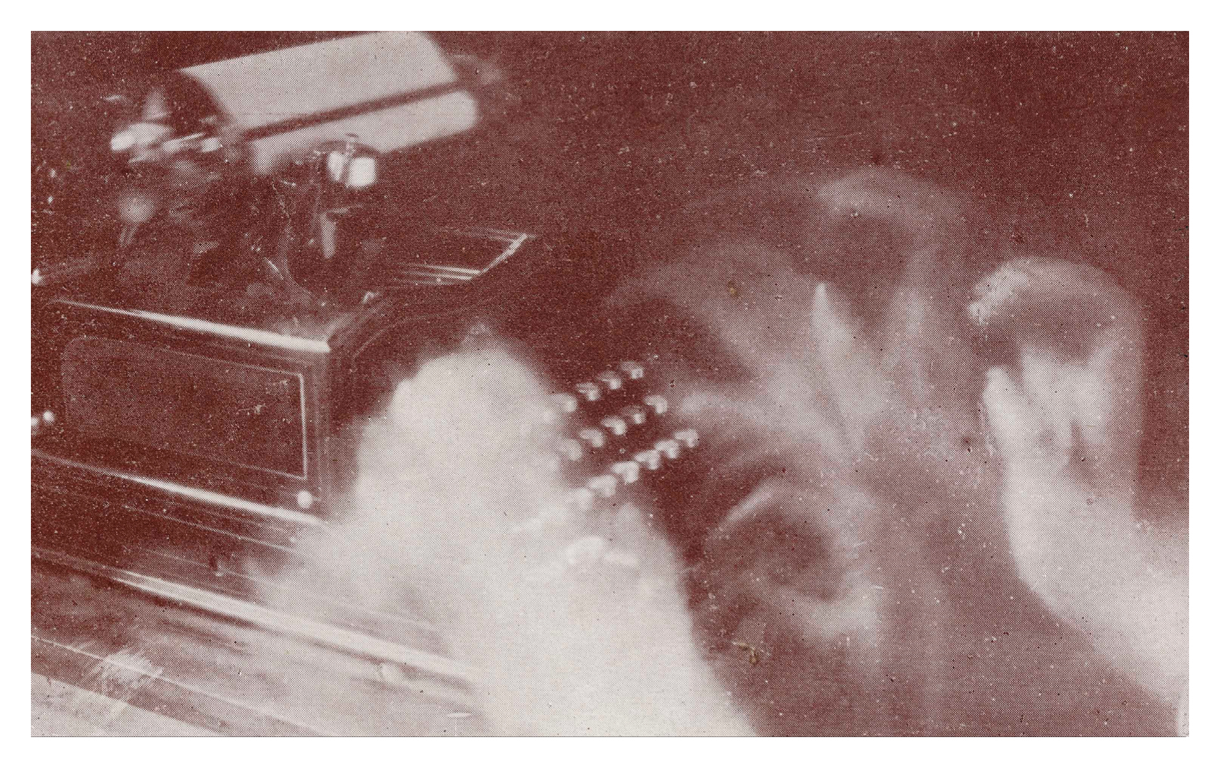
Notes:
Futurism, a modernist movement centered in Italy in the early twentieth century, focused on the technologies and dynamism of modern life. This photograph (Dattilografa, 1913) by Anton Giulio Bragaglia (1890–1960) captures the spirit of the futurist movement perfectly, portraying writing as an energetic and technology-enhanced activity.

Slide 20
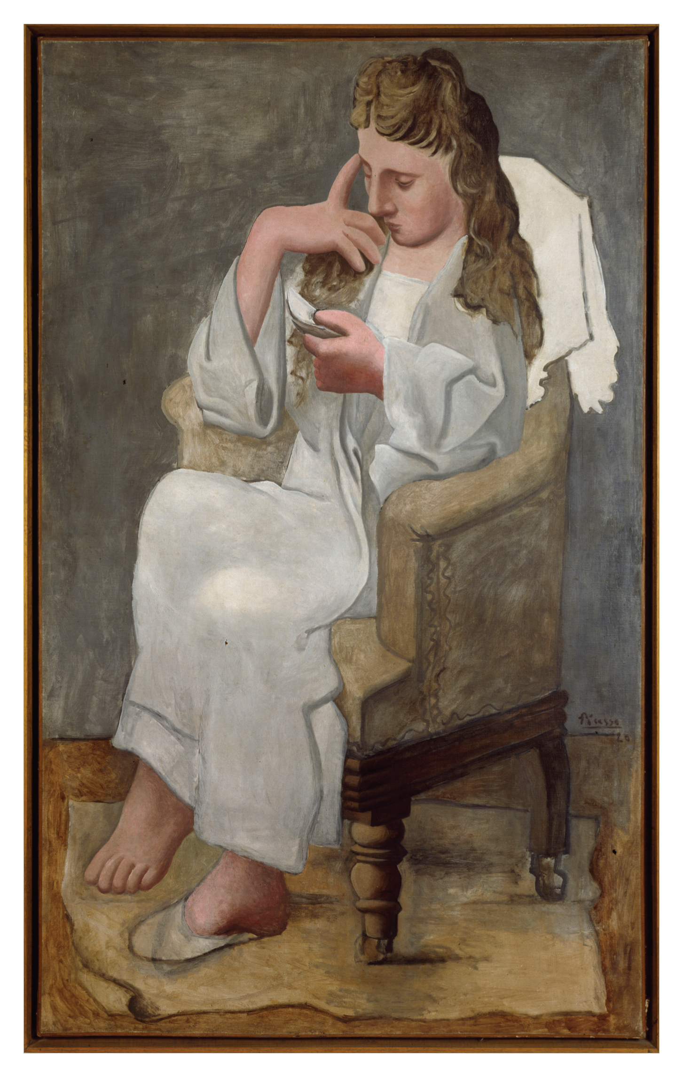
Notes:
The Reader (Woman in Grey), 1920, an oil painting by the twentieth-century’s most famous artist, Pablo Picasso (1881–1973).

Slide 21
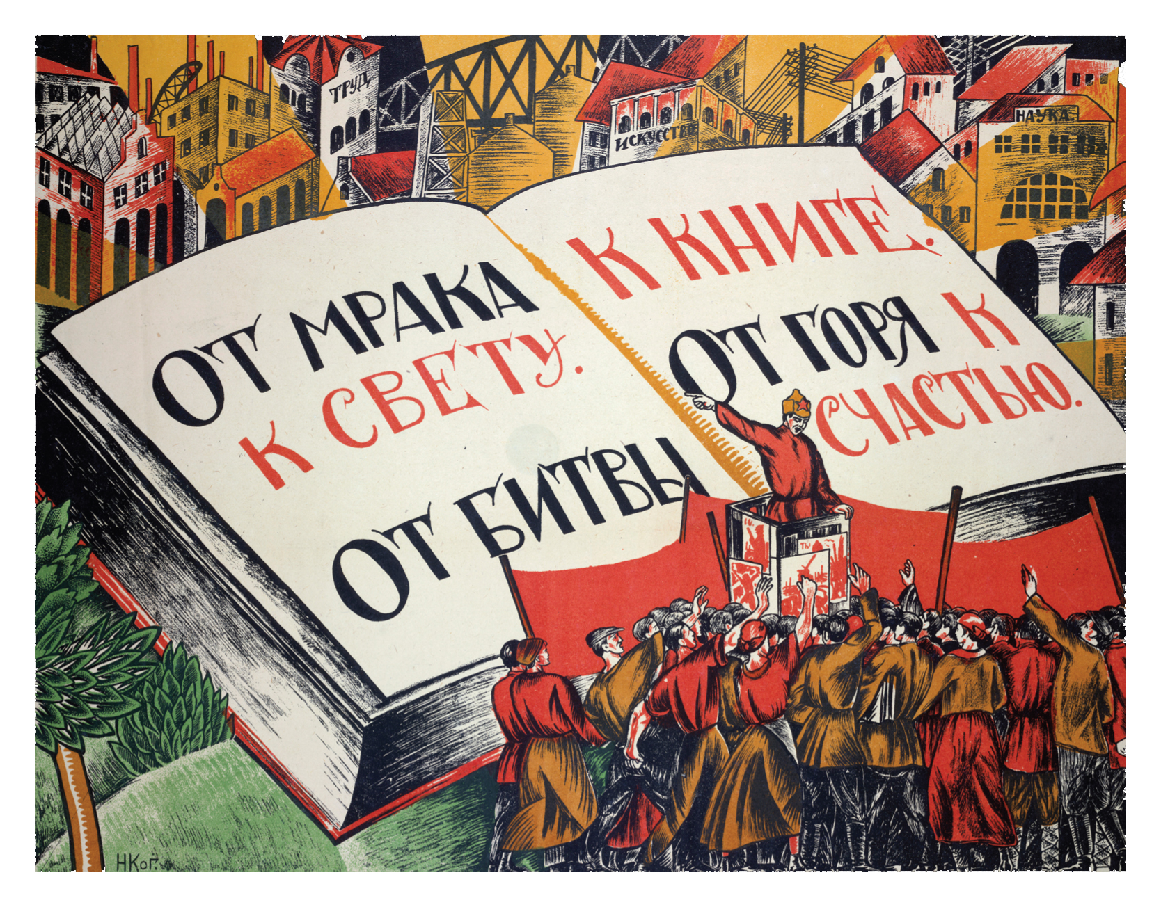
Notes:
Soviet propaganda poster, 1921. The text reads, “From the gloom to the light; from battle to books; from grief to happiness.”

Slide 22
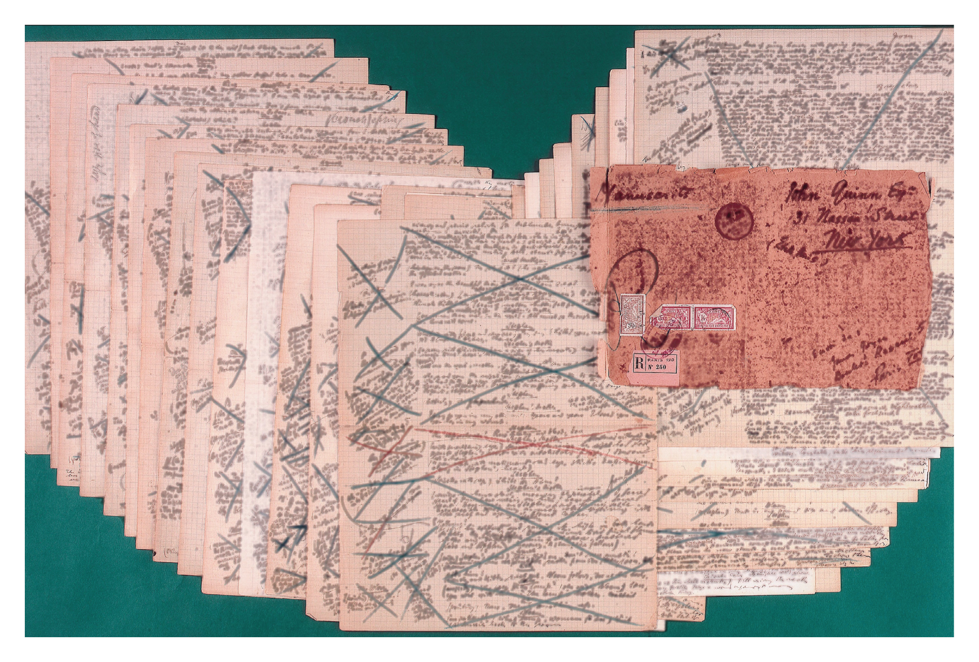
Notes:
Manuscript pages— heavily marked with corrections and additions— from the “Circe” chapter of James Joyce’s novel Ulysses (1922).

Slide 23
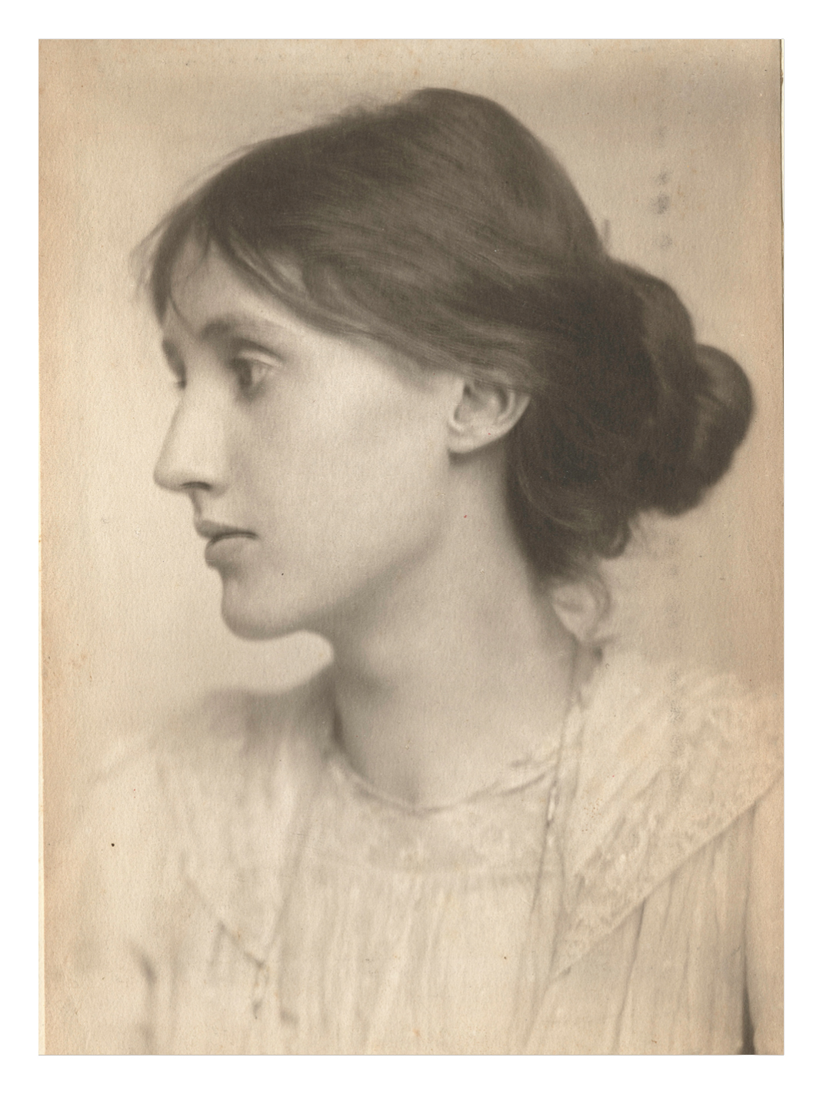
Notes:
Portrait of Virginia Woolf (1882–1941) taken in 1902, and a page from Woolf’s draft notebook for her novel Mrs. Dalloway (1925). Surveying the history of literature and finding so few women, Woolf had this to say in A Room of One’s Own (1929): “I would venture to guess that Anon, who wrote so many poems without signing them, was often a woman.”

Slide 24
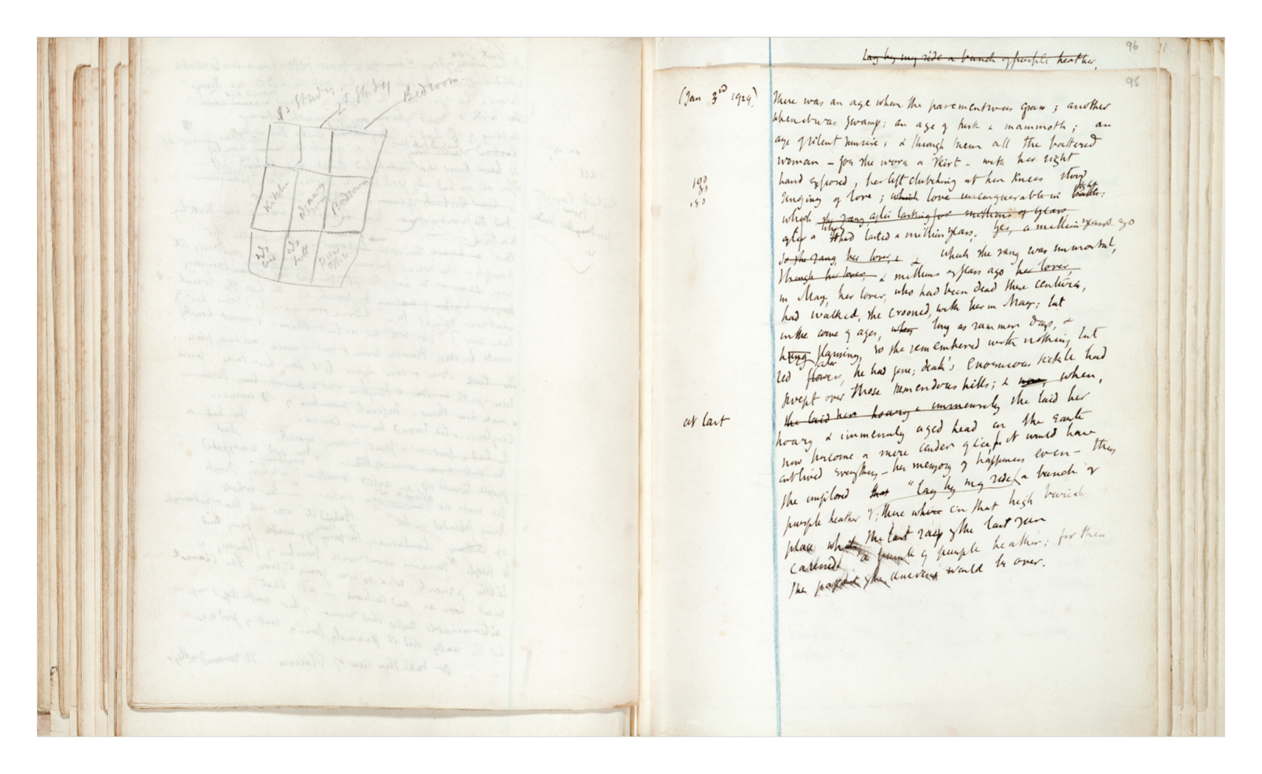
Notes:
Portrait of Virginia Woolf (1882–1941) taken in 1902, and a page from Woolf’s draft notebook for her novel Mrs. Dalloway (1925). Surveying the history of literature and finding so few women, Woolf had this to say in A Room of One’s Own (1929): “I would venture to guess that Anon, who wrote so many poems without signing them, was often a woman.”

Slide 25
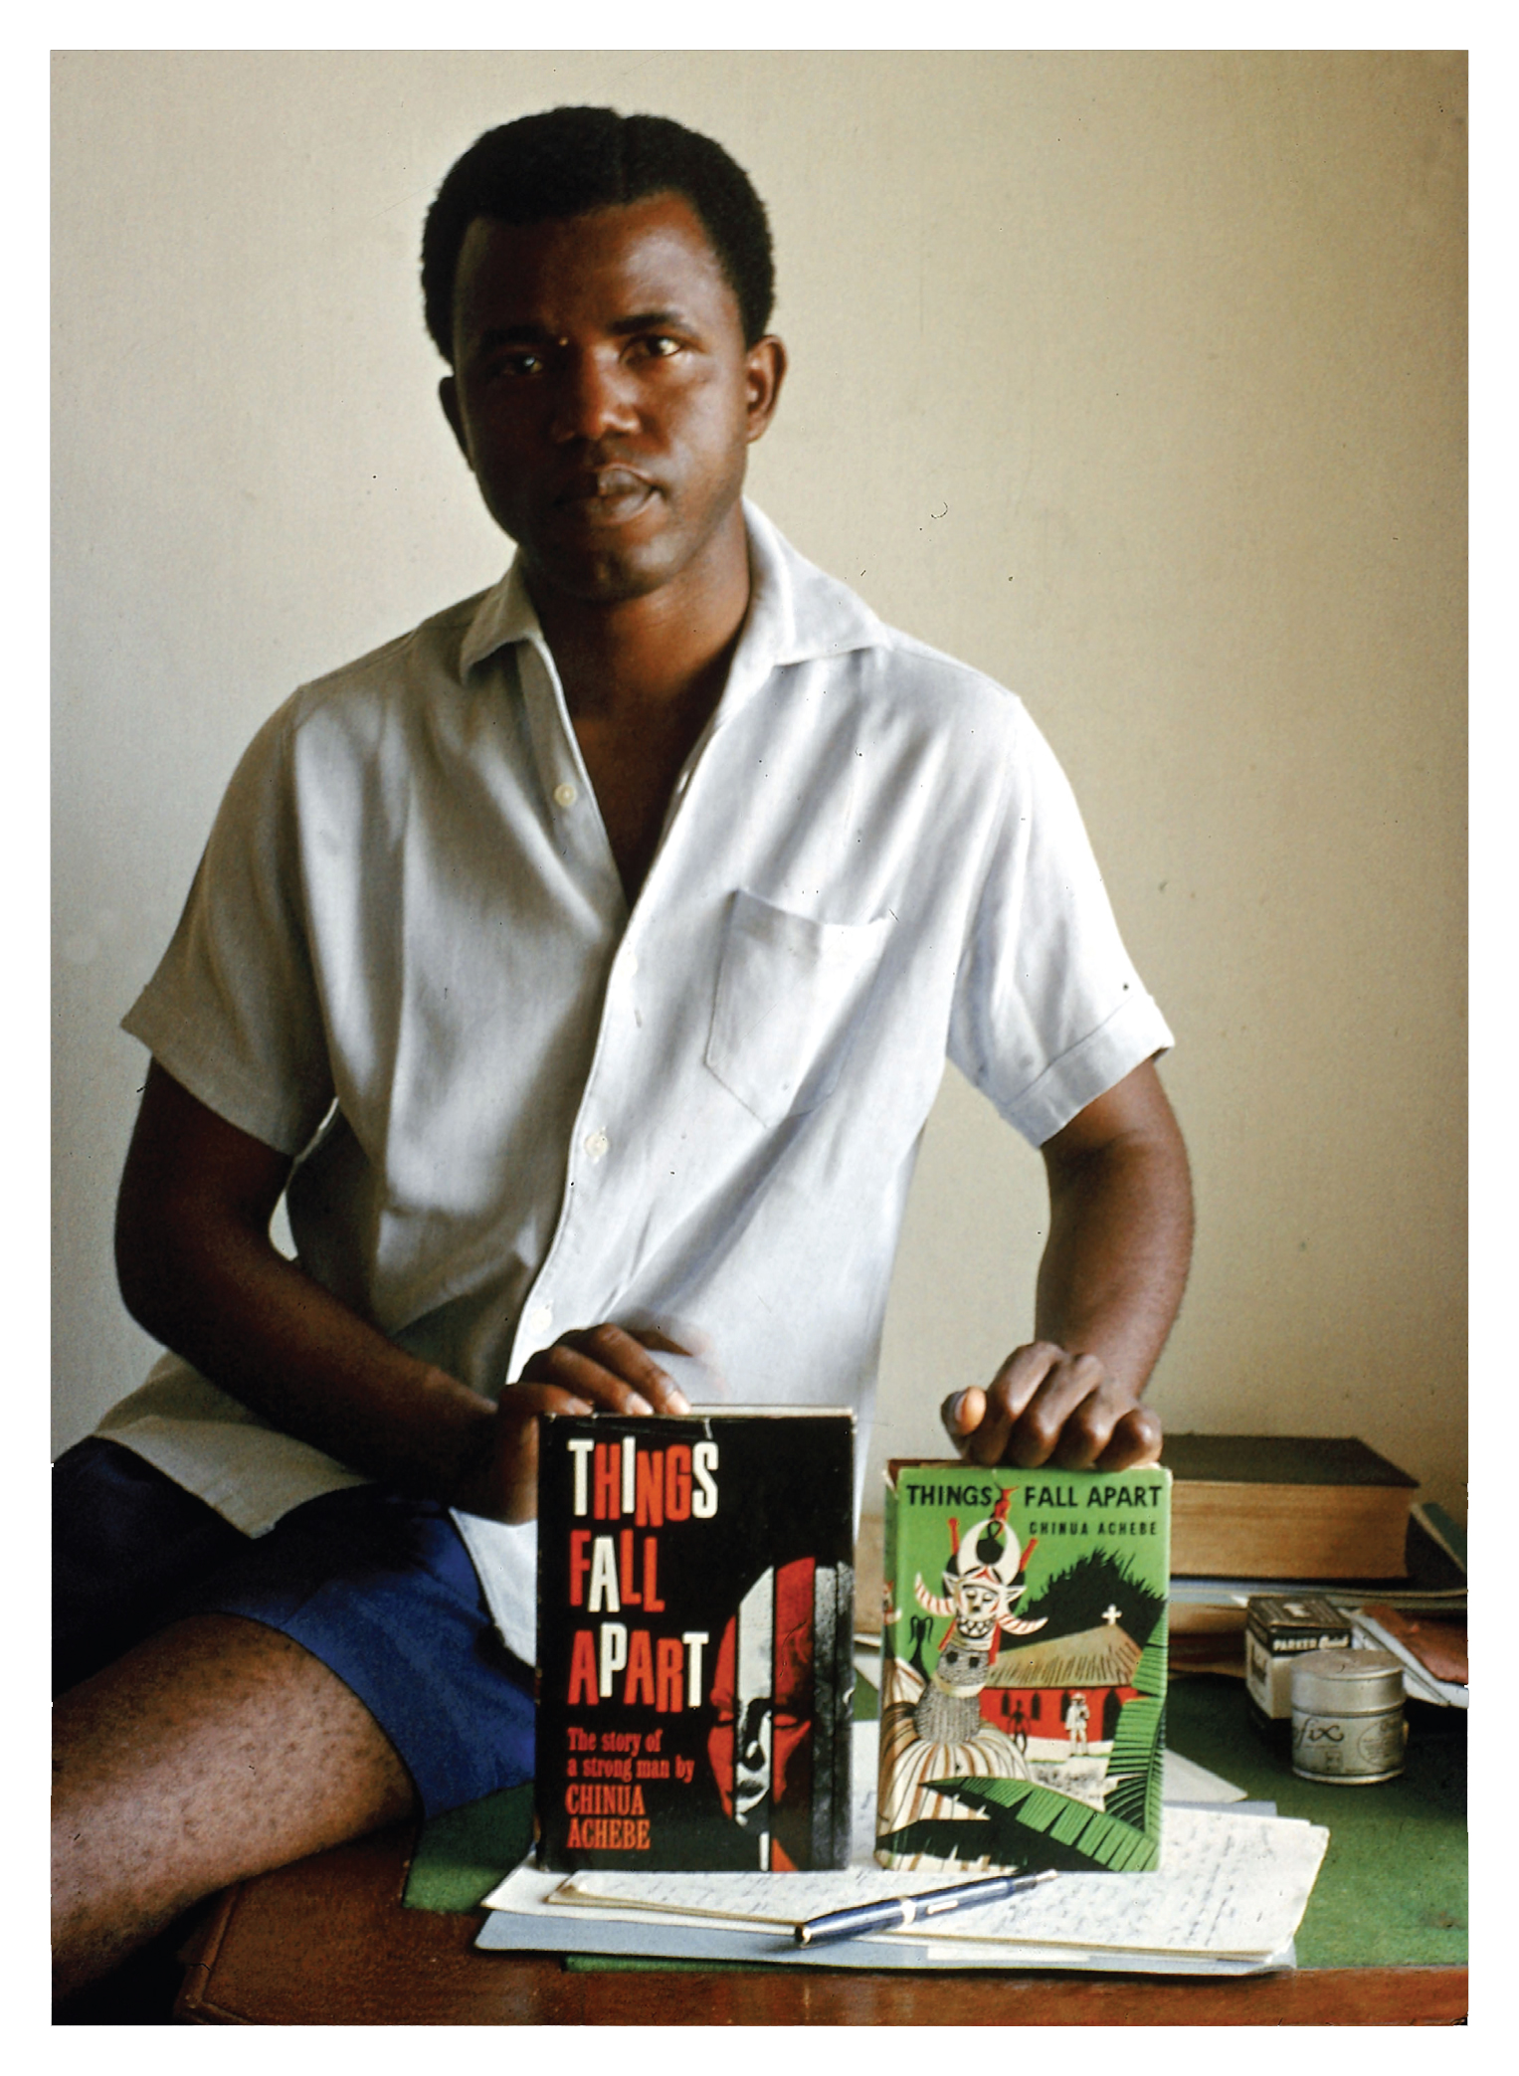
Notes:
The Nigerian author Chinua Achebe (born 1930), photographed in 1960 holding two editions of his book Things Fall Apart (1958), which would become the most widely read and respected African novel in English.

Slide 26
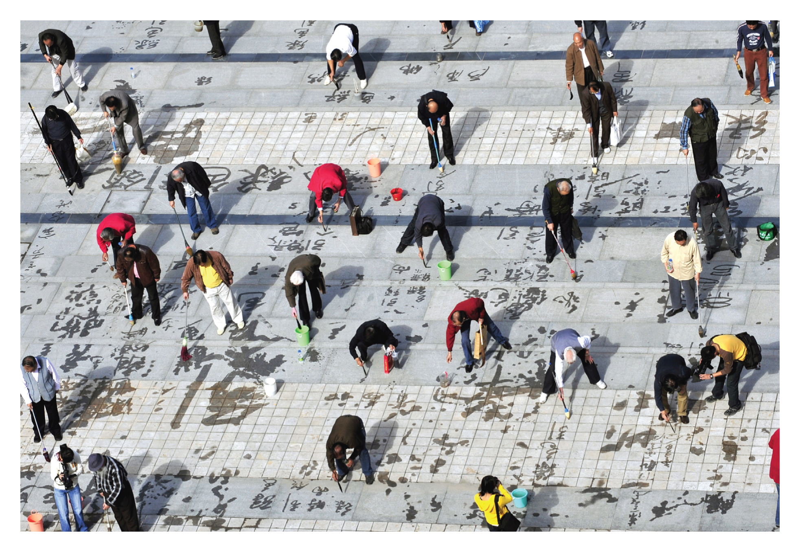
Notes:
Participants in a 2010 calligraphy contest in the city of Xian, Shanxi Province, China.

Slide 27
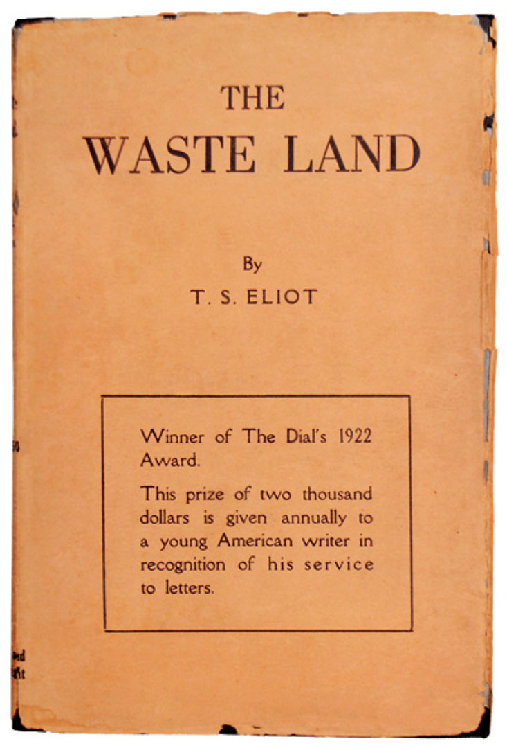
Notes:
The cover of the first American edition of T. S. Eliot’s modernist masterpiece, The Waste Land, published in 1922, and the opening menu of an ebook/app version of the poem, released in 2011. Clearly, the new media and technologies of the twenty-first century will change the way we read and experience poetry, drama, fiction, and other writing. But in what ways? How quickly?

Slide 28
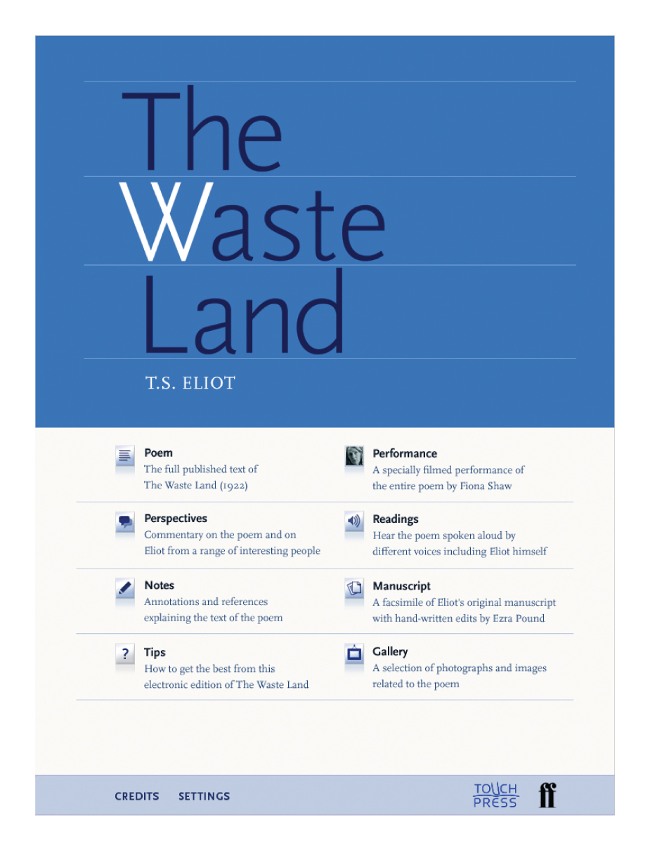
Notes:
The cover of the first American edition of T. S. Eliot’s modernist masterpiece, The Waste Land, published in 1922, and the opening menu of an ebook/app version of the poem, released in 2011. Clearly, the new media and technologies of the twenty-first century will change the way we read and experience poetry, drama, fiction, and other writing. But in what ways? How quickly?

Slide 29
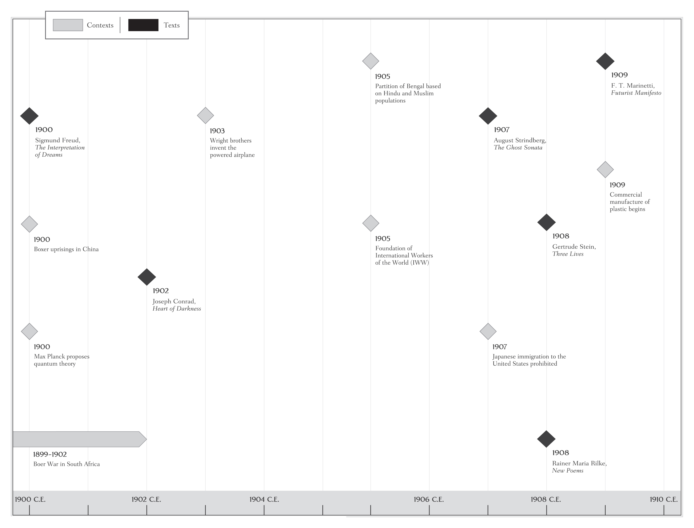

Slide 30
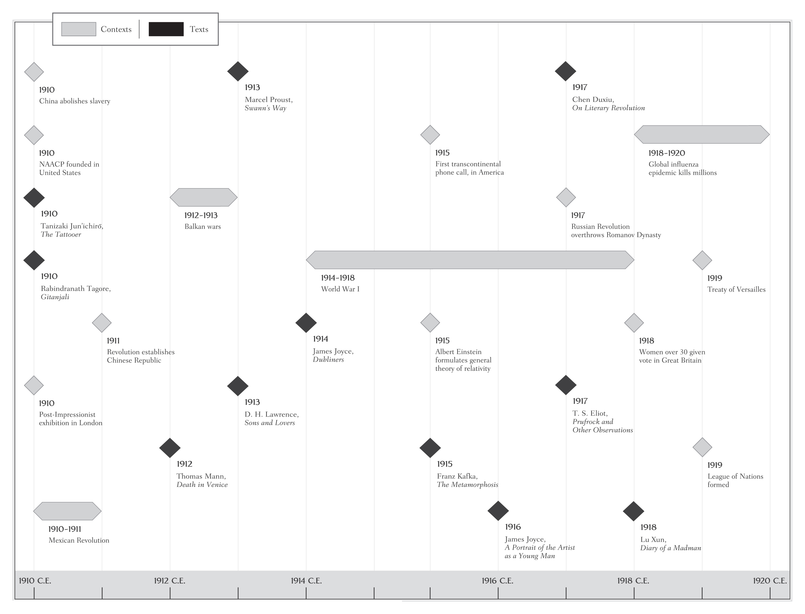

Slide 31
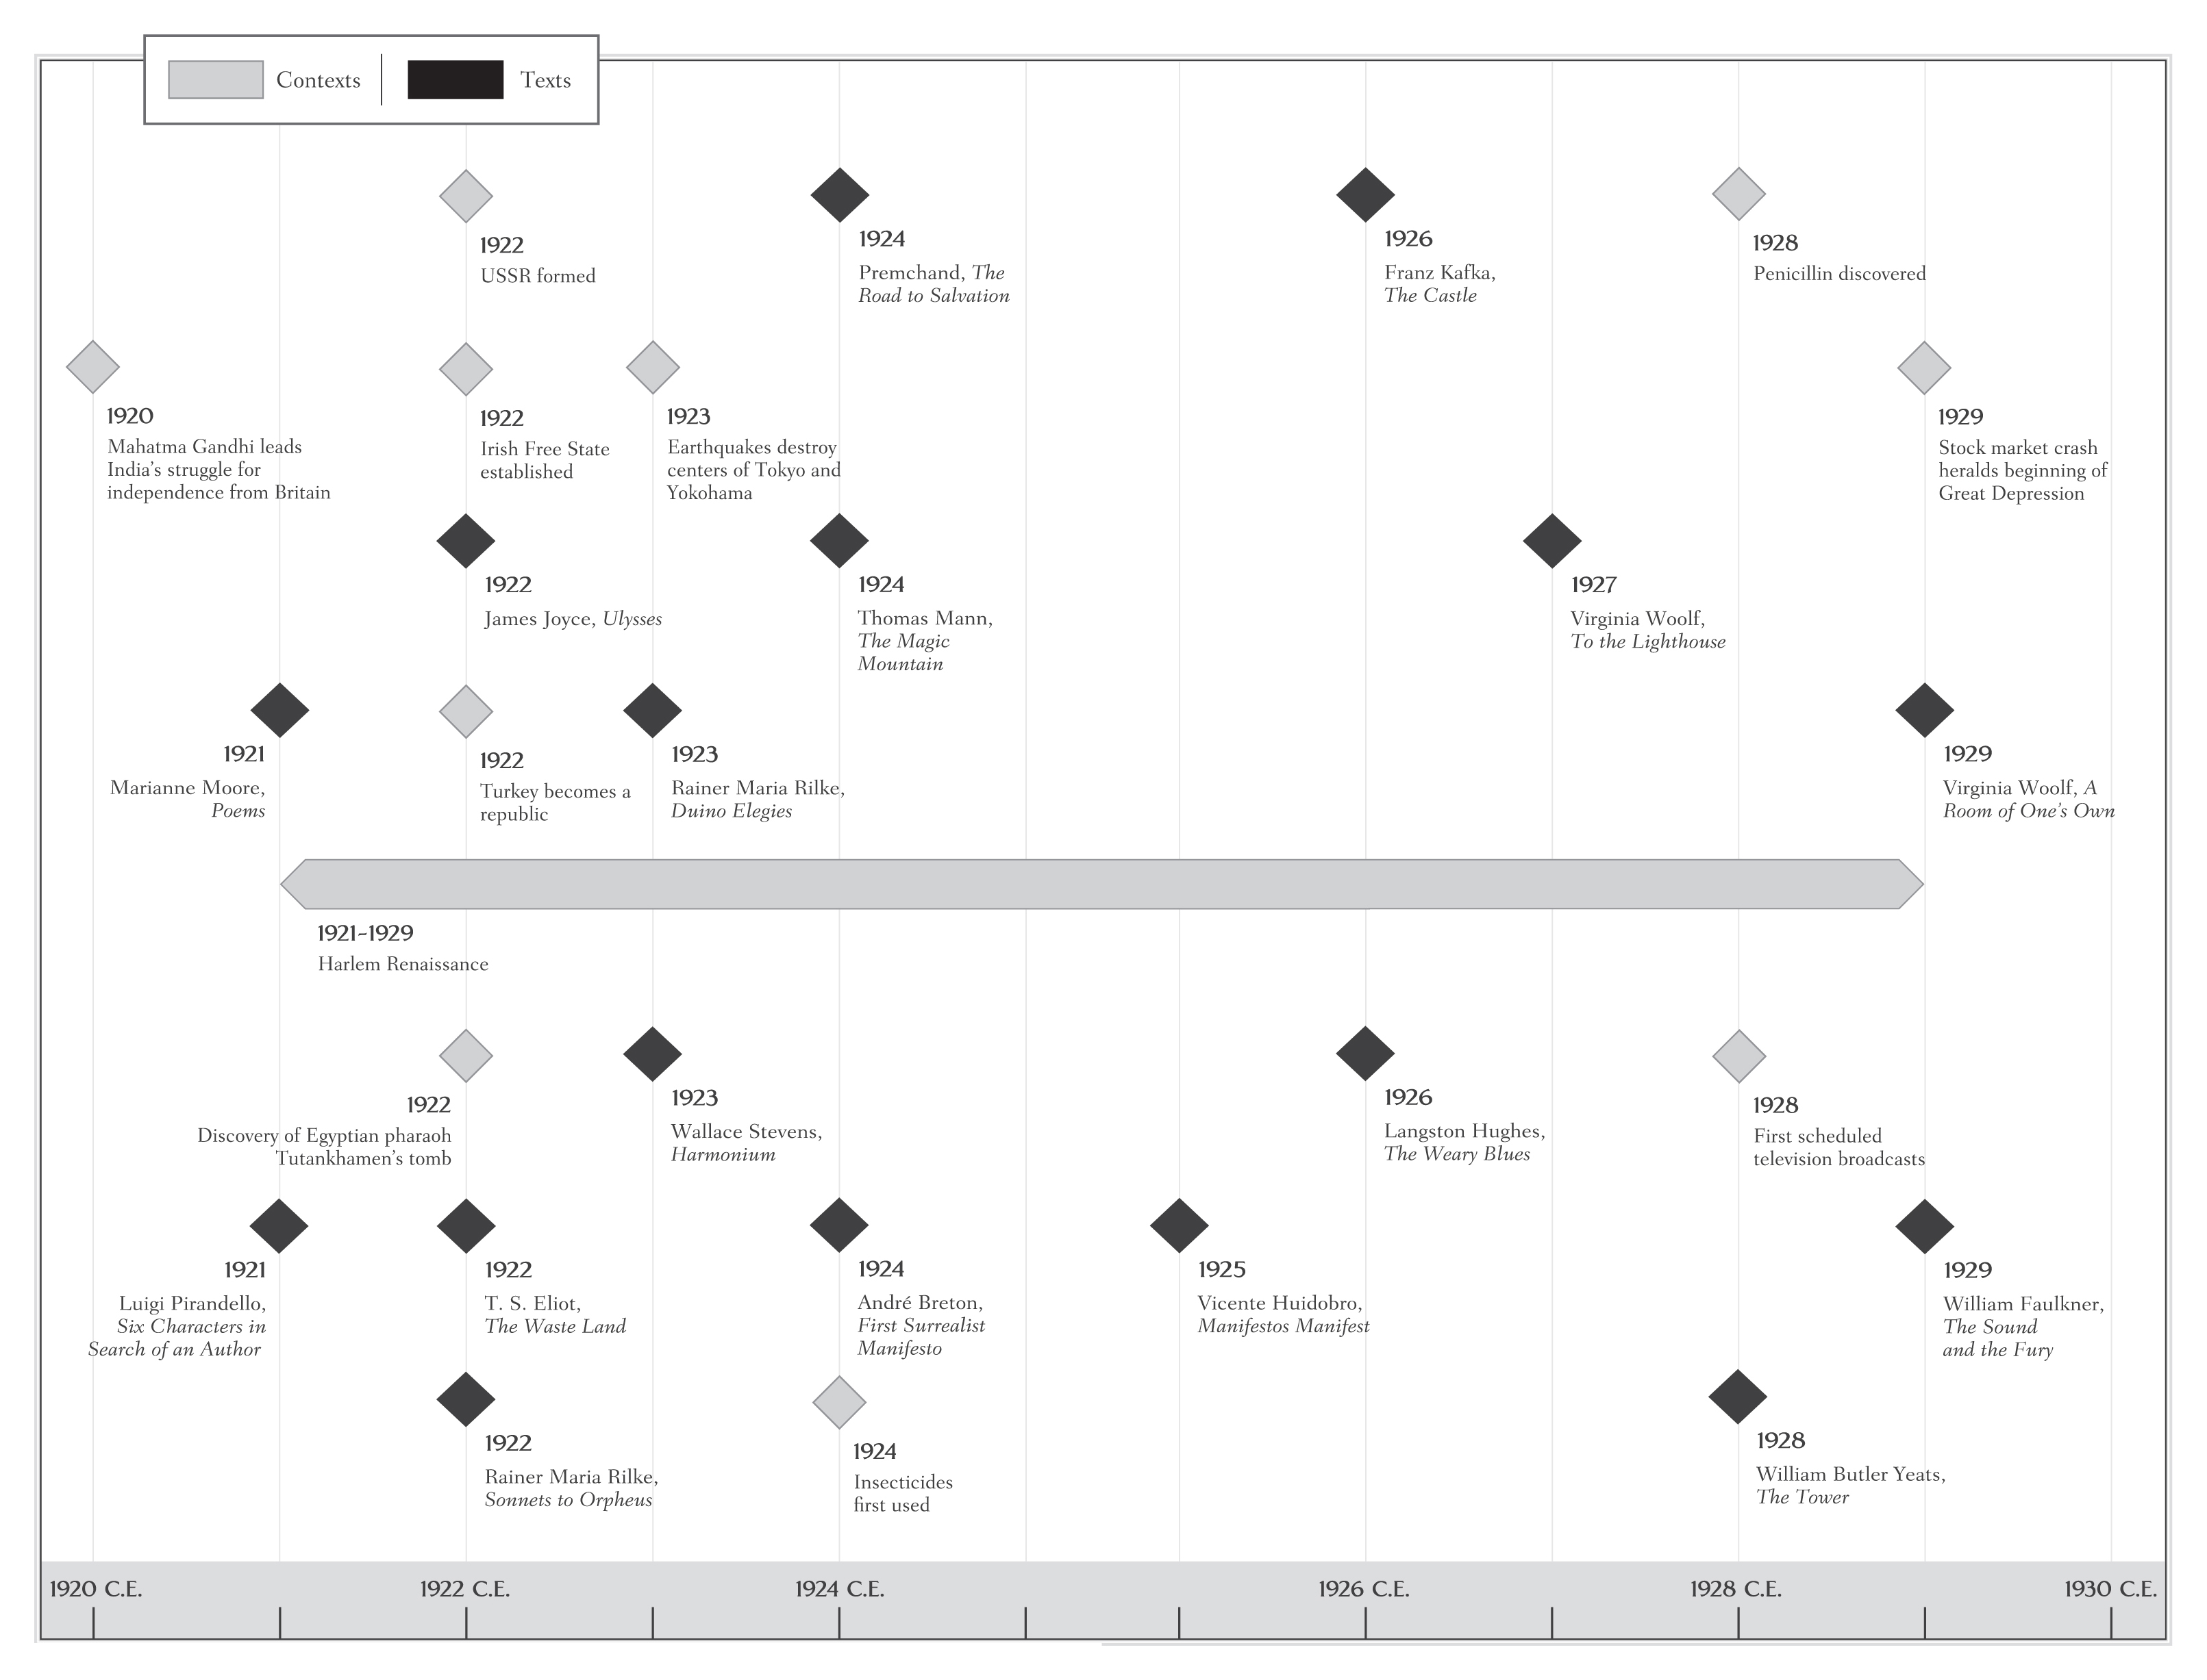

Slide 32
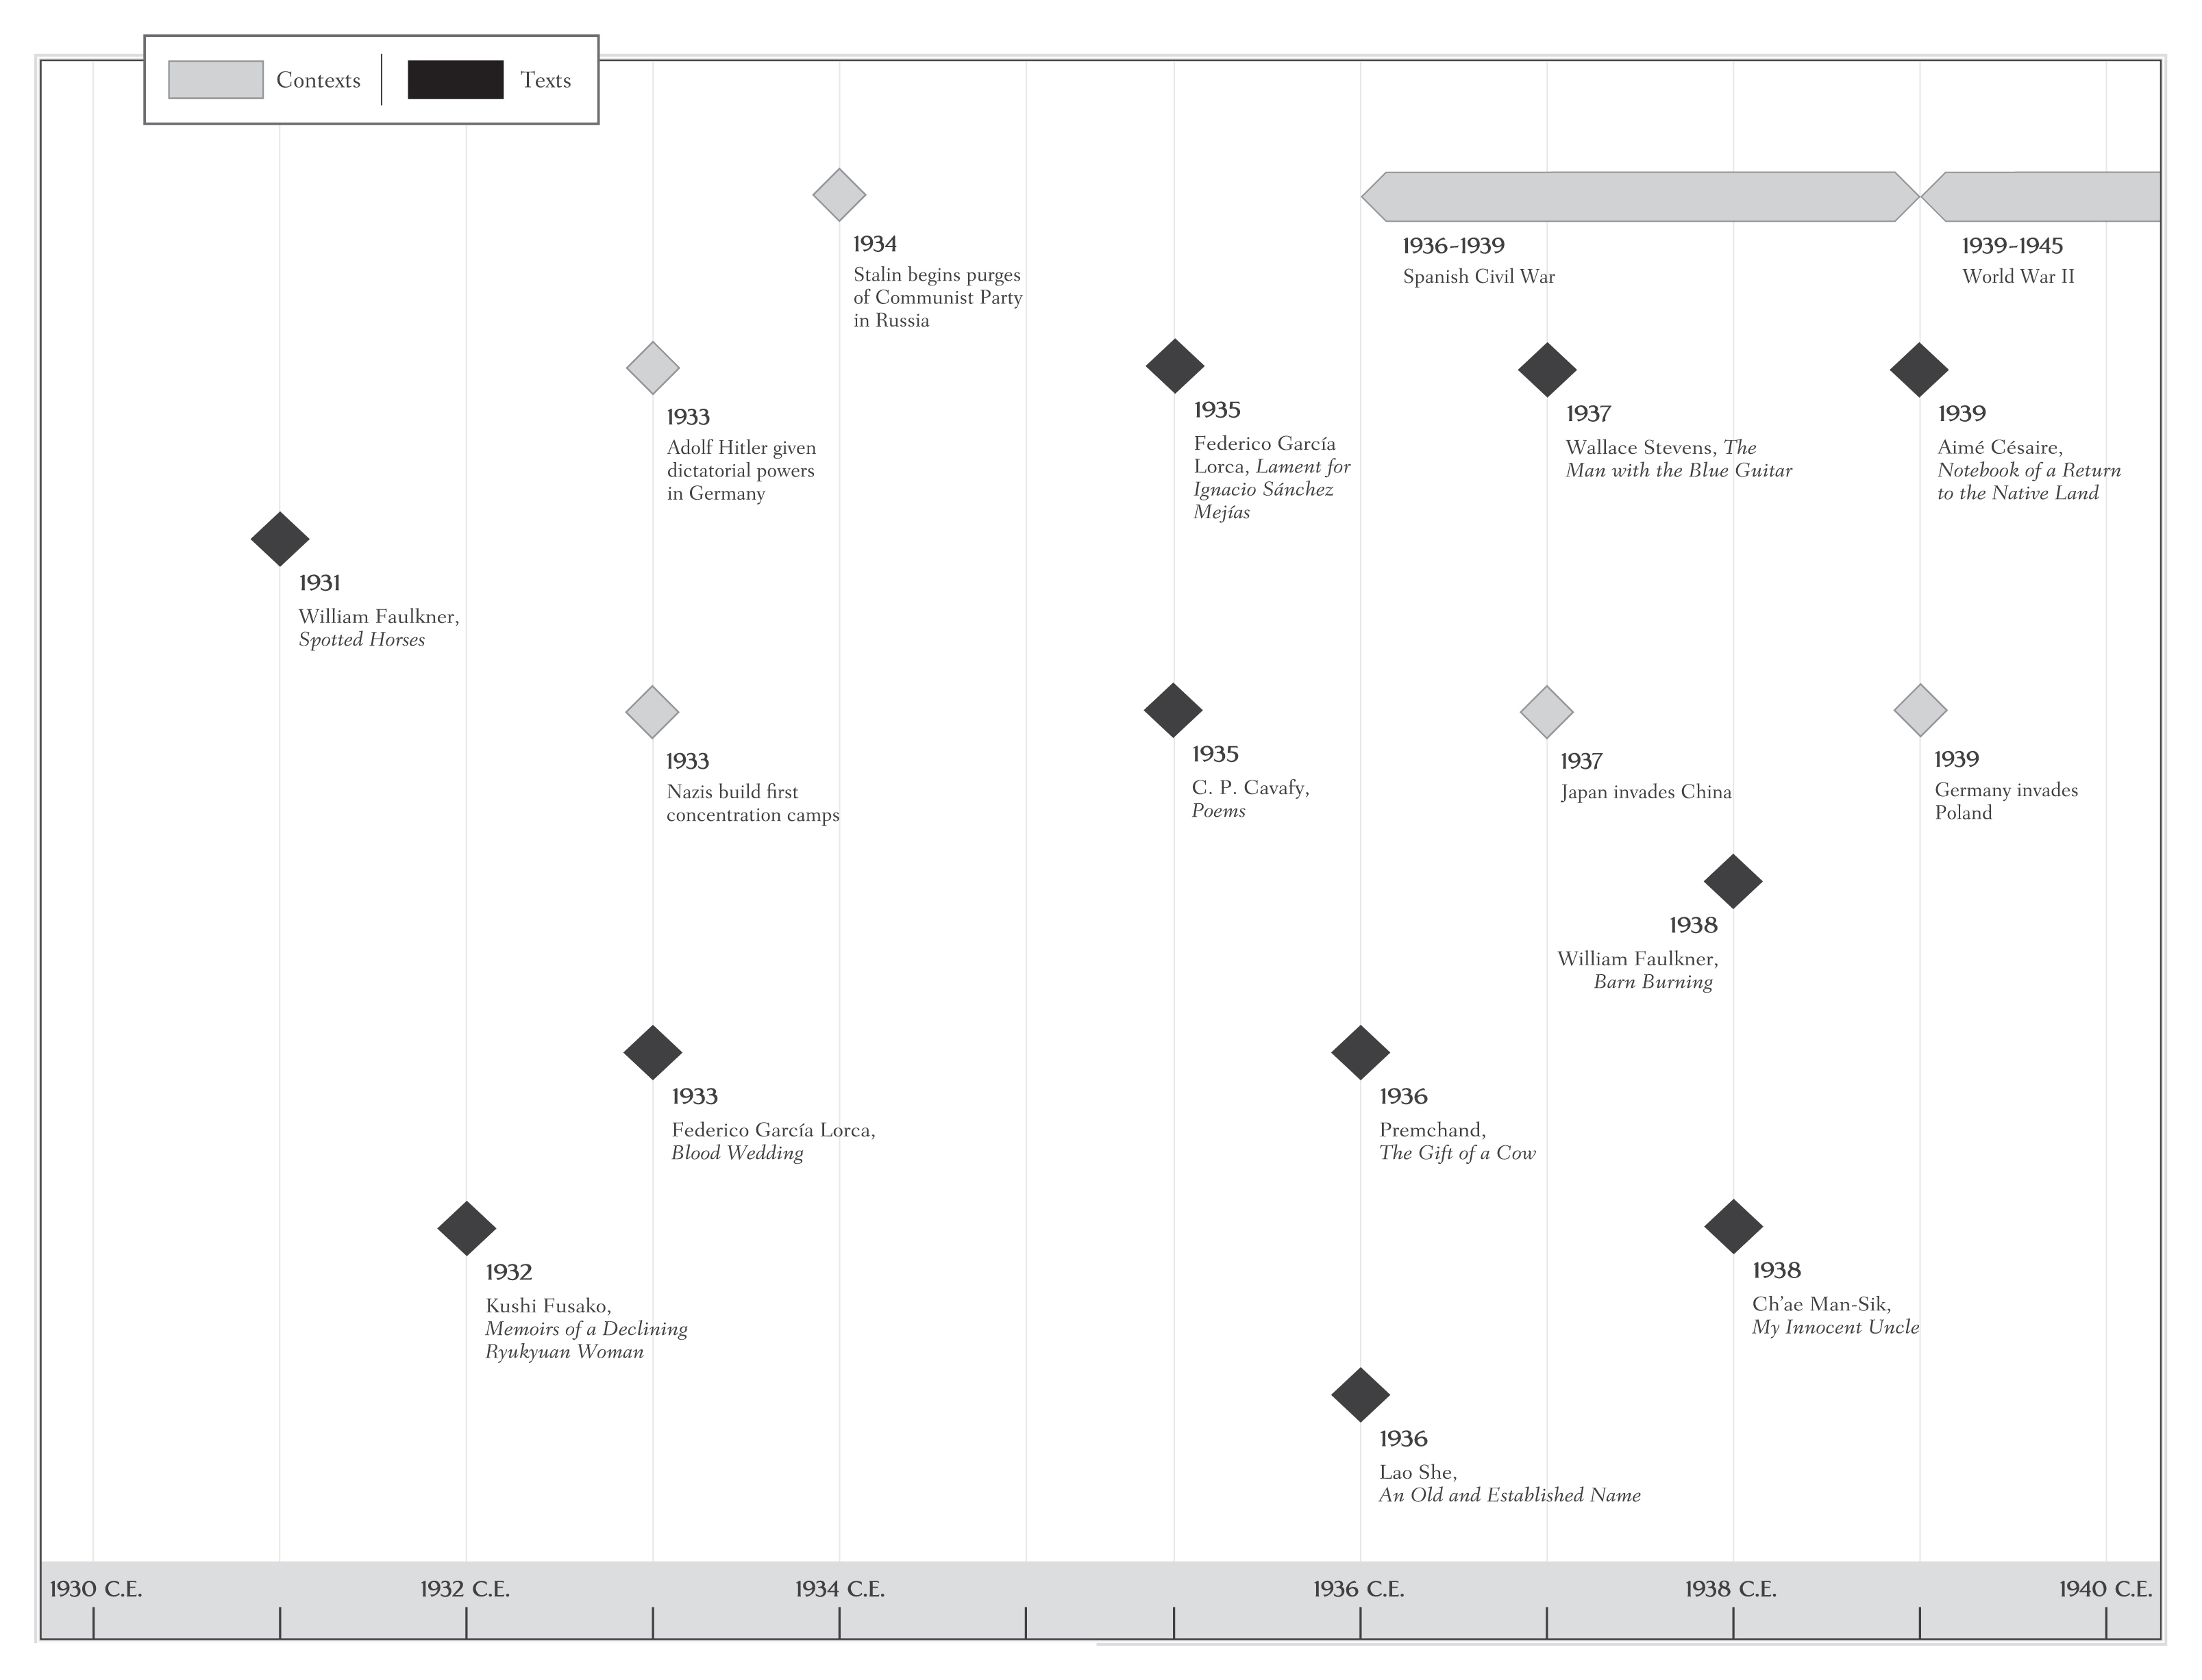

Slide 33
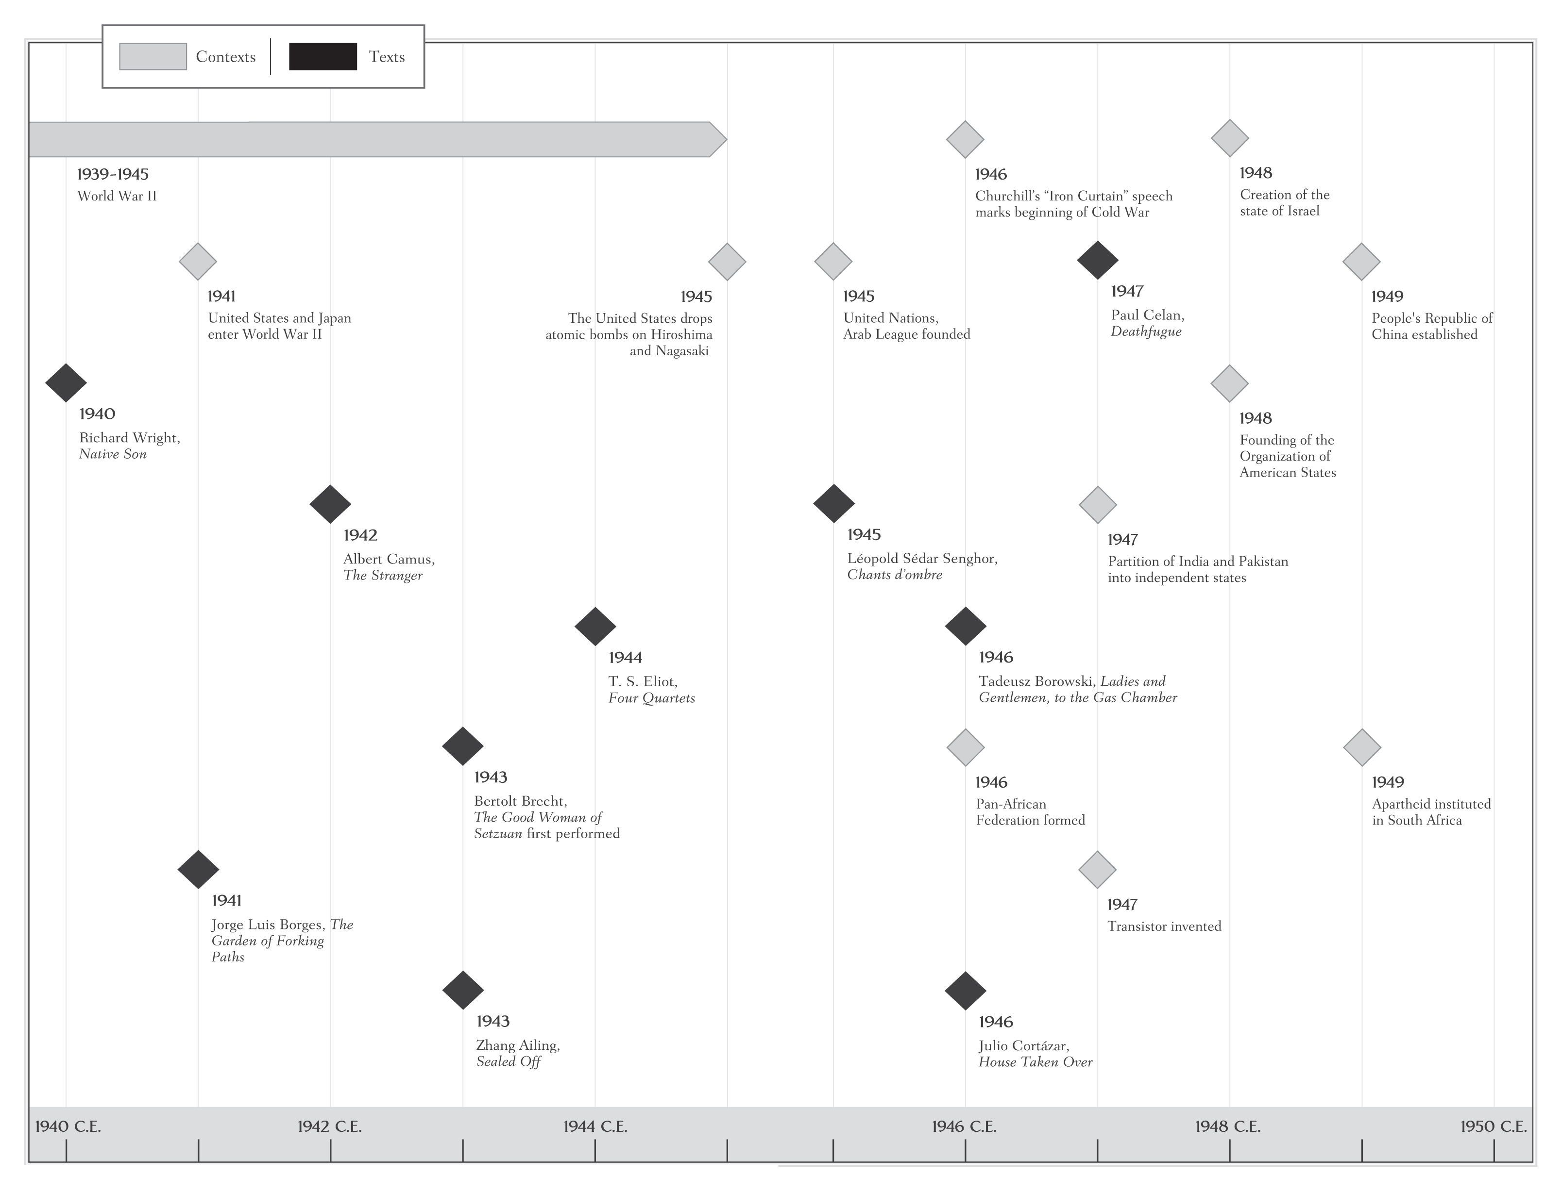

Slide 34
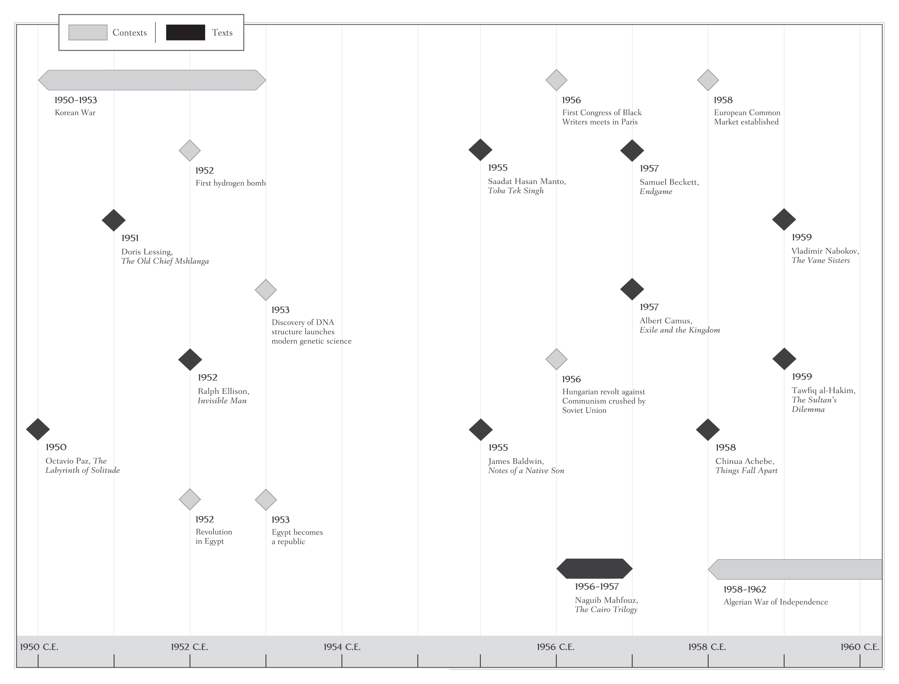

Slide 35
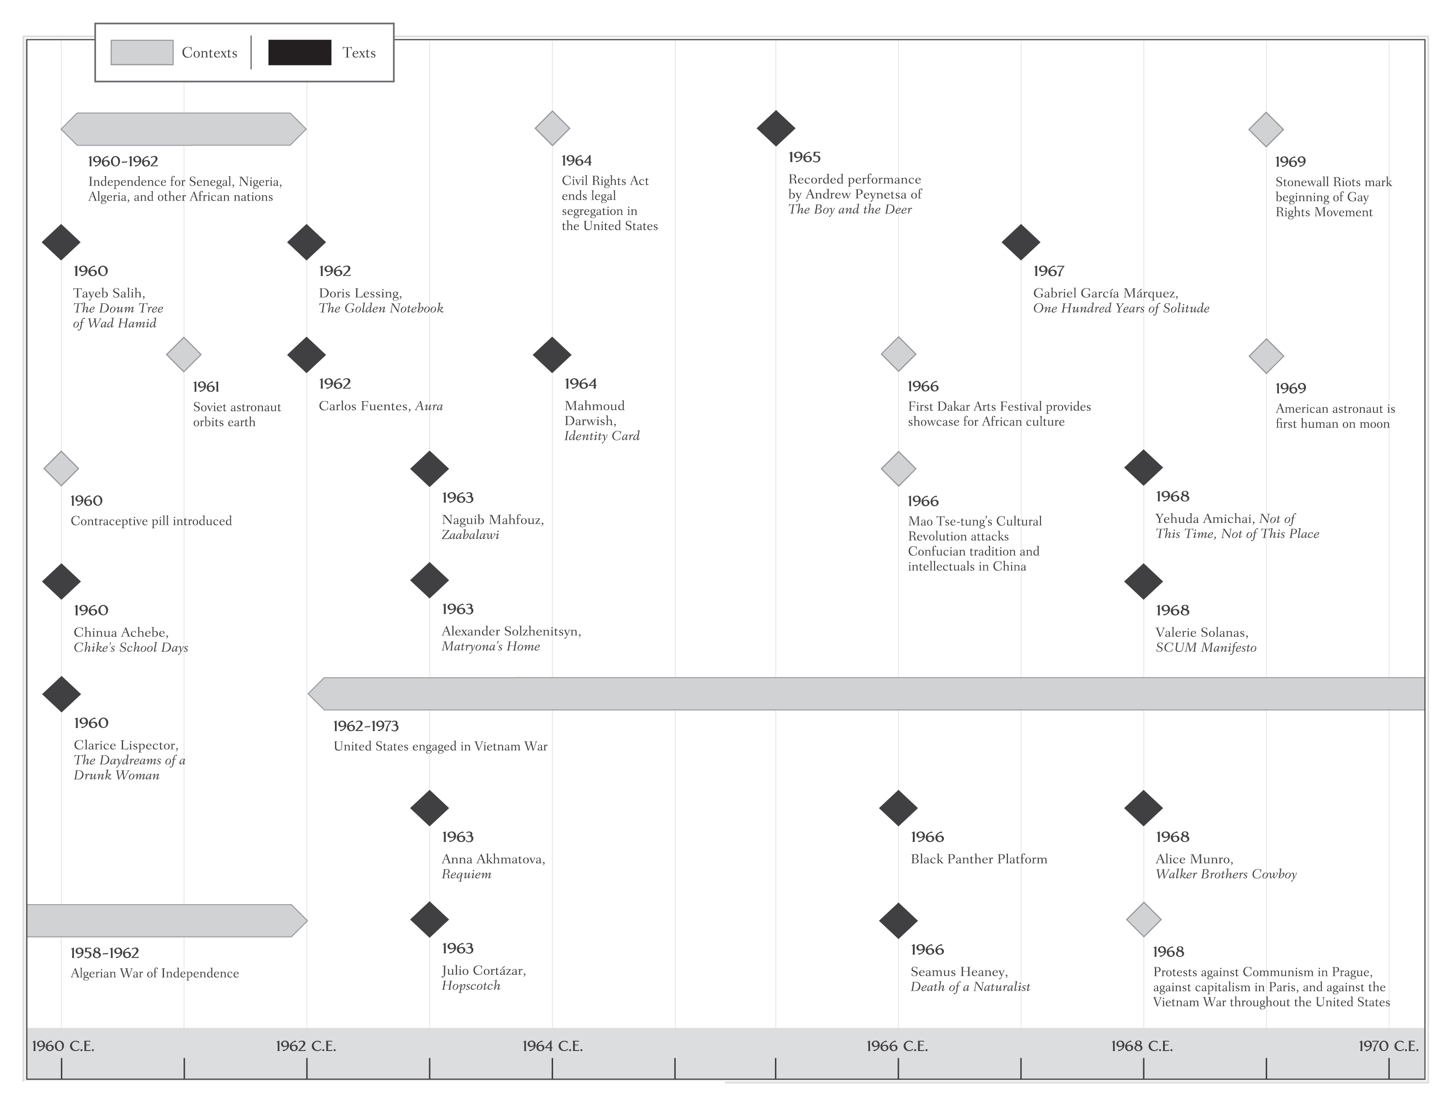

Slide 36
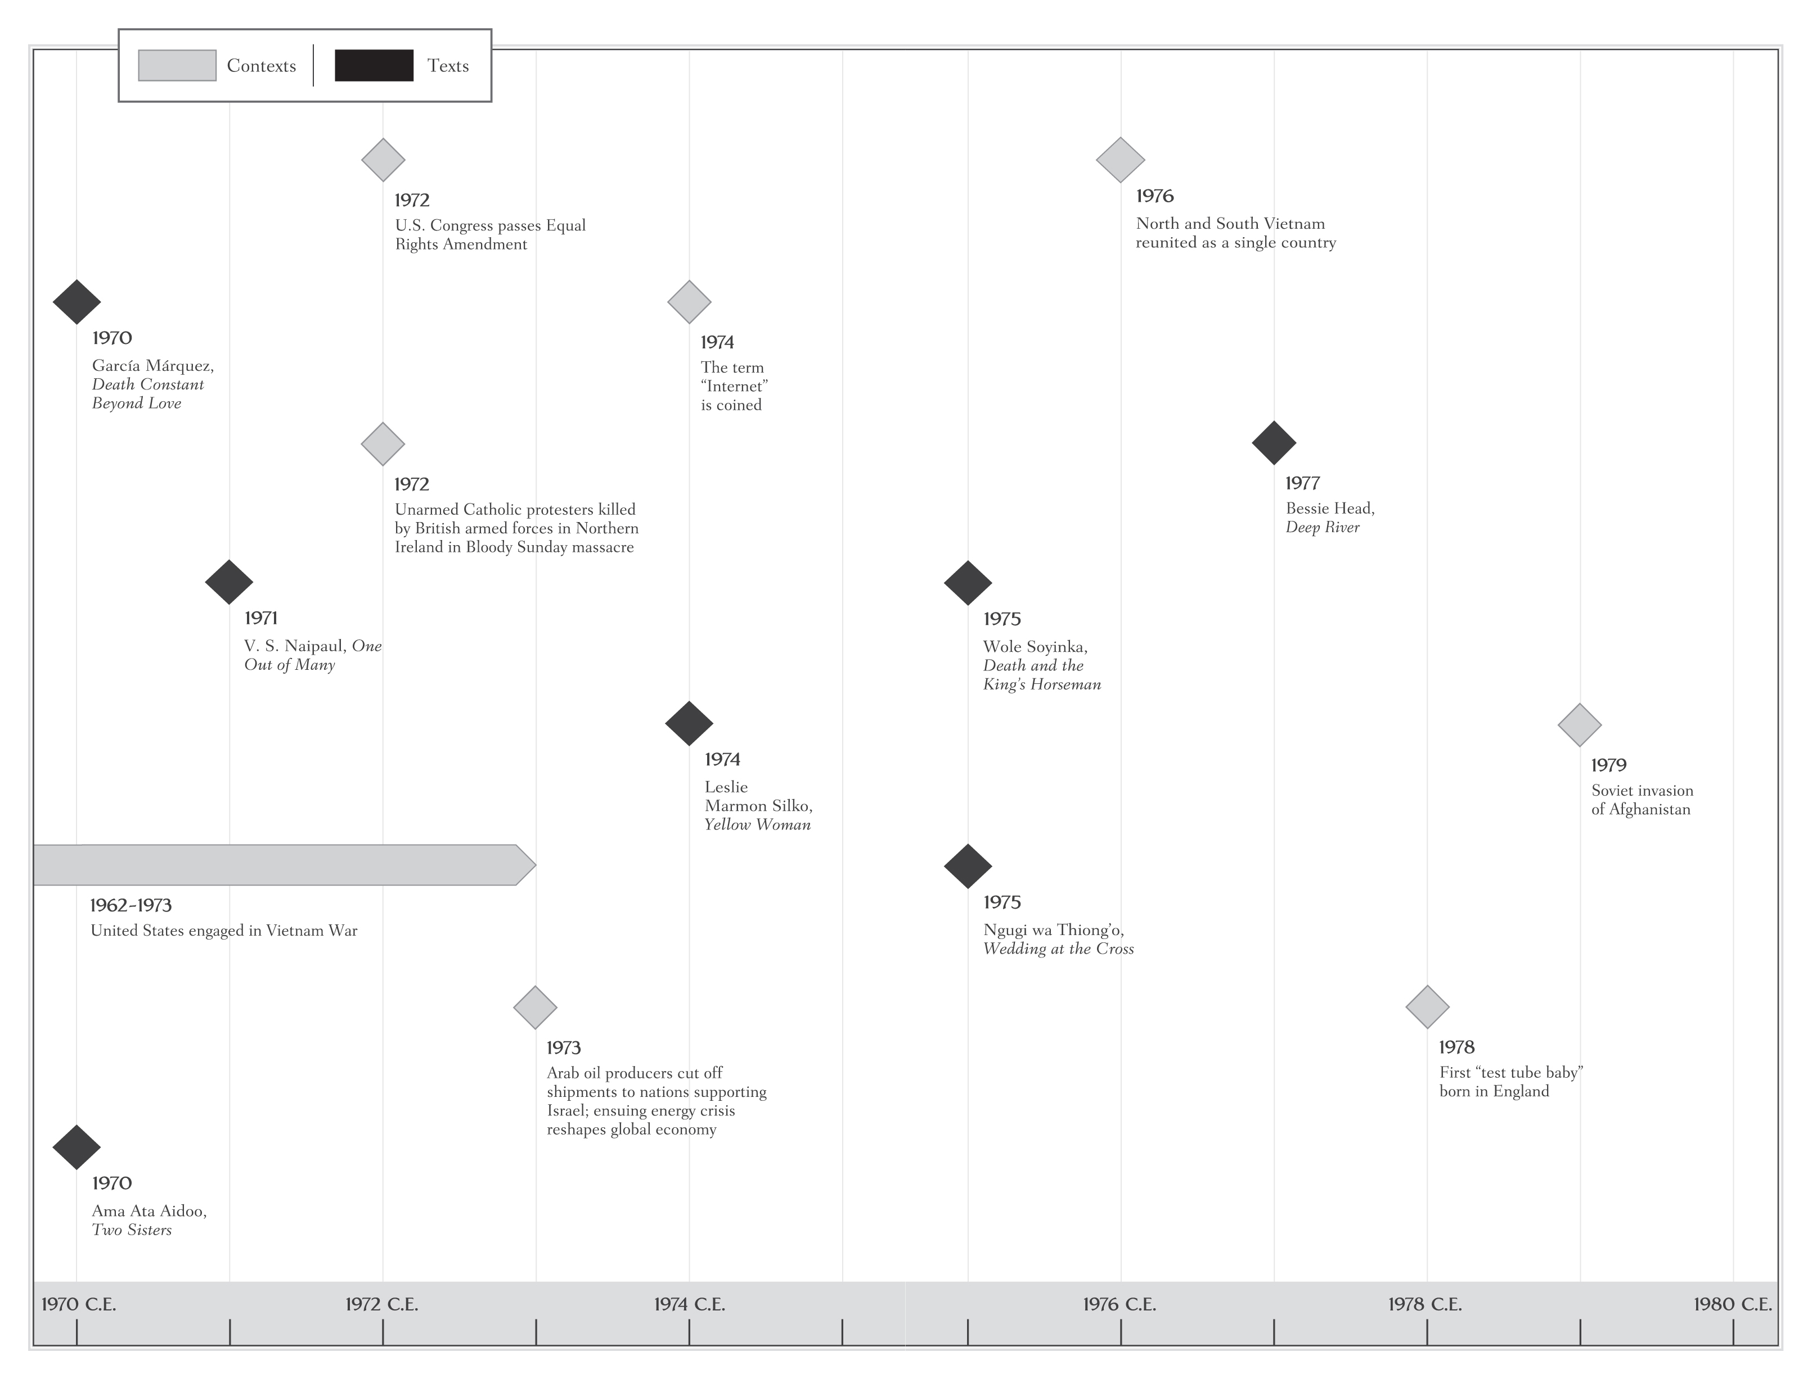

Slide 37
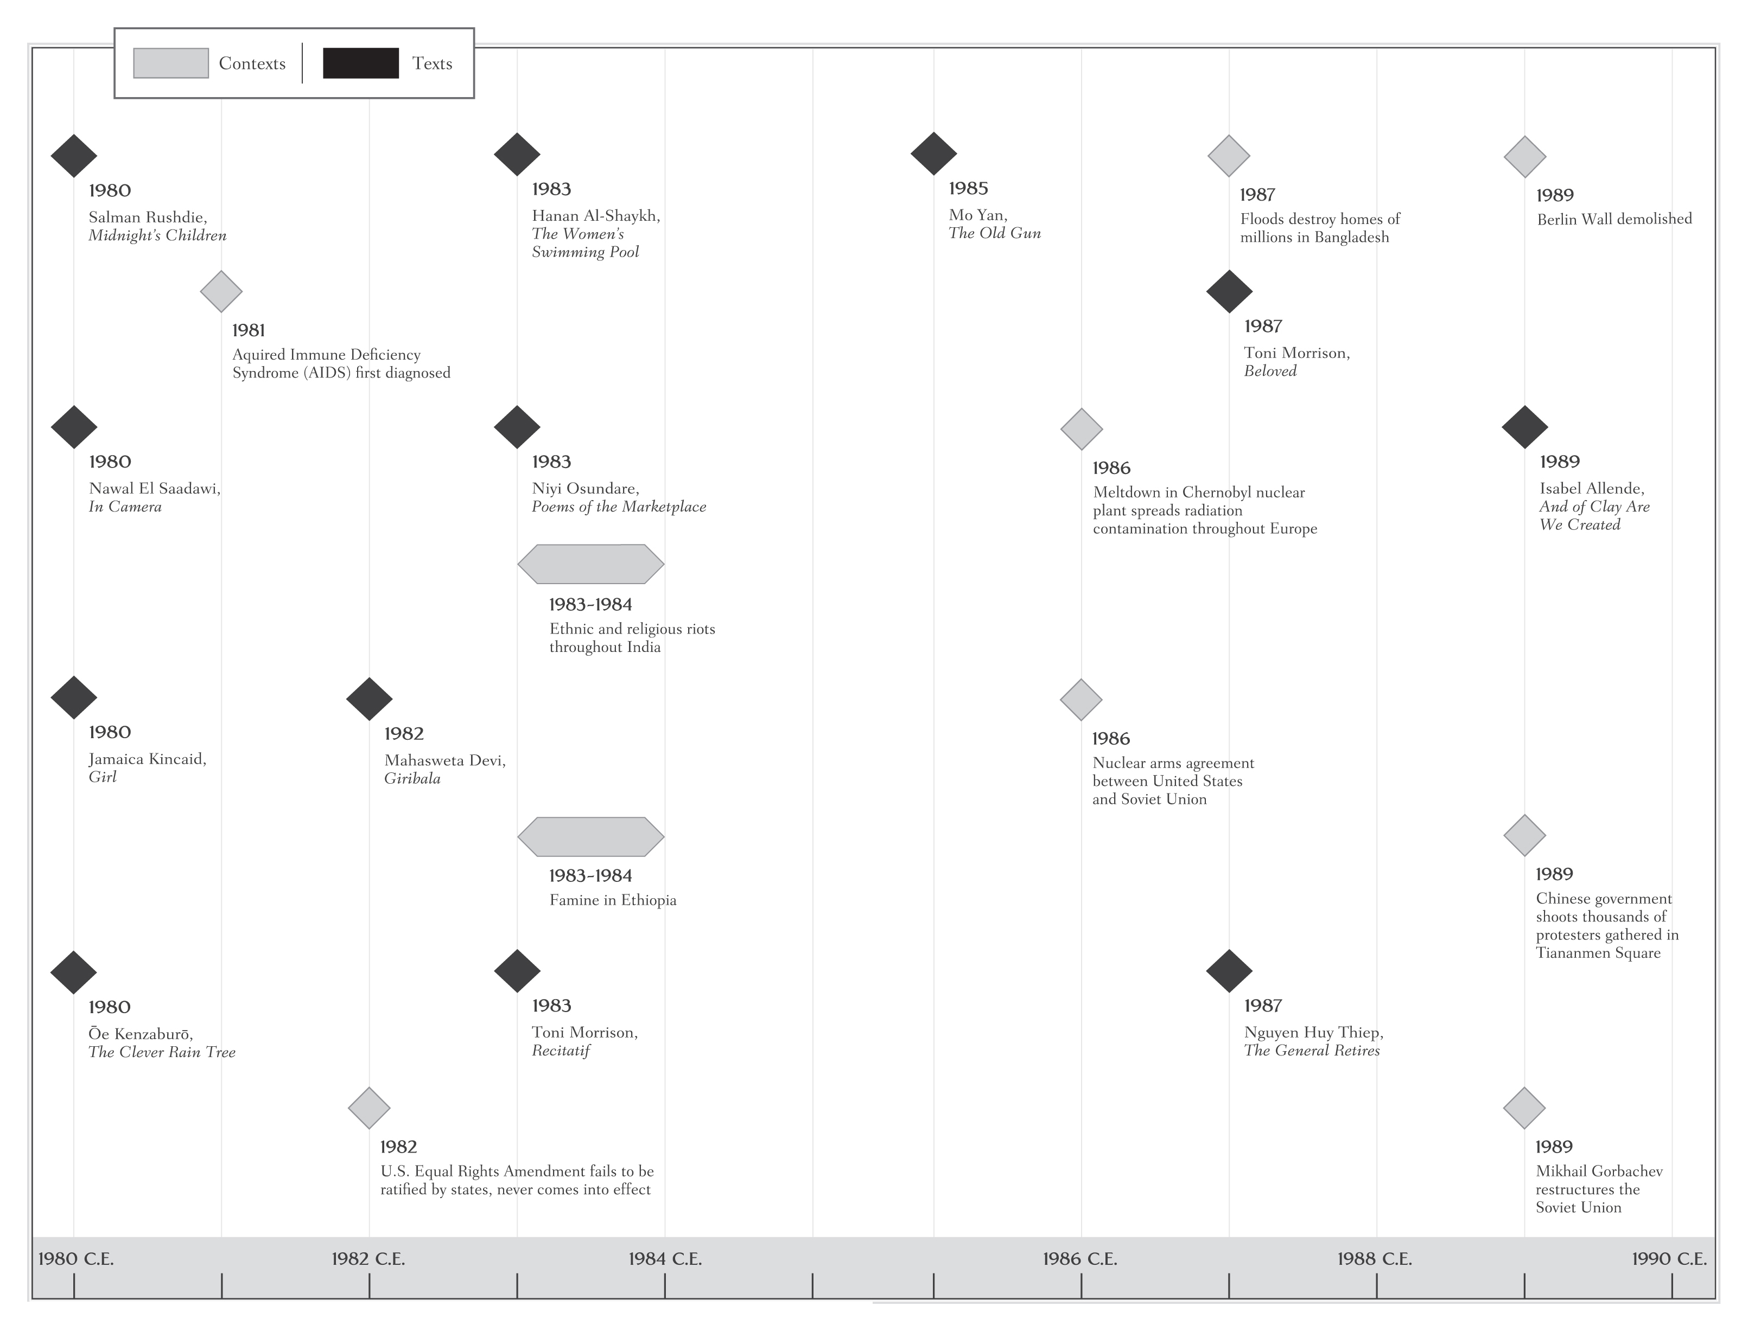

Slide 38
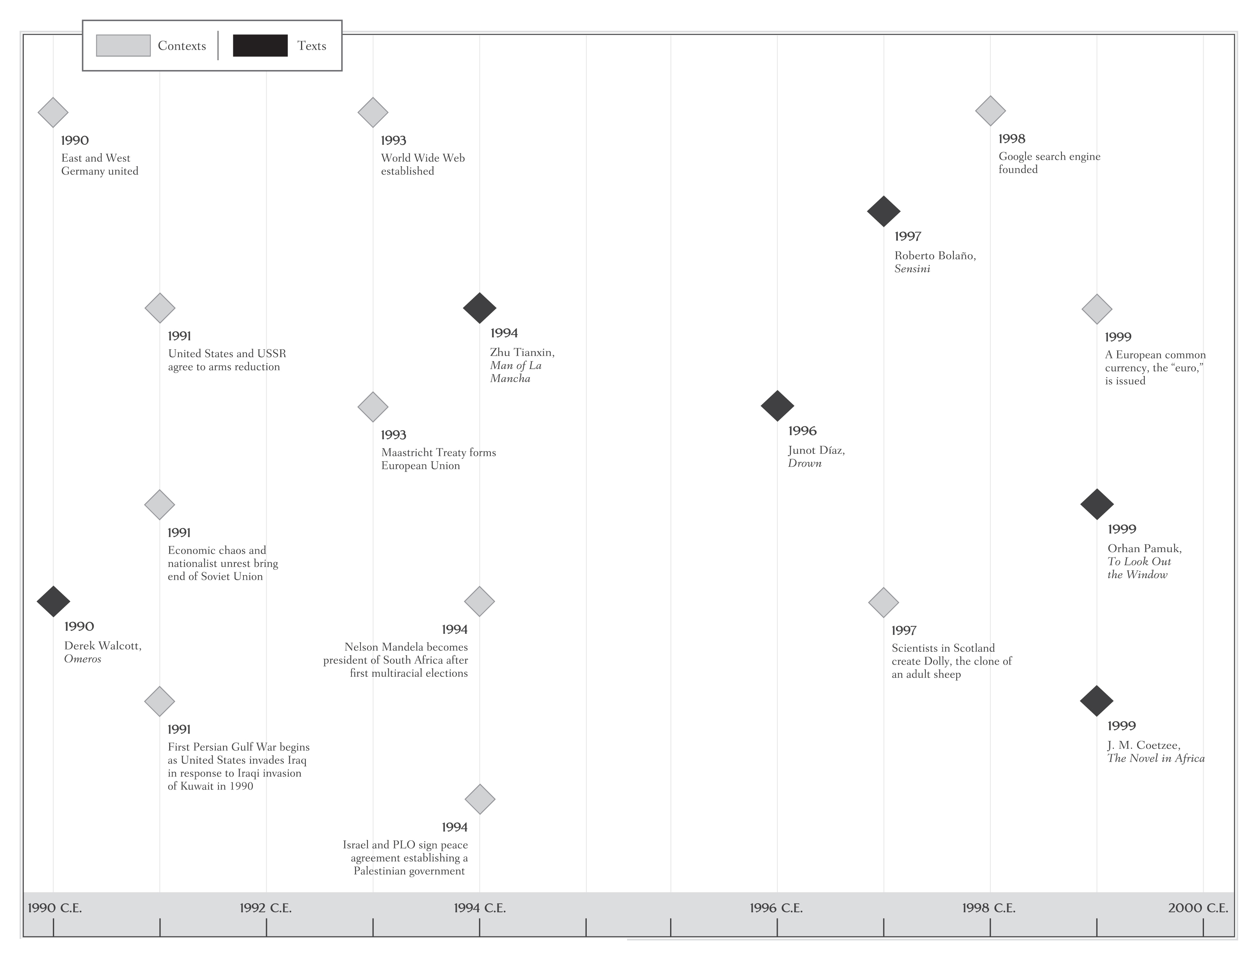

Slide 39
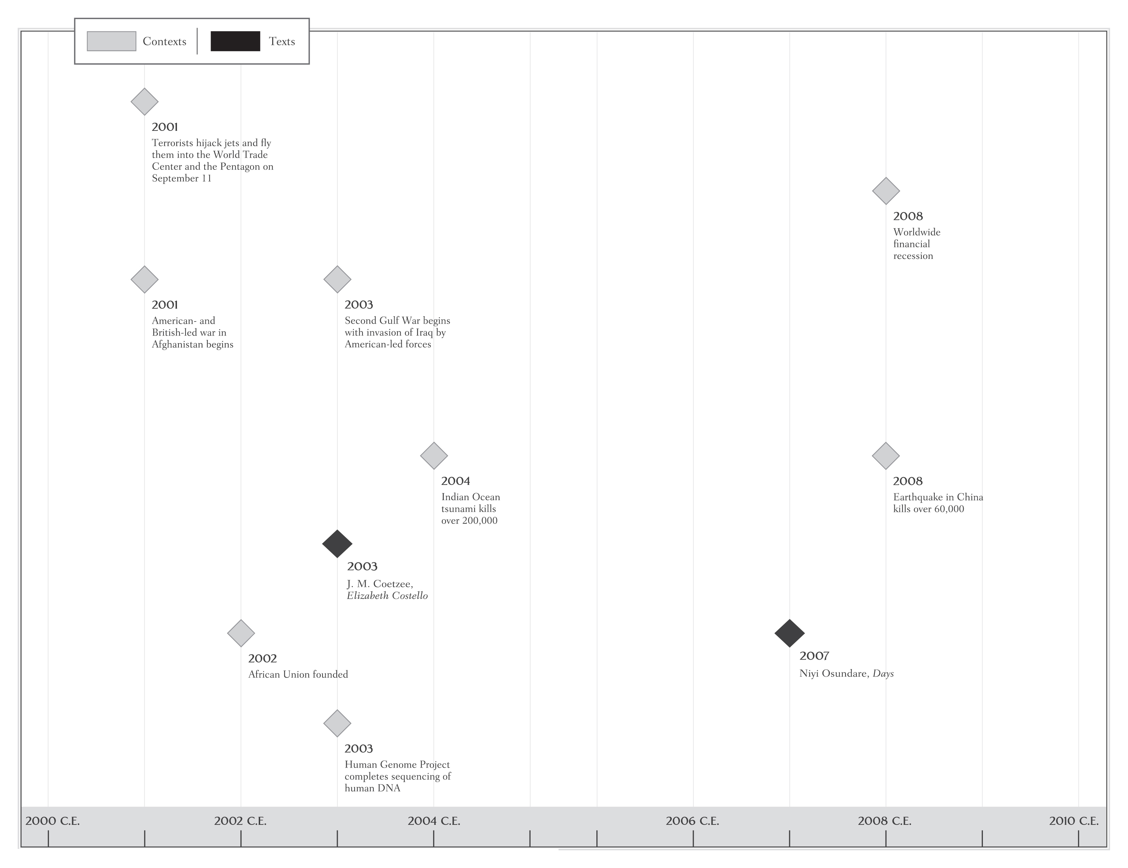

Slide 40
This concludes the PowerPoint presentation for Volume F

