Slide 1
PRONOUNS
Pronouns take the place of a noun or another pronoun.
The words replaced are called ANTECEDENTS

Slide 2
Communication without Pronouns
Anthony and Mary Ellen had to find Anthony and Mary Ellen’s books and Anthony and Mary Ellen’s backpacks before Anthony and Mary Ellen could go in Anthony and Mary Ellen’s car to Anthony and Mary Ellen’s grandmother’s house.
Can you simplify this awkward sentence?

Slide 3
COMMUNICATION WITH PRONOUNS
Anthony and Mary Ellen had to find their books and backpacks before they could go in their car to their grandmother's house.
In the examples above, Anthony and Mary Ellen are the plural antecedents of all the pronouns.

Slide 4
PRONOUN CASES Textbook – pg 476
SINGULAR PLURAL
PERSON SUBJECT OBJECT POSSESSIVE SUBJECT OBJECT POSSESSIVE
First I me my, mine we us our, ours
Second you you your, yours you you your, yours
Third he him his they them their, theirs
she her her, hers they them their, theirs
it it its they them their, theirs
Also third person: one, a person, a classmate, a friend, etc.

Slide 5
Subject Pronouns
As Subjects:
The following pronouns are used as the subjects of sentences.
I, you, he, she, it, we, they, and who
Examples:
In September, (we, us) are going on a cruise to Mexico.
John and (they, them) drove to Tampa.

Slide 6
Object Pronouns
As Objects:
The following pronouns are used as direct objects. (A direct object follows an action verb and receives the action of that verb.)
me, you, him, her, it, us, them and whom
Examples:
Mr. Smith fired (I, me).
The teacher chose (he, him).

Slide 7
Subject or Object Pronoun?
Problems in choosing the correct form of the pronoun usually arise when the subject or object is compound.
You can make sure the pronoun is correct by taking out “and/or”and trying each part of the subject alone with the verb.

Slide 8
Subject or Object Pronoun?
Examples:
Mary and (I, me) left the house.
Make separate sentences:
Mary left the house.
I left the house.
Solution:
Mary and I left the house.

Slide 9
Subject or Object Pronoun?
Example:
The teacher gave the test to Ann and (I, me).
Make separate sentences:
The teacher gave the test to Ann.
The teacher gave the test to me.
Solution:
The teacher gave the test to Ann and me.

Slide 10
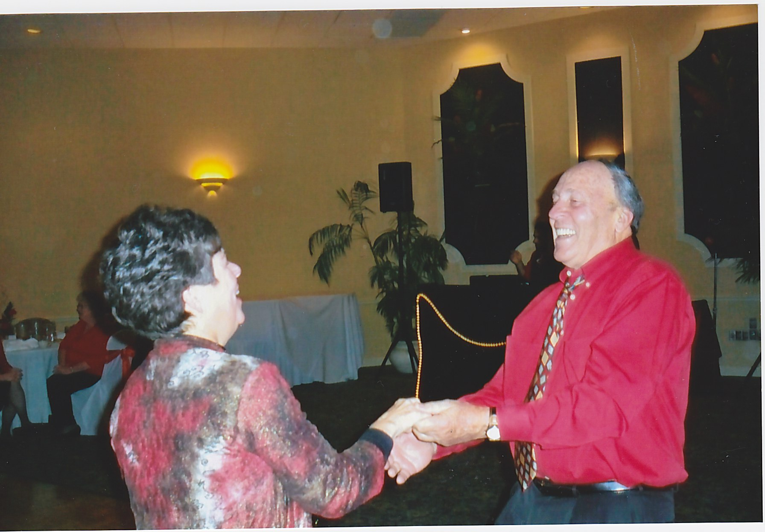

Slide 11
REFLEXIVE PRONOUNS
A reflexive pronoun indicates that someone performed an action himself or herself.
Example:
We, ourselves, felt sorry for the contestants.
He did the typing himself.

Slide 12
REFLEXIVE PRONOUNS
Do not use a reflexive pronoun as the subject of a sentence.
Example: Incorrect
Joe and myself love to fish.
Example: Correction
Joe and I love to fish.

Slide 13
Comparisons using like or as
Subject pronouns are often used in comparisons expressed by the word than or as in an abbreviated sentence.
To find the correct pronoun, supply the omitted words.

Slide 14
Comparisons
Example:
Bobby left earlier than (I, me).
Solution:
Left or did could be added.
I is the correct choice because of the understood word.
Bobby left earlier than I (did).

Slide 15
PRONOUN AGREEMENT
INDEFINITE PRONOUNS
Many indefinite pronouns are in the third person singular:
each, either, neither
Words that end in thing, one, or body
any thing
some one
no body
every

Slide 16
Pronoun Agreement
A few Indefinite pronouns are Plural.
Both, many, few, several, some, all

Slide 17
PRONOUN AGREEMENT
Use third person subject pronoun (singular or plural) to test noun or pronoun in question.
Singular Plural
he, she, it they

Slide 18
PRONOUN AGREEMENT
1. Everyone must take the bus to school and must bring _____ lunch with ______.
Substitute “he” for the singular indefinite pronoun “everyone.”
Answer:
He must take the bus to school and must bring ____ lunch with ____.

Slide 19
PRONOUN AGREEMENT
Examples:
Some want to take ______sound systems with _____.
Substitute “they” for the plural pronoun “some.”
Answer:
They want to take their sound systems with them.

Slide 20
PRONOUN AGREEMENT
Use a subject pronoun after forms of the verb
to be.
is, am, are, was, were, be, being, been
Example:
It was she who won the gold medal.
It may have been they who stole the coin.

Slide 21
