Slide 1
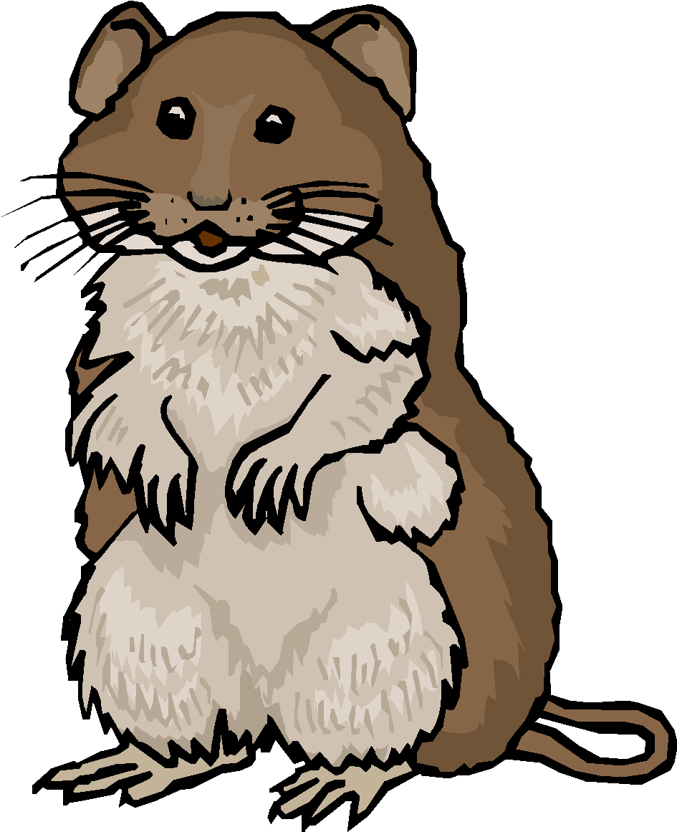
Prepositions
The mouse in the house

Slide 2
FUNCTION
1. Relate a noun or a pronoun to the rest of the sentence.
In the river under the table
To grandmother’s house at the gym

Slide 3
2. Show Spatial Relations
(Show how an object in space relates to something else)
Over my head under the table
Near the dock beside the desk

Slide 4
HINT: Think of places a mouse can go:
In a mouse hole
Under a table
Over the rug
Among the mops
Under the flower
Down the tunnel
Up my leg

Slide 5
Indicate time:
Before class during class
After class between classes

Slide 6
Hint:
Prepositions are short words
Into over above beyond under down of below
behind during at around
Common Ones – Page 136 in your text book

Slide 7
Prepositions are used in phrases with other related words.
Phrases start with a preposition and end with a noun or pronoun.

Slide 8
You can find the end of a prepositional phrase by remembering that every preposition asks a question.
Around what? Around the block.
Through what? Through the fog.

Slide 9
Watch out for INFINITIVE PHRASES
They look like prepositional phrases because they always start with “to.” However, the next word is a verb… not a noun or pronoun.

Slide 10
Examples:
To + Verb to + verb
To speak to walk

Slide 11
SUBJECTS AND VERBS ARE NEVER EVER FOUND IN PREPOSITIONAL PHRASES.

Slide 12
Practice with Prepositions
Valencia Website
-Current Students
-Under tutoring and academic Help
Pick Reading and Writing
West Campus
Communications Center
English
Prepositions
Do three exercises

Slide 13
Practice on Prep Phrases & Subject/Verb Identification
Internet:
-Valencia Website
-Current Students
-Under tutoring and academic Help
Pick Reading and Writing
West Campus
Communications Center
English
Verb Form and Subject/Verb Agreement
Exercises 2-7

