Slide 1
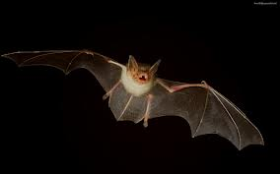
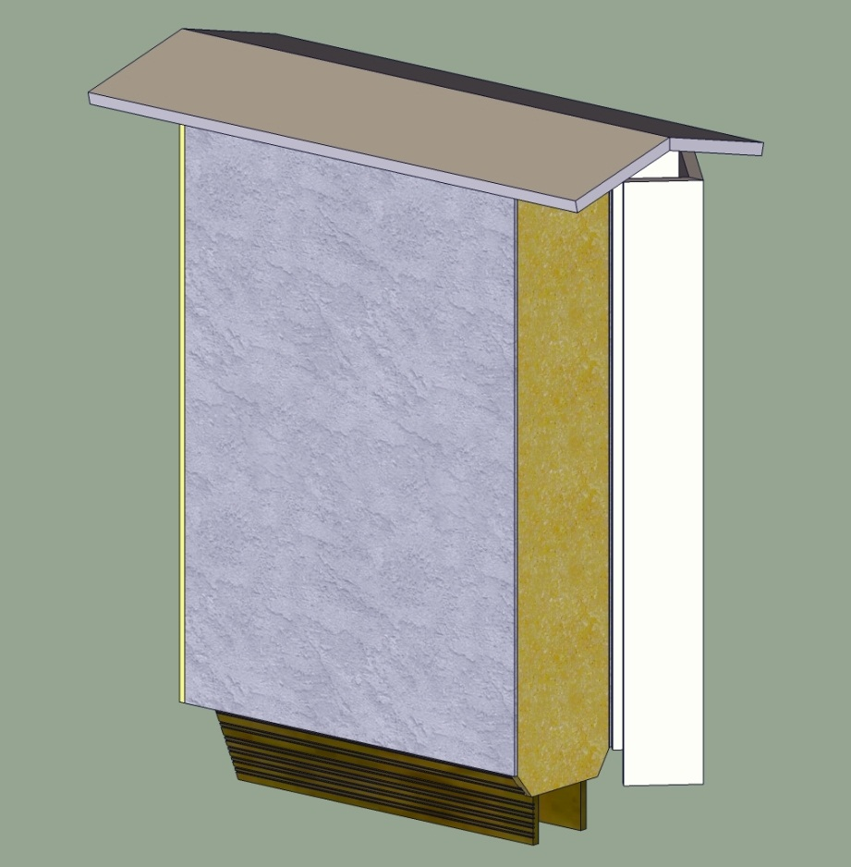
Valencia Bat House Project
Solar Powered Bats!
Notes:
The picture on the right is an early CAD drawing of the Bat House by Andy Ray.

Slide 2
Overview
Bat house is on-going project
Interdisciplinary –
Supported by College Sustainability Committee
Computer Programming (me)
Building Construction (Andy Ray)
Biology (Dr. Brenda Schumpert)
Now EET? (you?)
Vision is build, automate, erect, collect data, study bat habits.
Now able to use solar power for instruments/computers.
Notes:
This PowerPoint is available at:
http://frontdoor.valenciacollege.edu/materials.cfm?uid=GREED9

Slide 3
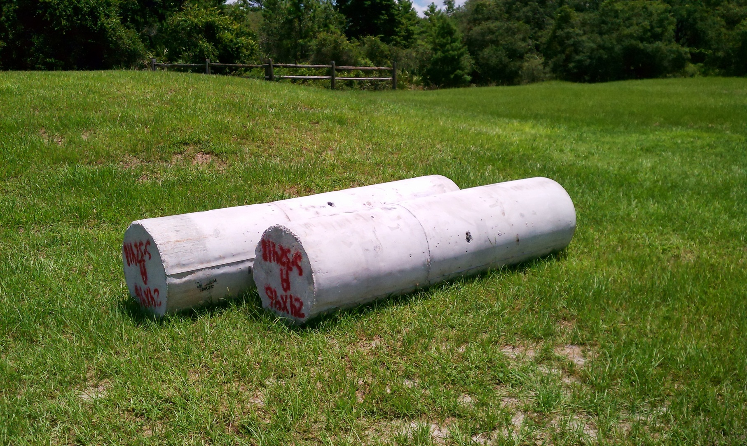
Location
Notes:
These are the concrete footers to hold the bat house upright on two surplus light poles. They are nine feet long, and two feet in diameter, and weight just under two tons each.
You can see them out across Lake Pamela on the Kirkman Road side, if you look out from the back of the library, cafeteria or student lounge.
Here are the poles (we only need two):

Slide 4
Need for Power
Bat house will have the following sensors and systems:
Entrance/Exit detectors (photoelectric)
Temperature sensors (thermistors)
Light sensors
Webcam with IR illuminator
Data acquisition computer (Raspberry Pi) with WiFi link to campus
All this needs electricity – meaning solar.
Notes:
I provided FES with a spreadsheet containing some rough power estimates.
It’s copied here:
http://frontdoor.valenciacollege.edu/materials.cfm?uid=GREED9
All these are somewhat speculative, of course. One possible advantage to the bat house application is that almost all of the power is needed at night, when bats are active, and relatively little power need be consumed during the day when the battery is charging from the solar panels.
The primary daytime load would be the computer and the wifi link.

Slide 5
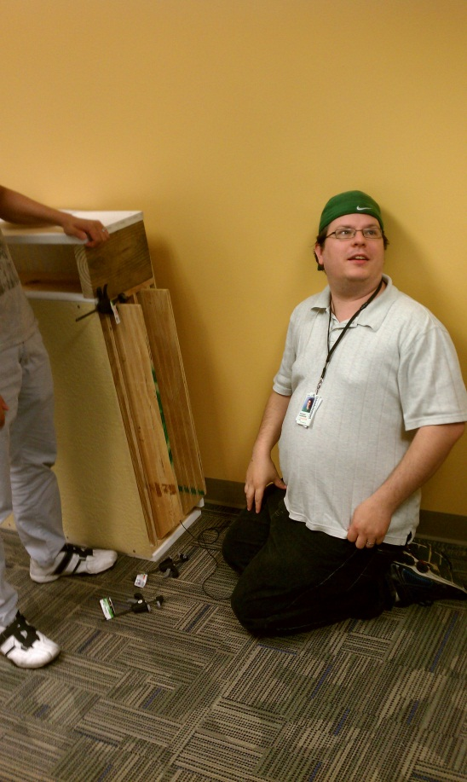
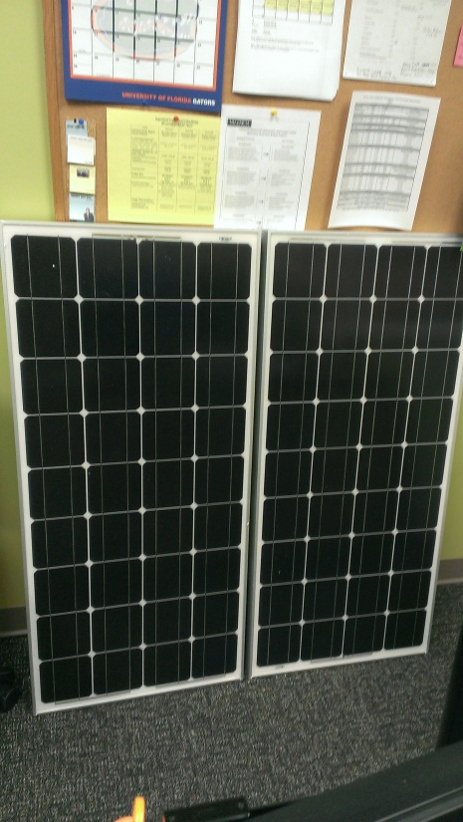
Here’s what we’ve got
One Bat House + poles
Two 100 Watt Solar panels
One 100 Amp Hour battery
One charge controller
Microcontrollers (Pi, LaunchPad, Arduino)
Prototype software (Arduino-based)
Details on next slide…
Notes:
The leftmost picture shows Michael hooking up some sensor for a test of the data acquisition software developed by the Spring, 2013 Physical Computing class. The bat house is laying on its side, with the openings where the bats will come and go facing Michael.
The solar panels are shown in the rightmost picture.
All this stuff is located in the Information Technology lab space in Building 7.

Slide 6
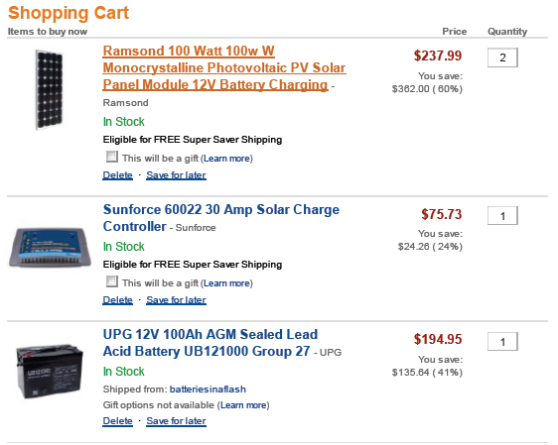
System components
Notes:
Here’s our Amazon shopping cart for the panels, the charge controller and the battery.

Slide 7
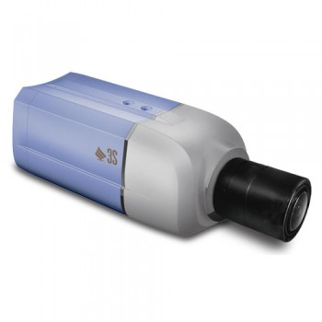
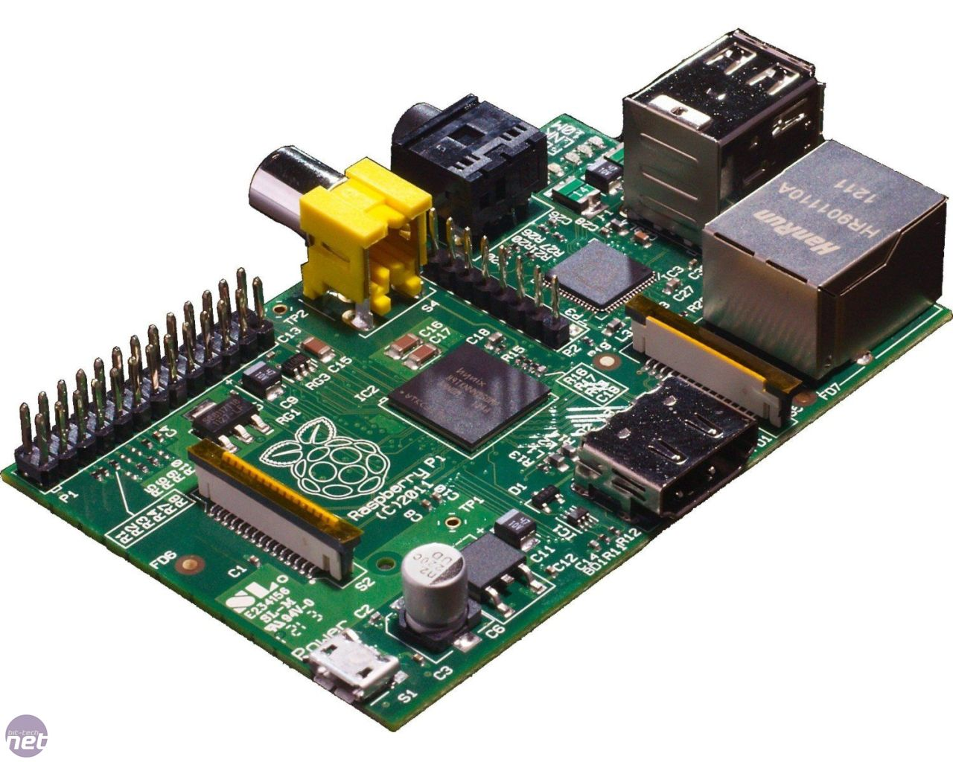
System Components (2)
Notes:
The leftmost picture is a Raspberry Pi.
http://www.raspberrypi.org/
This is a single-board ARM computer running Linux. This will be the primary platform for the data acquisition software and for any housekeeping programs we need. We have a number of these in the IT lab if you are interested in checking them out.
The rightmost picture is the camera.
http://www.supercircuits.com/security-cameras/megapixel-security-cameras/3s-2-megapixel-day-night-box-security-camera-n1072
It’s a “smart” camera, meaning it has built-in network (wired Ethernet) capability, along with the ability to record locally on a micro SD card. Needs an IR illuminator for night-time use, likely.

Slide 8
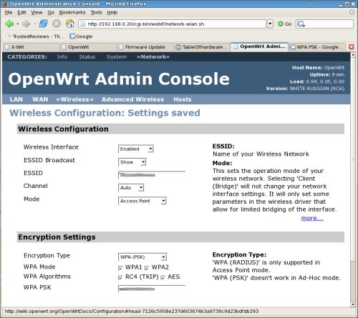
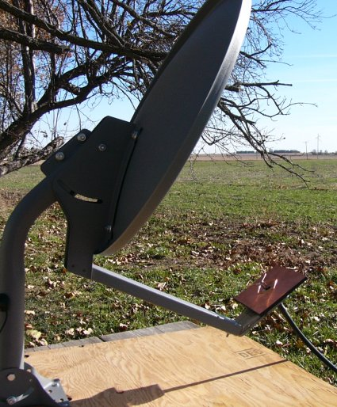
System components (3)
Notes:
The leftmost picture is a screenshot of OpenWrt, an alternative firmware that can be flashed onto many inexpensive routers, enabling them to become Ethernet to WiFi bridges, for instance.
https://openwrt.org/
The rightmost picture is a home-made, long-range WiFi antenna:
http://www.engadget.com/2005/11/15/how-to-build-a-wifi-biquad-dish-antenna/
It employs a surplus small-aperture DBS satellite dish, fed with a home-made BiQuad antenna. Something like this would definitely get our WiFi signal across Lake Pamela!

Slide 9
Here’s what we need
Your expertise:
How to mount the panels (angles, etc.)
Wiring among panels, charge controller, battery
A “power budget” – how much juice can we get regularly?
System monitoring – alarms, stats, etc. re charge and battery condition.
WiFi connectivity back to campus
Your sweat:
Mount the panels, house the battery, wire the system
Your suggestions and creative ideas…
What you get:
Concrete accomplishments, something you can point to and put on your resume
Our eternal gratitude. ☺

Slide 10
Contact Info
Jerry Reed, Associate Faculty, Computer Programming and Analysis (and Office of Information Technology)
407 582 5583
greed9@valenciacollege.edu
Building 10, room 202 (cubicles)

