Slide 1
Building Strong Questions
and when to use them

Slide 2
A Crisis of Curiosity
Has your experience in school thus far promoted your curiosity?
Why? Or Why not?
What are you curious about on a day-to-day basis?
How often are you curious?
Children who prefer to explore higher levels of uncertainty ask more questions, are better at identifying information needed to resolve uncertainty, and are more persistent and motivated to understand material. When engaging in similar experiences, highly curious children learn more compared to children who prefer to explore less uncertainty.

Slide 3
People like answers, but questions have more value in writing and learning
A SET OF FACTS
A law is the system of rules that a country or community recognizes as regulating the actions of its members and may enforce by the imposition of penalties.
The human eye can perceive roughly 7,000,000 different colors.
US highways are designed with straight pathways for airplane landing in case of a war on home soil.
A SET OF QUESTIONS
Why does the constitution exist?
How many planets are in the solar system?
How are candles made?

Slide 4
Questions Cultivate Curiosity
How can movies be more accessible?
Do we have to carry so many devices?
Why do we have to wait for pictures to develop?
Is convenience worth the cost?

Slide 5
Let’s ask some questions!

Slide 6
Tips for asking strong questions
Basics
Start with the major six
who
what
when
where
why
how
Try!
Whether or not you know the answer isn’t important right now
Don’t worry
Don’t worry about staying on topic
Write first
Edit later
Stretch
Stretch the limits of your imagination

Slide 7
Try it out!
Take Question 1 of the Questions Quiz

Slide 8
Framing questions based on the type of answers you seek
CLOSED QUESTIONS:
Prompt a “yes” or “no” answer
or a very brief response
Generally, lead a person to one side
OPEN QUESTIONS:
Prompts a longer, story response
Tricky, because they may seem leading. If so, they should be re-written
Allow a clear option for the person to disagree

Slide 9
Open and Closed Questions
“Is gun control effective?”
“Why is gun control effective?”
“Do you believe gun control is effective?”
“What are some of the benefits/drawbacks of gun control?”
Open
Closed
Think about how you would answer the question, and what the question is asking. It’s equally important to focus on the grammatical structure of the question, as it is to focus on someone’s experience of the question.

Slide 10
Try it out!
Take Questions 2-4 of the Questions Quiz

Slide 11
Subcategories of Questions
Binaries
Elicit a yes or no answer (closed)
“Is this your book?” or “Should I call back tomorrow?”
Starters
Answers potentially start a discussion, and tend to be factual
“What do you do for a living?” or “What is our strategy?”
Clarifiers
Help you dig deeper or get more information; typical help explain how something works (factual or metaphor)
“How would you solve this?” or “Why don’t we do it this way?”
Storifiers
Help find out the beliefs, reasons, intentions, attitudes, or behaviors of a person; typical answers are stories
“Why should we solve this?” or “Why is this important?”
Probers
Help explore possibilities and require imagination or creativity
“What would happen if…” or “Have you considered…”

Slide 12
Hypothetical /Rhetorical Questions
What are they?
Questions without intended responses
The answer should be implicitly understood between questioner and audience
When to use them?
Avoid in essays
Easier to use in speeches
Best in conversation
How they affect the writing?
Can make a point
Can introduce a topic
Can distance the reader from the topic
Can cause confusion

Slide 13
Asking responsible questions
Use neutral language
01
“Why is abortion bad for society?”
“How does abortion affect a society?”
Focus on the verbs
02
“How can I get better at math?”
“How can I improve my math scores?”
Review assumptions
03
“Do you like Vietnamese food?”
“Have you eaten Vietnamese food?”

Slide 14
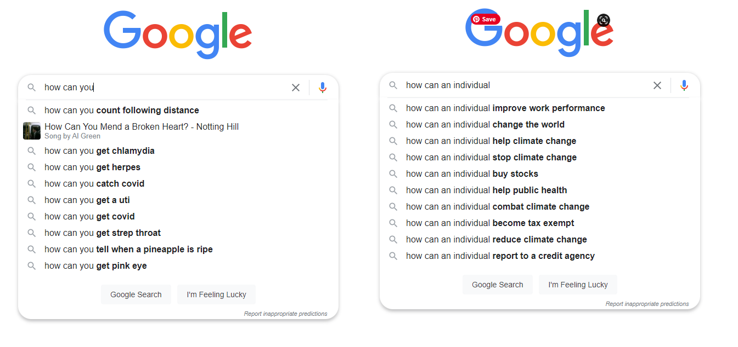
Words matter… sometimes unfortunately

Slide 15
Try it out!
Take Question 5 of the Questions Quiz

Slide 16
Answers have little value in our world
especially when compared to the power of questions

