Slide 1
Flip that Essay
Learning about Revision from House Flippers

Slide 2
Overview & Goals of Today’s Lesson
Understanding Revision
Develop a plan
Test different methods
Revision vs. Editing

Slide 3
Revising stage
ReVision
ReVision
Notes:
The revising stage of making changes to your draft is all [] about revision—where you [] RE + VISION your work, or look at it again with fresh eyes.

Slide 4
What’s the Difference?
EDITING
Small-picture focus
Lower-order issues
Affects individual sentences
REVISION
Big-picture focus
Higher-order issues
Affects the paper as a product
Focus and Development
Grammar and Mechanics

Slide 5
What to focus on…
REVISION
Focus on prompt
Development of claims
(Re)Organization
Style and Tone
EDITING
Punctuation
Word choice
Accurate verbs
Subject-verb agreement
Verb tense consistency
Logical Reasoning
Proofreading
Spelling
Capitalization
Complete Sentences
Fragments
Run Ons
Comma Splices
Clarity of ideas

Slide 6
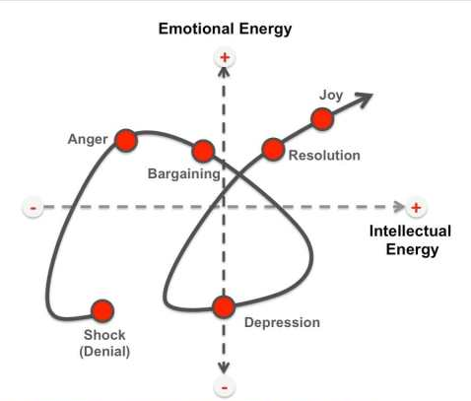
Revision takes time

Slide 7
Learning from people who constantly revise
Limitations
In stock
In style
Available
Goals
Renovate to Rent
Profit
Issues
Damage
Safety
Amenities
Distance

Slide 8
Learning from the best
Priorities
Discoveries
What didn’t change
Compromises

Slide 9
Methods for Revision
Identify Desired Results
Determine acceptable evidence
Create content that fits the plan
COLLAGE
BACKWARDS
HIGHLIGHTER
SCAMPER

Slide 10
Scamper Technique
Substitute
Combine
Adapt
Reverse
Modify
Put to another Use
Eliminate
What would happen if you did something in your essay completely different (while still following the prompt)?
ideas in your essay that just aren't matching up to what the research suggests is true
any ideas you've used in assignments throughout the unit that haven't made it into your essay yet
the organizational pattern, structure, or focus of your essay to get a fresh perspective
your current claims to new purposes. What else do you claims apply to about the generation or product that may be helpful to address?
two existing parts of your essay to produce a more efficient claim, or maybe to utilize a clearer rhetorical pattern for organization
any current claims that are out of your depth for claims that better fit the focus and scope of your research

