Slide 1
Apples and Oranges
“That phrase don’t make no sense, why can’t fruit be compared?!” -Lil Dicky

Slide 2
Basic components of a comparison
Subjects
Points
Position

Slide 3
What makes a successful comparison?
Basis for Comparison
Parallel Points
Common Denominator

Slide 5
Parallel points
Use the whiteboard or chat to suggest a noun/object

Slide 6
Mini Breakout Room Session 3 minutes!!
Using the two objects your group was given, identify as many points for comparison as possible

Slide 7
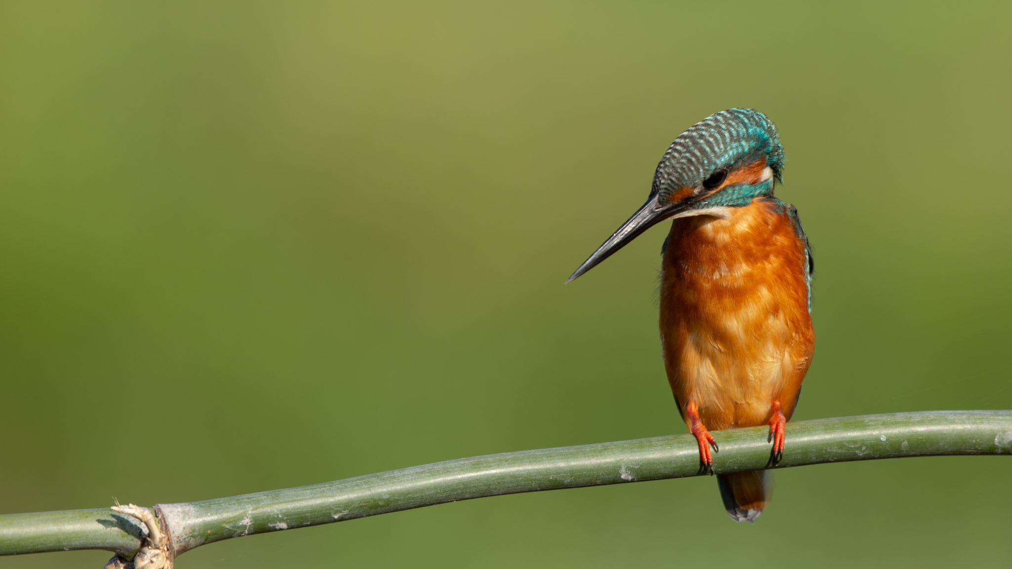
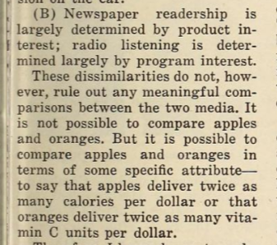
Common denominators making comparisons meaningful

Slide 8
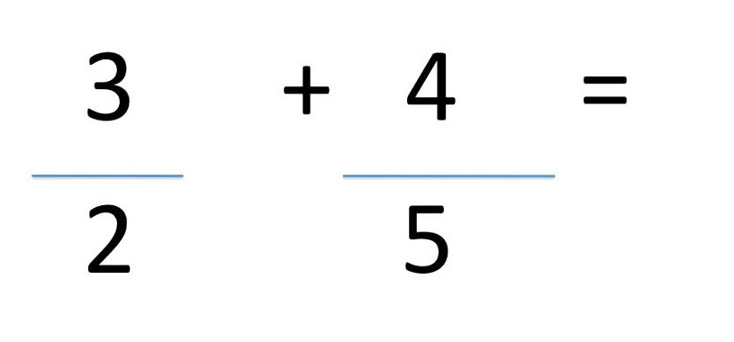
How do I add these fractions?
Common Denominators in Comparison work the same way
✓ Our subjects are similar enough to compare
✓ We know what’s different between them
Our CD is why it matters that they’re different

Slide 9
Essay #2 Comparisons: using your topics
Breakout Room Session: 10 minutes
Select one person’s topic
Identify the subjects and points of comparison
Determine why it matters that they’re different

Slide 10
Report out:
Tell us about your comparison topic and why it matters
Which part was the most difficult to figure out?
Which was the easiest?
Do you have unanswered questions?

