Slide 1
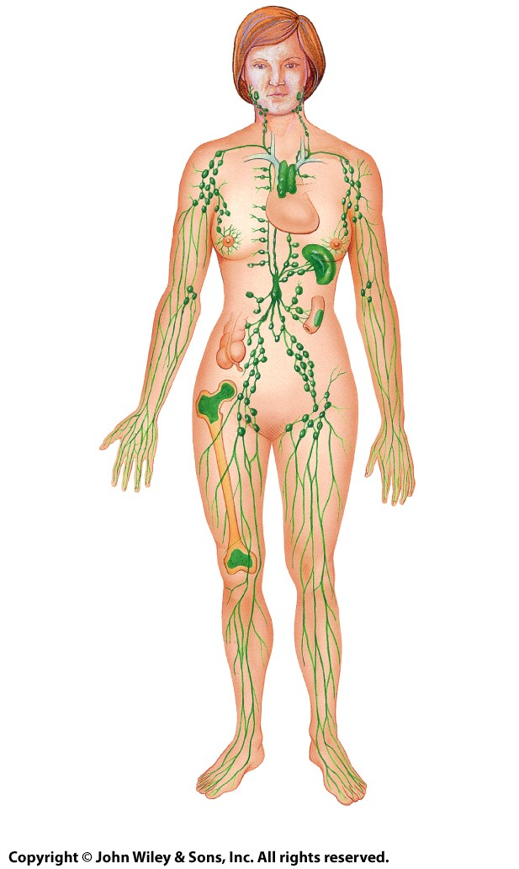
Right internal jugular vein
Right jugular trunk
Right subclavian trunk
Left jugular trunk
1
6
2
Left subclavian vein
3
4
Intestinal and lumber trunks
5
(a) Overview of lymphatic vessels

Slide 2
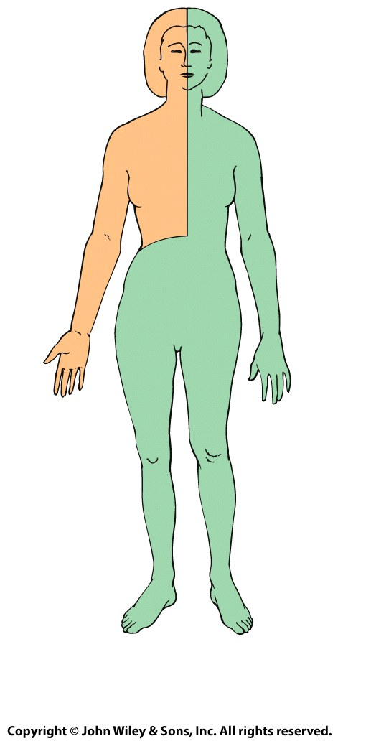
7
8
(b) Lymph drainage

Slide 3
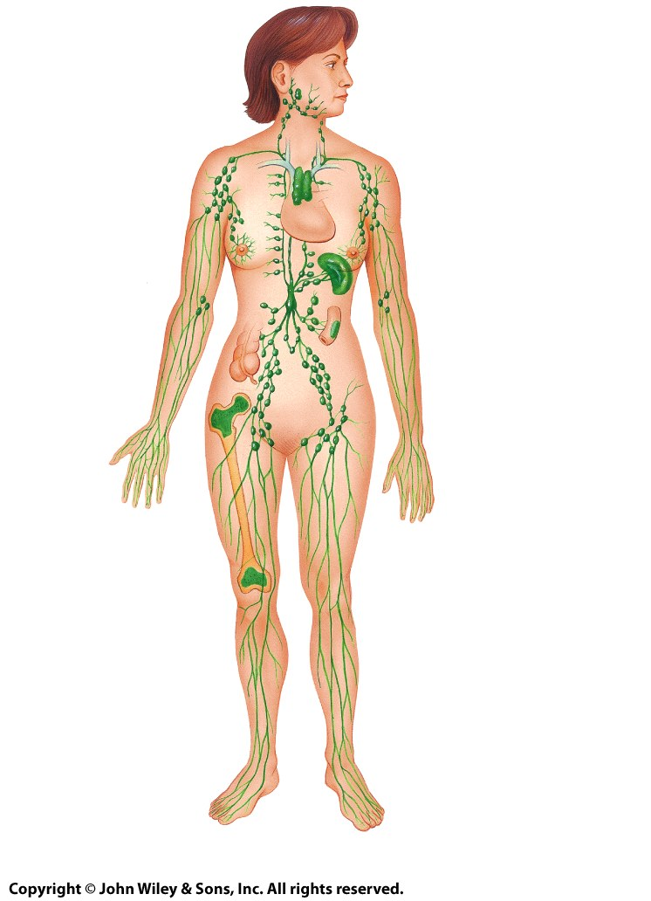
4
5
Left internal jugular vein
Right subclavian vein
Left subclavian vein
6
10
11
12
13
7
Small intestine
Large intestine
14
8
15
16
9
(b) Anterior view

Slide 4
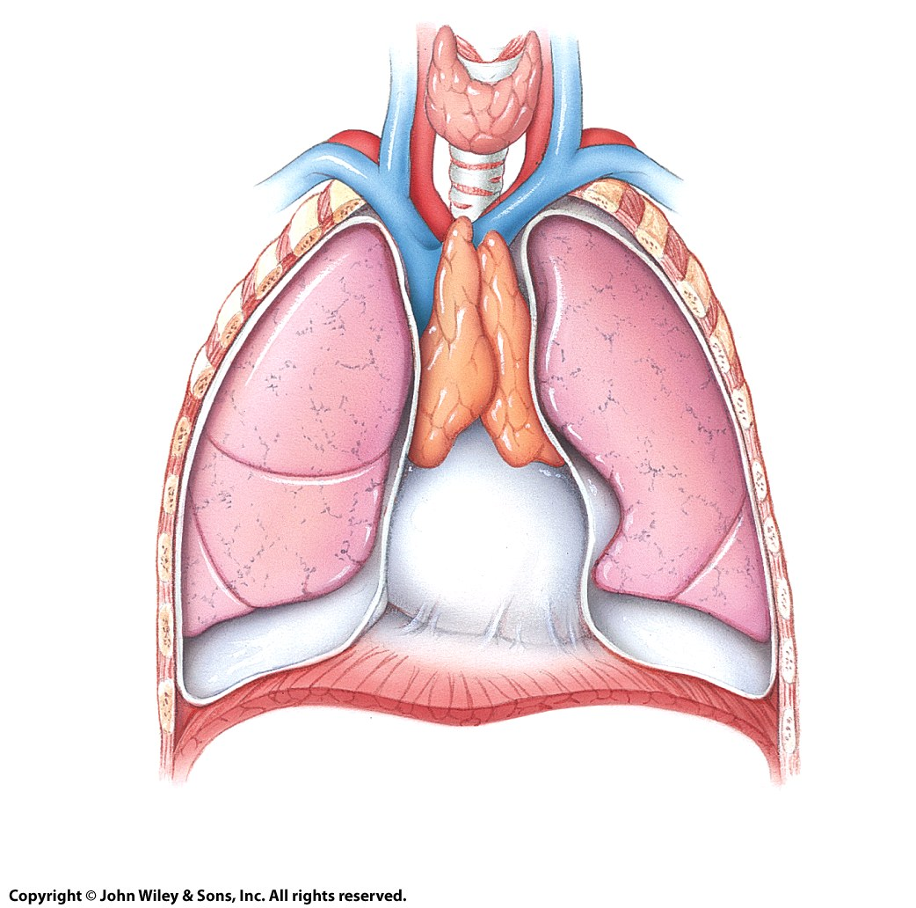
Thyroid
gland
Brachiocephalic veins
Trachea
Thymus
Right common
carotid artery
Parietal pericardium
Superior
vena cava
Right
lung
Left
lung
Diaphragm
(a) Thymus of adolescent

Slide 5
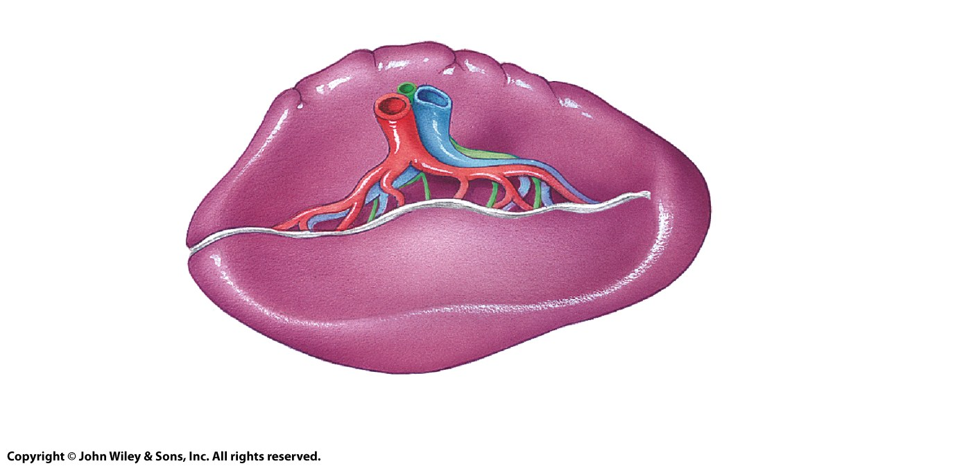
SUPERIOR
1
2
Colic impression
Gastric impression
3
Renal impression
(a) Gross structure

Slide 6
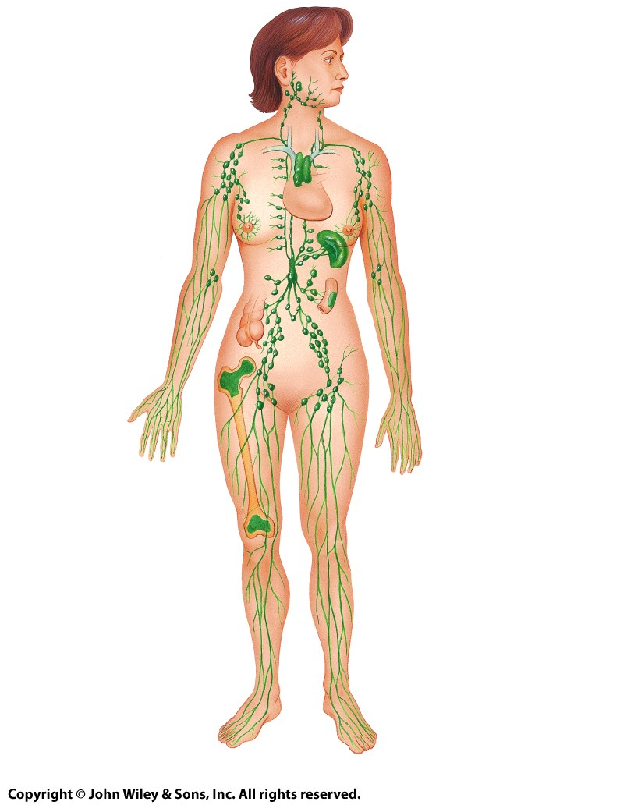
1 Palatine tonsil
2 Submandibular node
3 Cervical node
4 Thymus gland
Axillary node 8
Spleen 9
5 Intestinal node
Peyer's patches 10
6 Appendix
Iliac node 11
Inguinal node 12
7 Red bone marrow
(b) Location of immune system cells

Slide 7
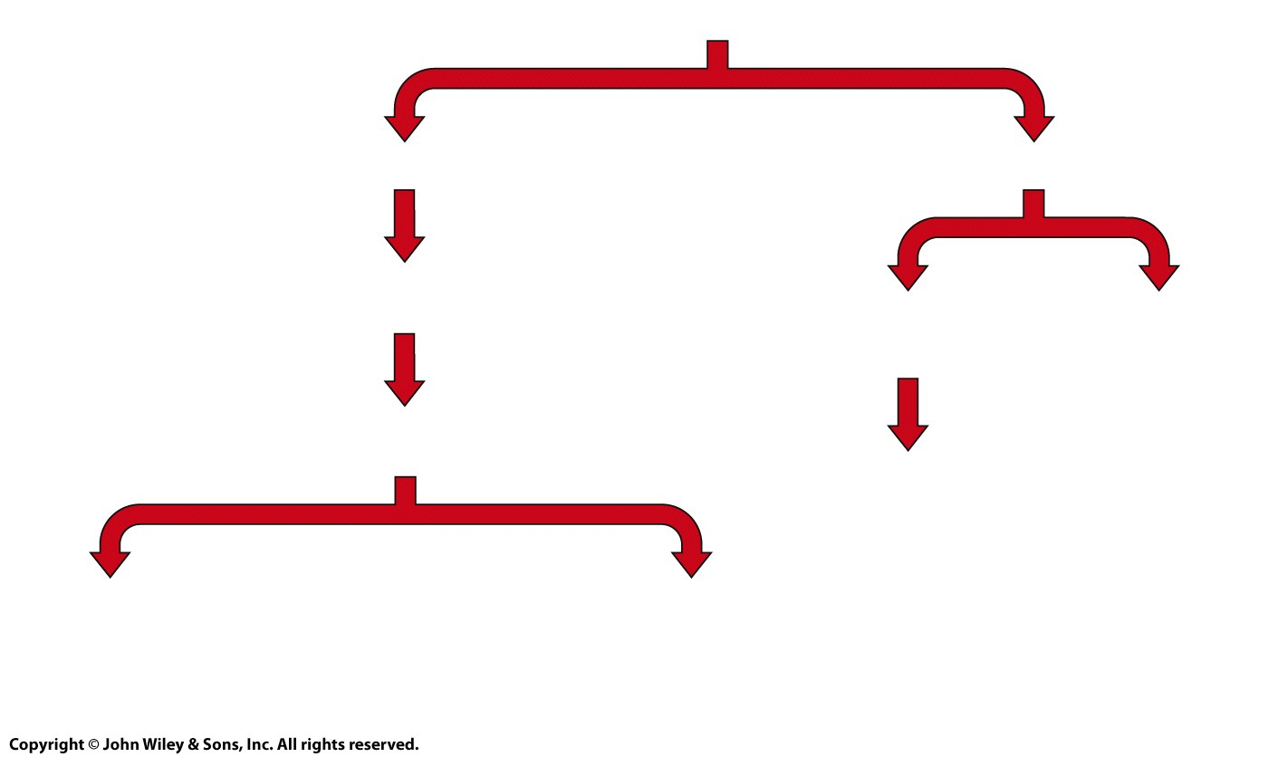
Red Bone Marrow
1 __________
7 __________
8 __________
(clone)
Mature T cell
2 __________
9 __________
10 __________
3 __________
4 __________
5 __________
(clone)
(clone)
6 __________

Slide 8
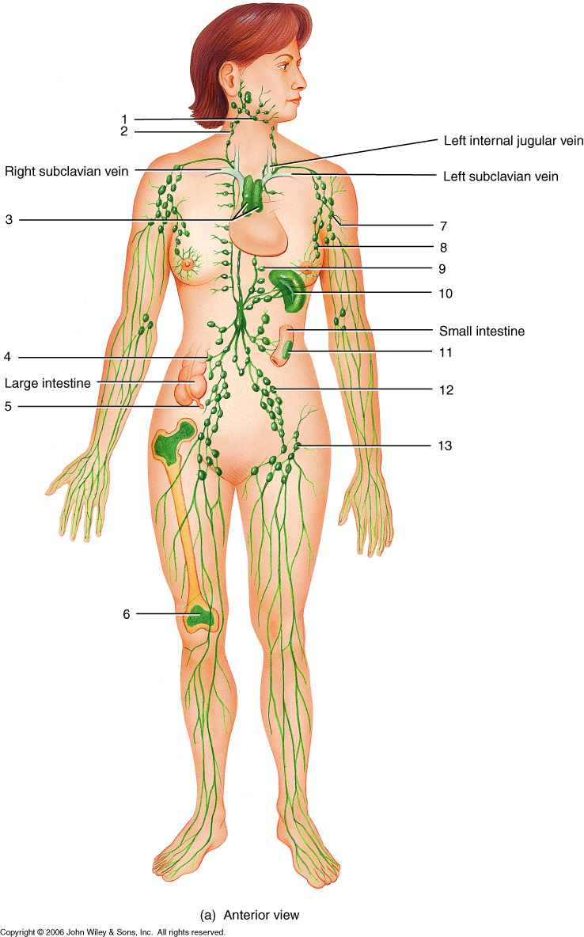
allen2e_31_01a_li
Notes:
allen2e_31_01a_li.jpg

Slide 9
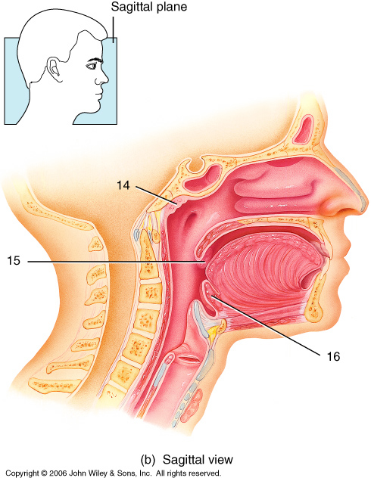

Slide 10
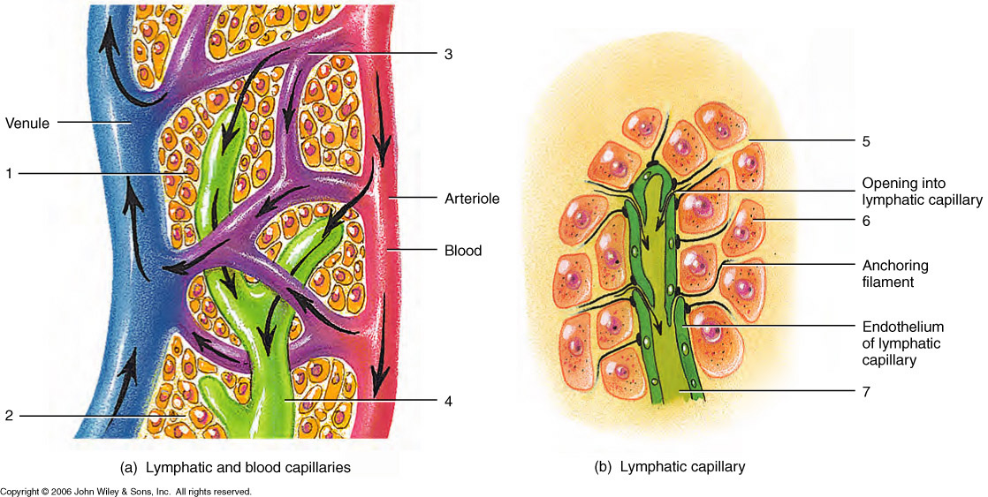
allen2e_31_02_li
Notes:
allen2e_31_02_li.jpg

Slide 11
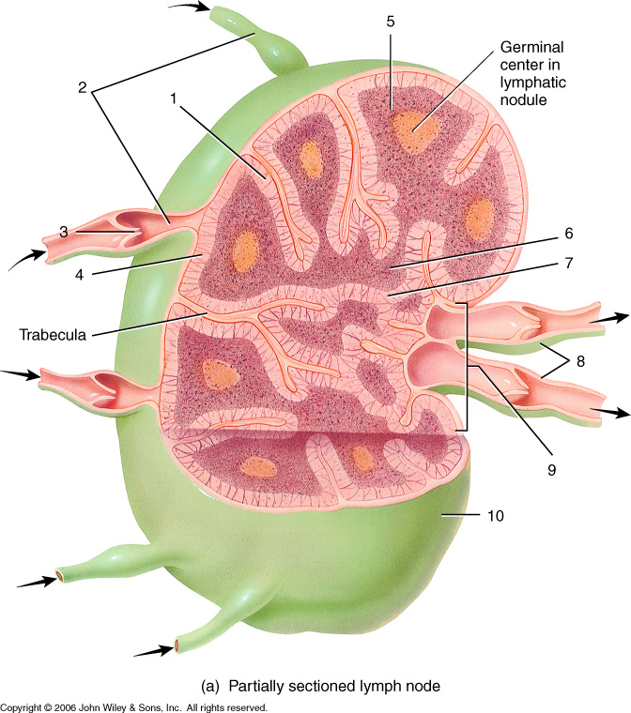
allen2e_31_04a_li
Notes:
allen2e_31_04a_li.jpg

Slide 12
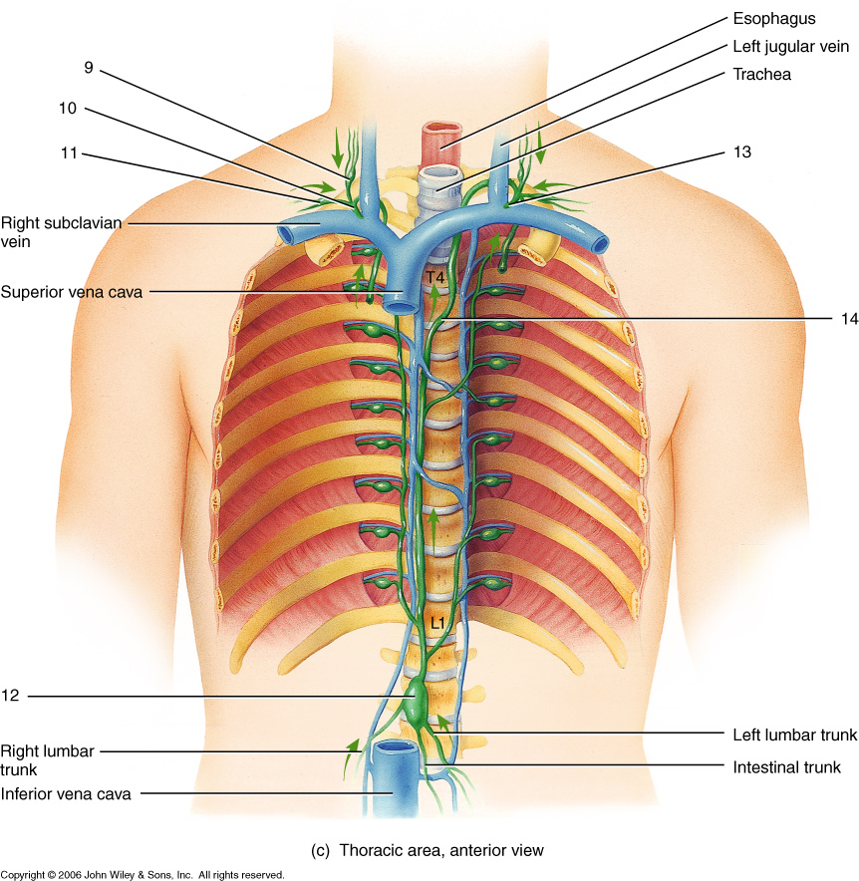
allen2e_31_03c_li
Notes:
allen2e_31_03c_li.jpg

Slide 13
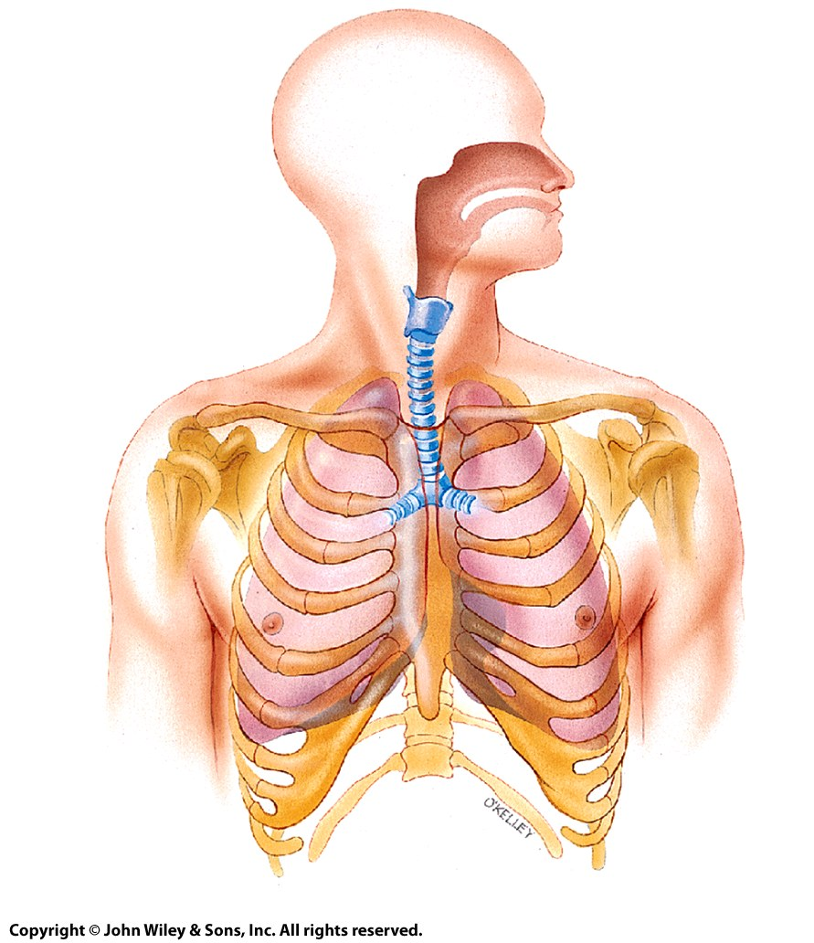
4
5
1
6
7
1
2
2
3
3
4
5
6
7
8
9
10
Anterior view

Slide 14
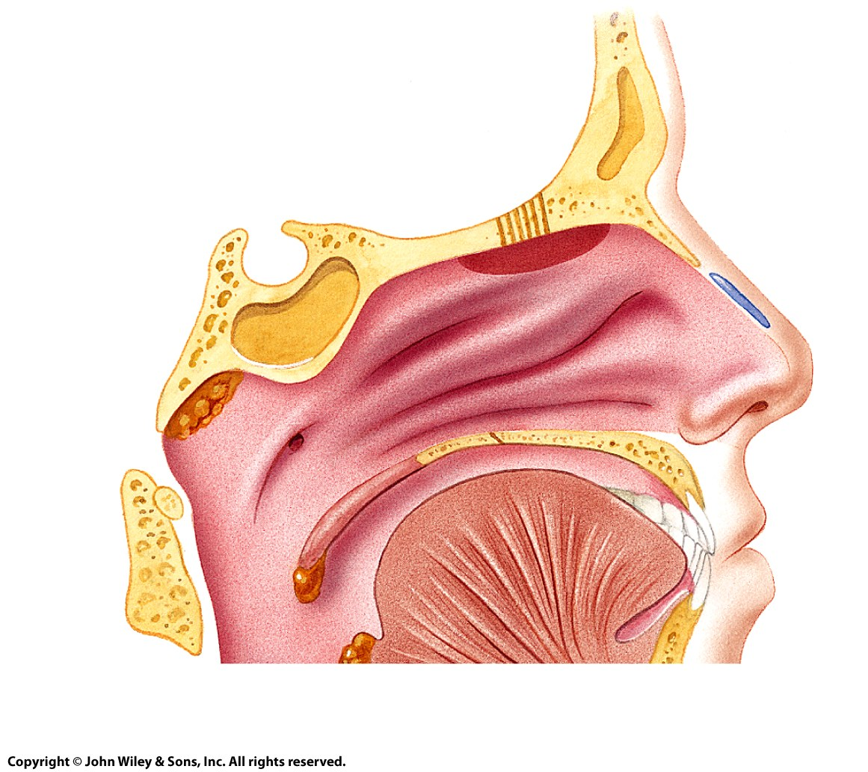
2
3
4
Frontal sinus
Frontal bone
Sphenoid bone
5
Sphenoidal sinus
6
7
1
8
9
(a) Sagittal section

Slide 15
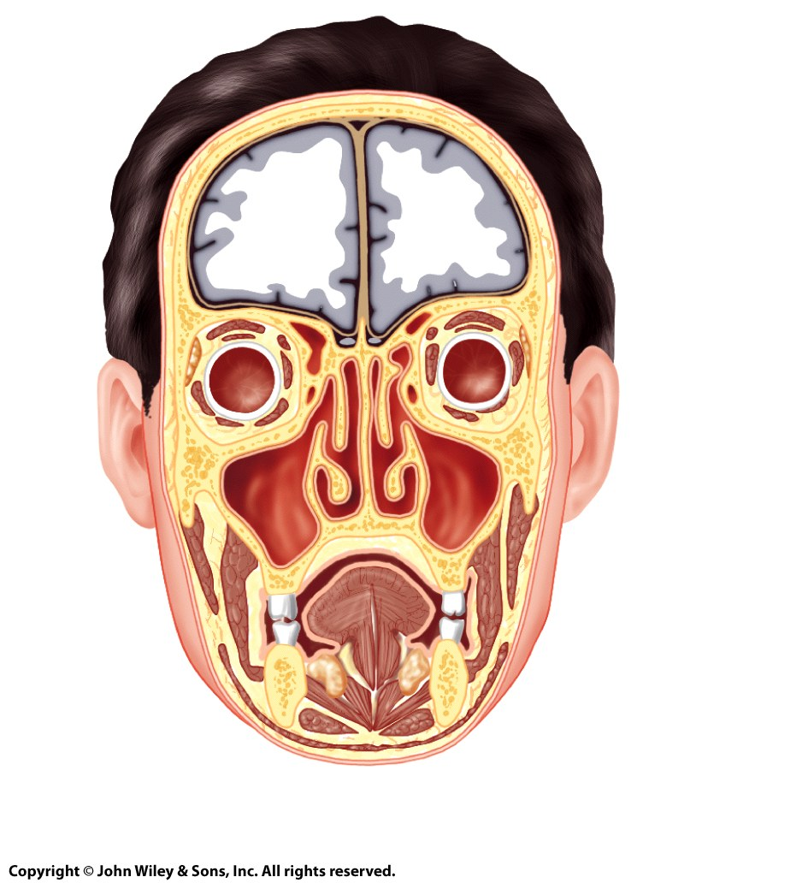
Frontal sinus
Ethmoidal sinus
13
10
11
14
12
Maxillary sinus
(b) Frontal section

Slide 16
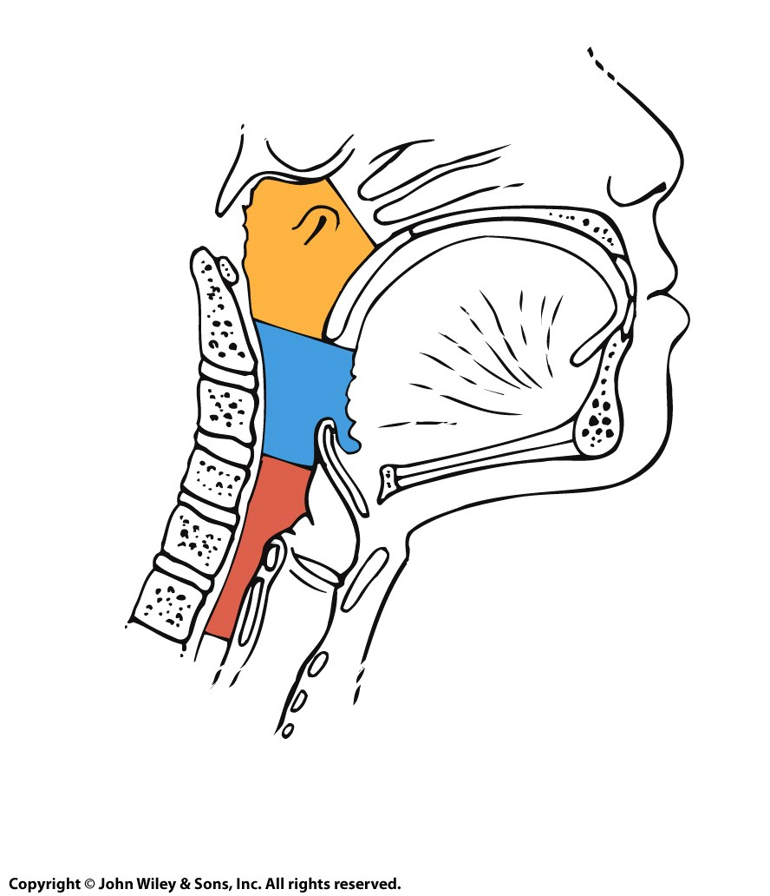
1
2
3
(a) Pharyngeal structure

Slide 17
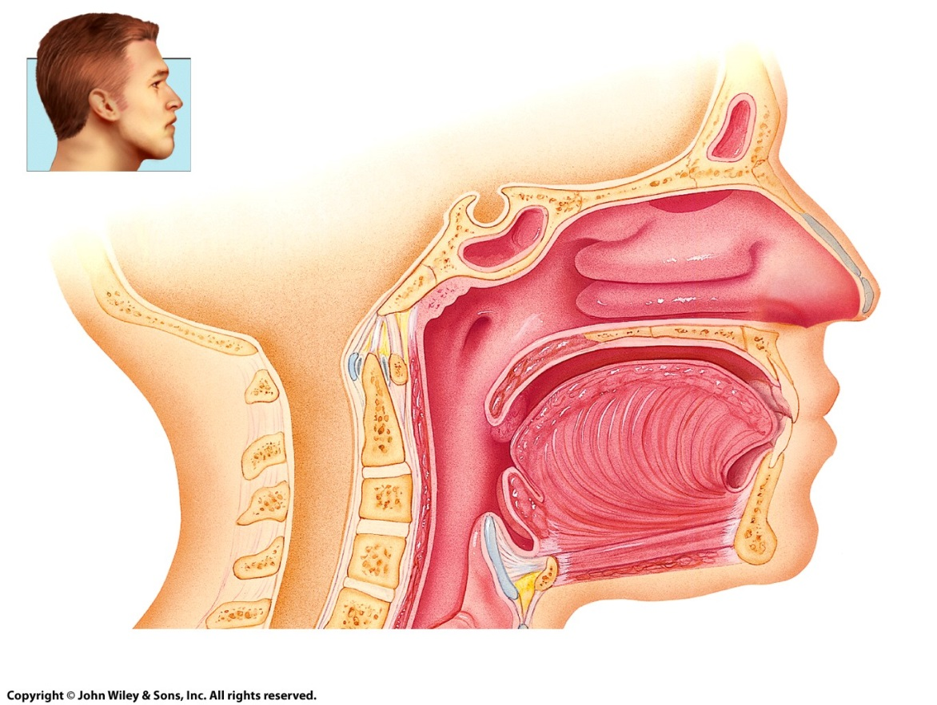
Sagittal plane
10
4
5
6
11
7
12
8
13
9
(b) Pharyngeal structure

Slide 18
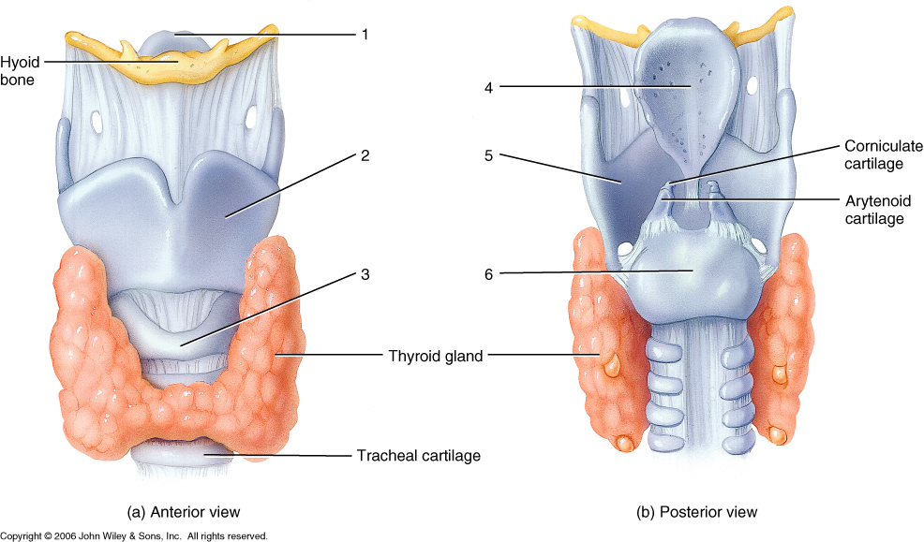
allen2e_32_04ab_li
Notes:
allen2e_32_04ab_li.jpg

Slide 19
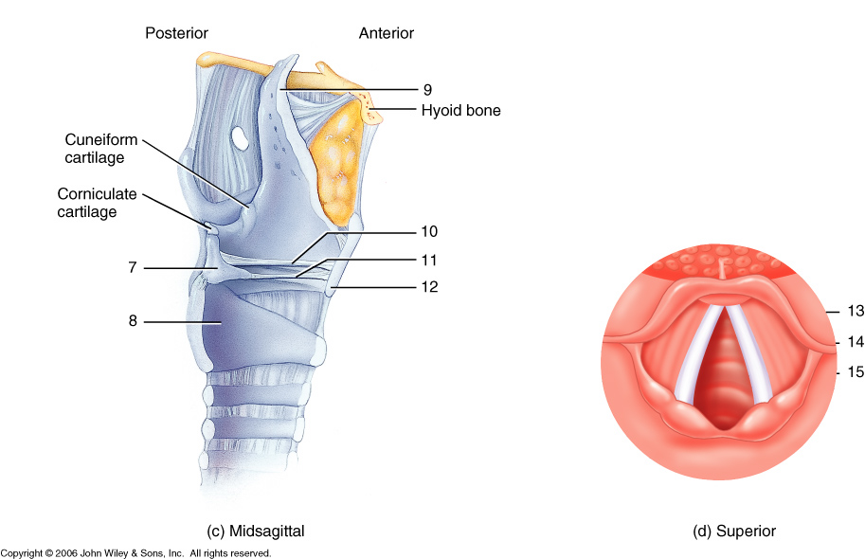
allen2e_32_04cd_li
Notes:
allen2e_32_04cd_li.jpg

Slide 20
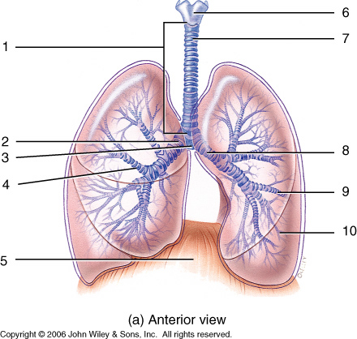
allen2e_32_05a_li
Notes:
allen2e_32_05a_li.jpg

Slide 21
allen2e_32_05a_li
Notes:
allen2e_32_05a_li.jpg

Slide 22
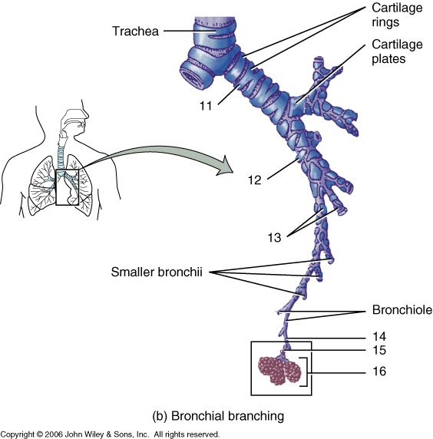
allen2e_32_05b_li
Notes:
allen2e_32_05b_li.jpg

Slide 23
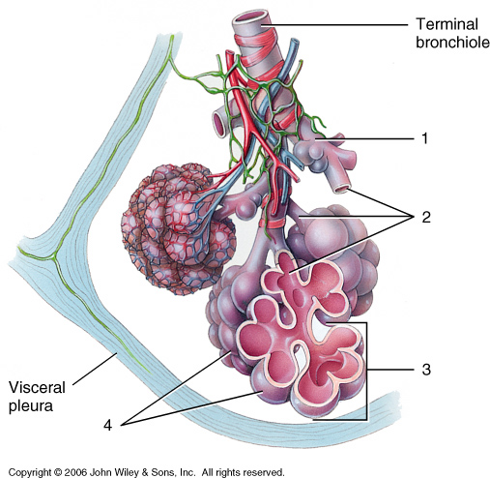
allen2e_32_06_li
Notes:
allen2e_32_06_li.jpg

Slide 24
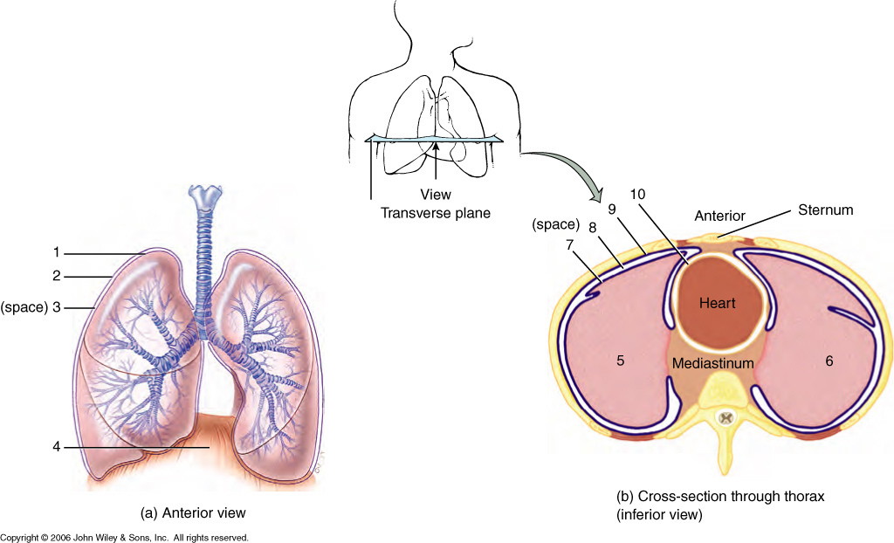
allen2e_32_08_li
Notes:
allen2e_32_08_li.jpg

Slide 25
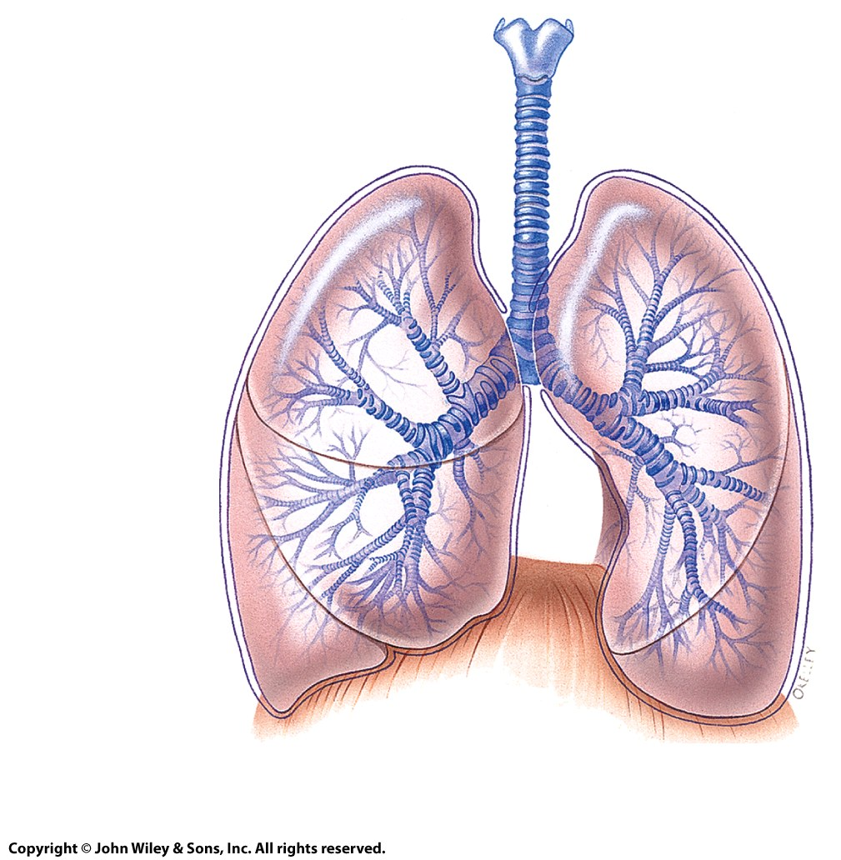
1
2
(space) 3
4
(a) Anterior view

Slide 26
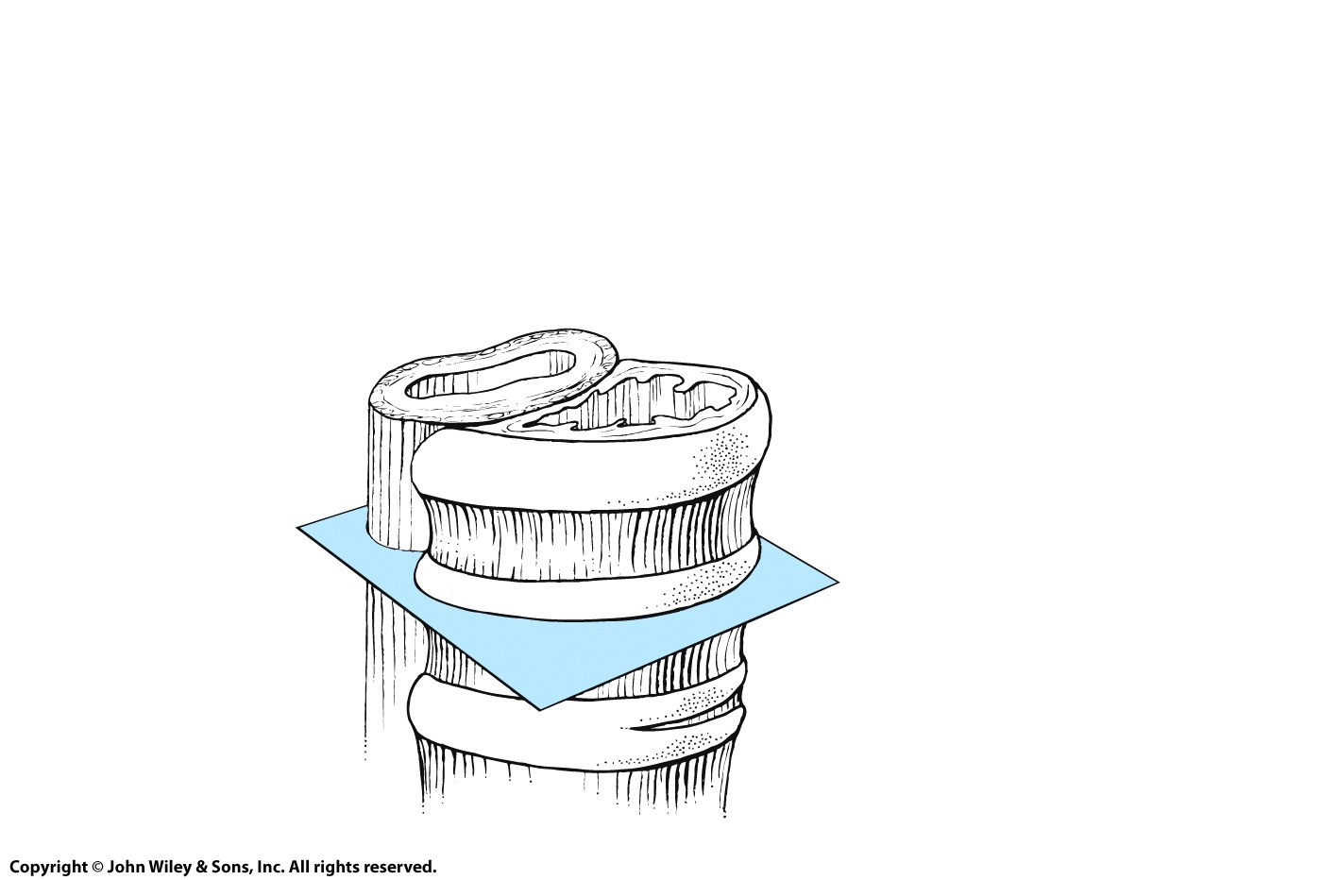
Lumen
Esophagus
Trachea
Epithelial lining
Trachealis
muscle
Transverse plane

Slide 27
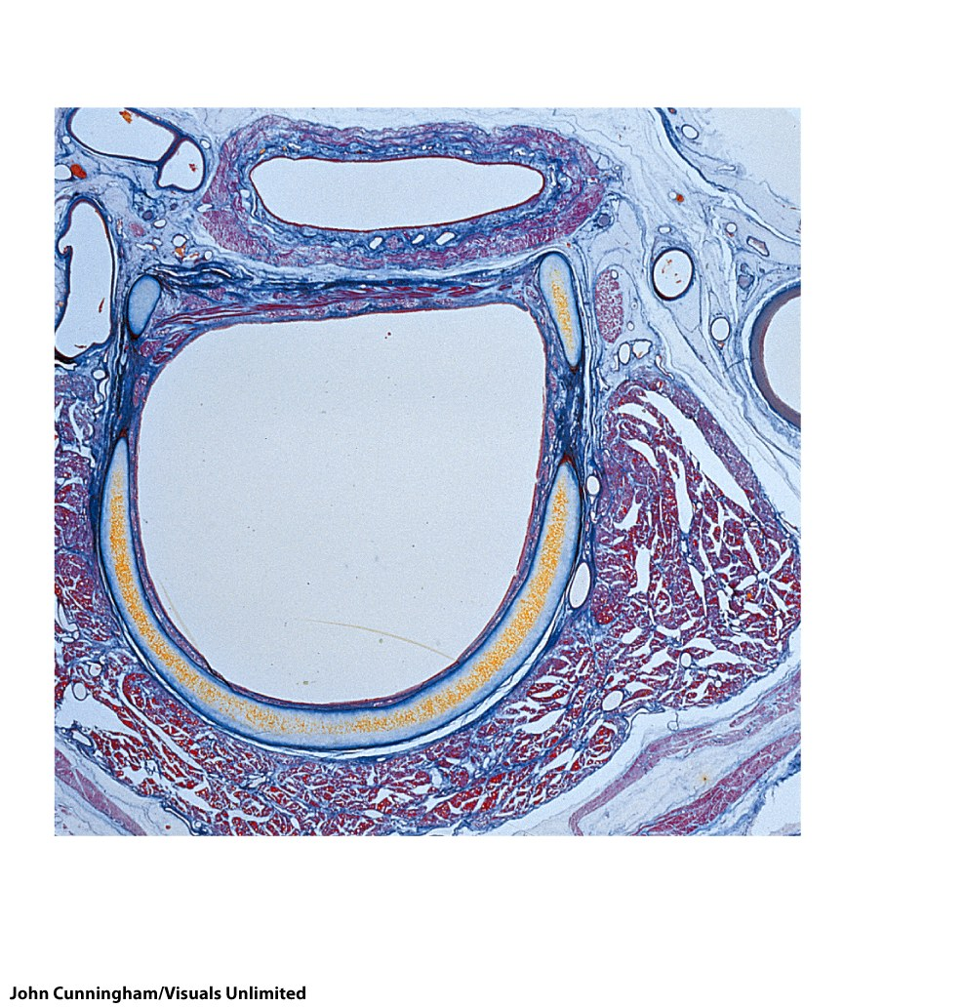
1
POSTERIOR
2
3
4
5
ANTERIOR
LM
(2.6x)
(a) Transverse section of trachea and esophagus

Slide 28
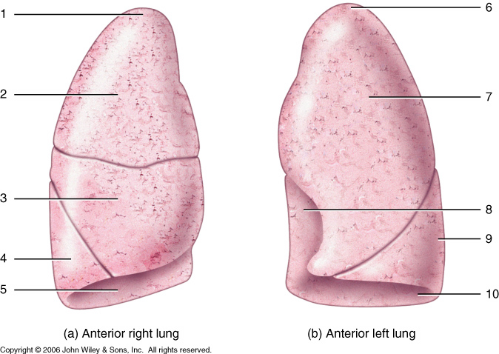
allen2e_32_06ab_li
Notes:
allen2e_32_06ab_li.jpg

Slide 29
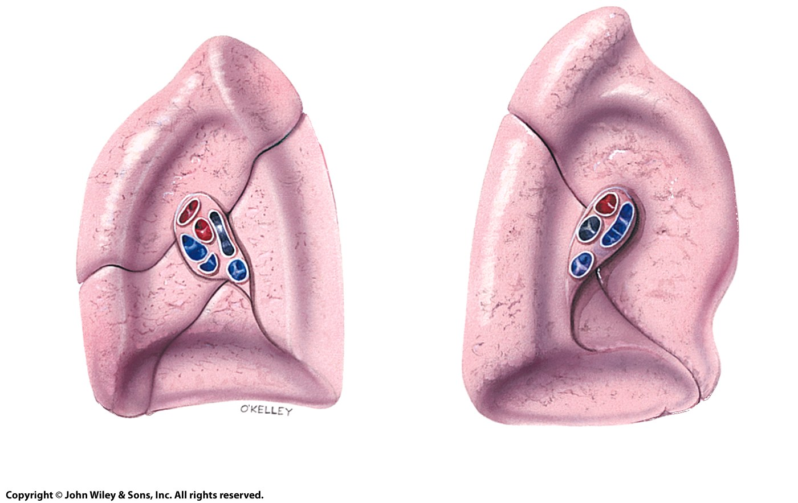
15
11
16
12
17
13
18
14
(c) Medial view of right lung
(d) Medial view of left lung

Slide 30
allen2e_32_09_li
Notes:
allen2e_32_09_li.jpg

Slide 31
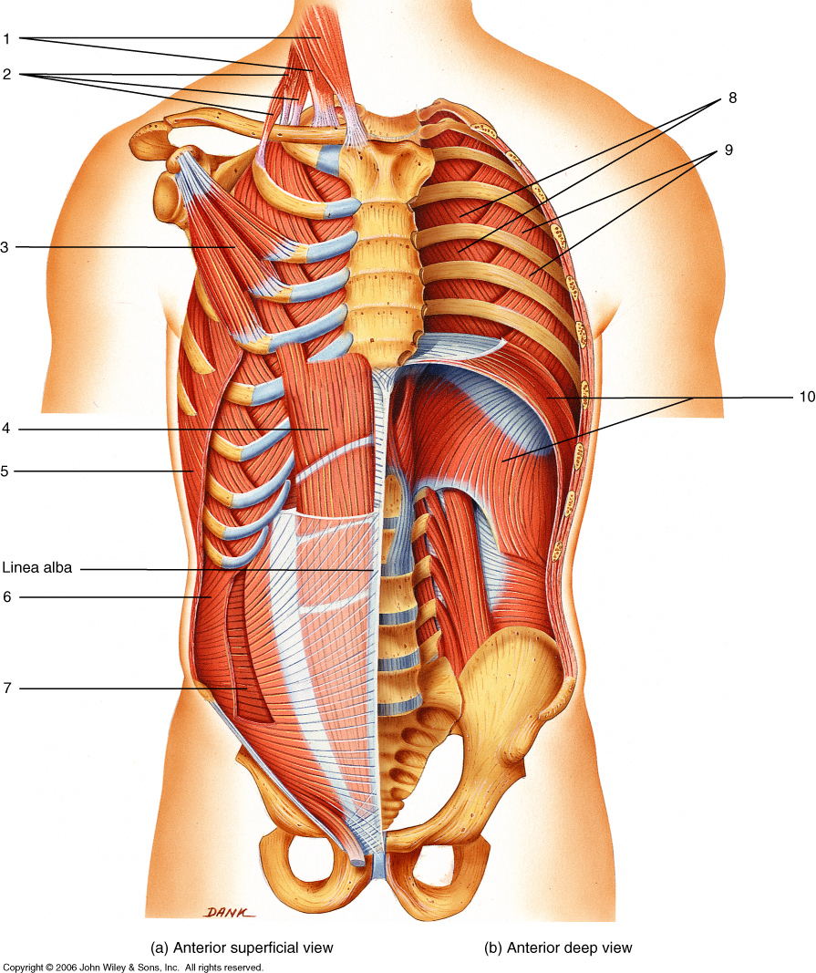
allen2e_33_01_li
Notes:
allen2e_33_01_li.jpg

Slide 32
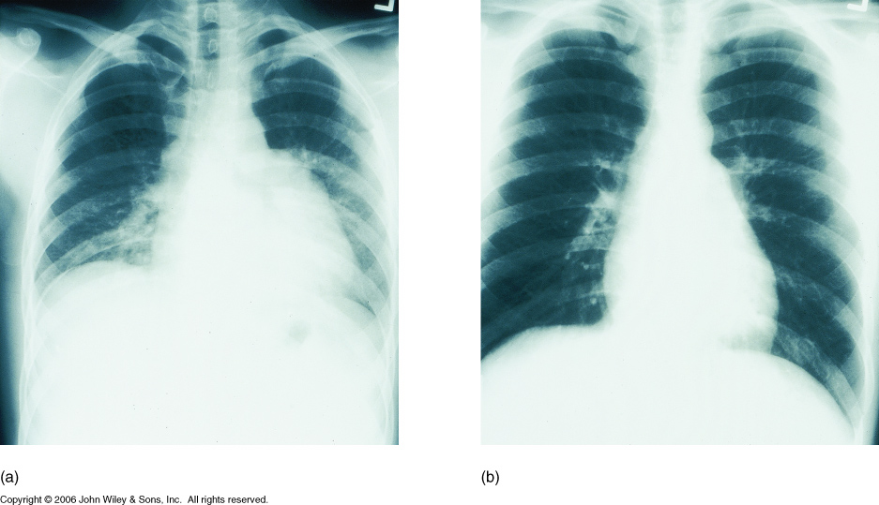
allen2e_33_02_li
Notes:
allen2e_33_02_li.jpg

Slide 33
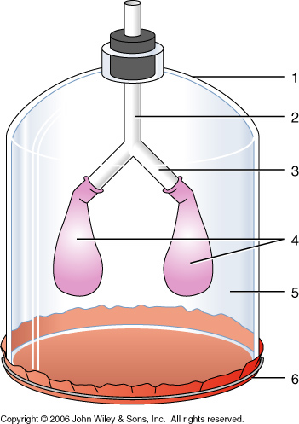
allen2e_33_03_li
Notes:
allen2e_33_03_li.jpg

Slide 34
allen2e_32_10_li
Notes:
allen2e_32_10_li.jpg

Slide 35
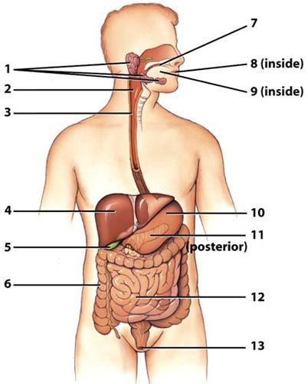
12. Small intestine:
Primary site of nutrient absorption

Slide 36
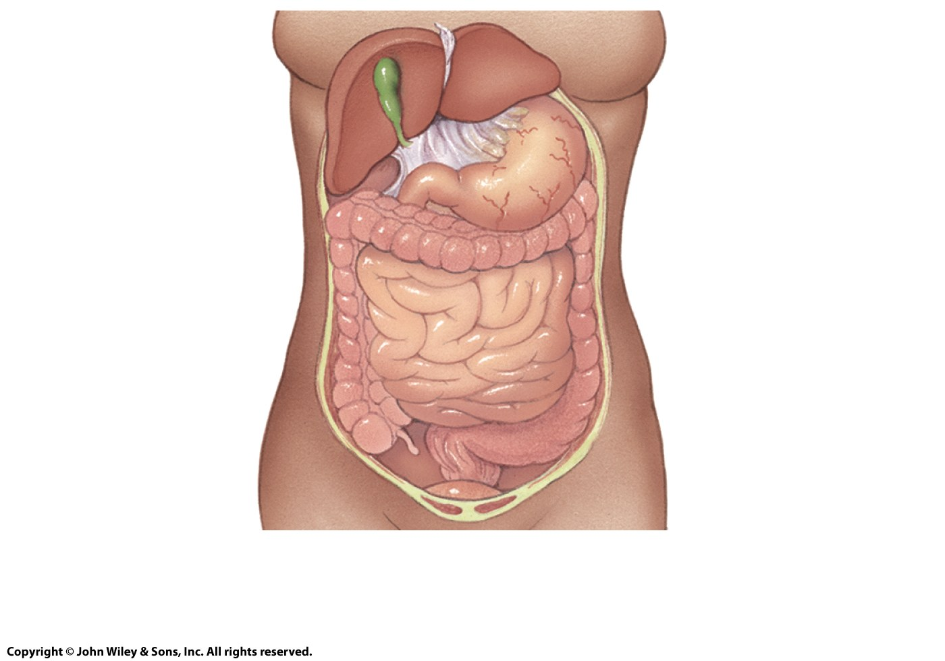
11. Lessor omentum
Gallbladder
11
Liver
Stomach
Transverse
colon
Duodenum
Descending
colon
Ascending
colon
Sigmoid
colon
(c) Anterior view with liver
and gallbladder lifted

Slide 37
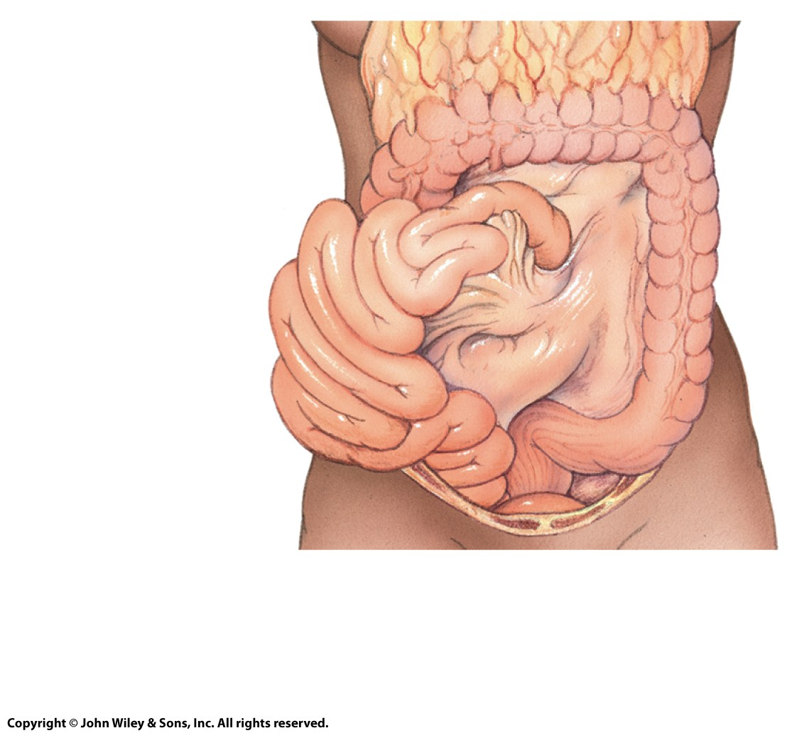
12
Transverse colon
12. Greater omentum
13. Mesocolon
14. Mesentery
13
Jejunum
14
Descending colon
Ileum
Sigmoid colon
(d) Anterior view with greater omentum lifted and small intestine reflected to right side

Slide 38
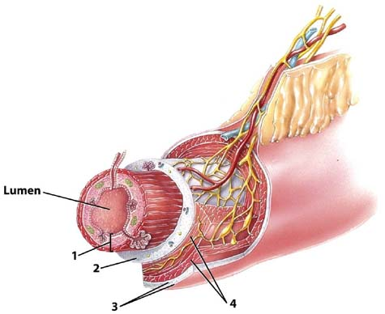

Slide 39
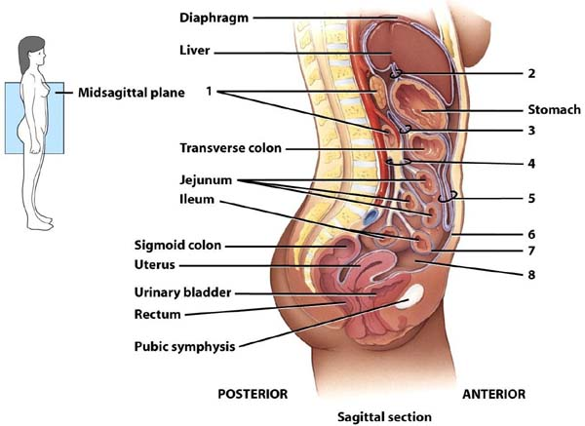

Slide 40
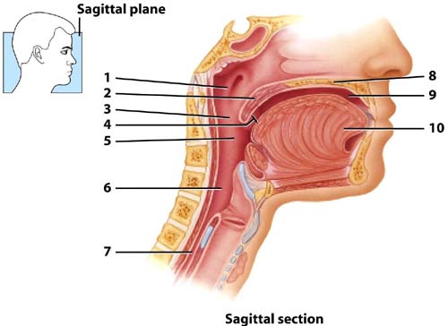

Slide 41
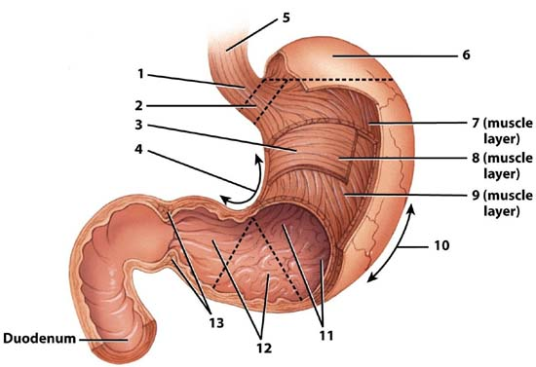

Slide 42
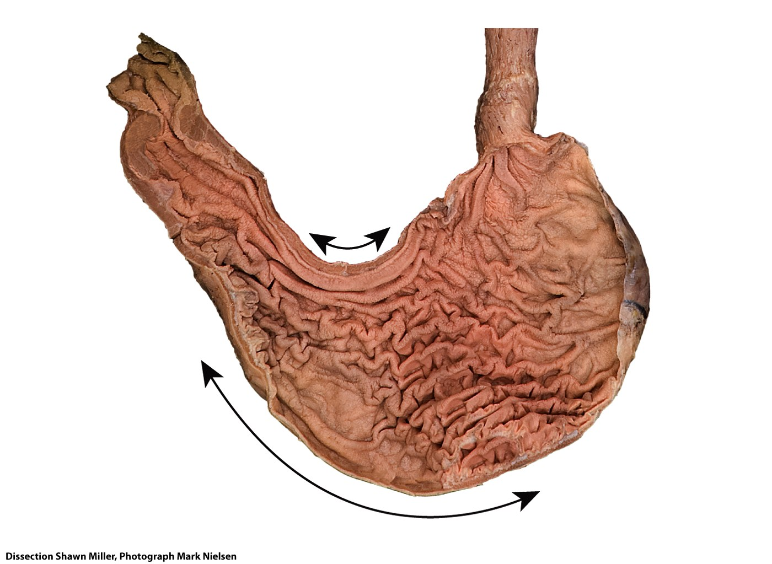
Duodenum
Esophagus
Pylorus
Pyloric canal
Lower esophageal
sphincter
Pyloric
antrum
Cardia
Pyloric
sphincter
Fundus
Lesser
curvature
Rugae of
mucosa
Body
Greater curvature

Slide 43
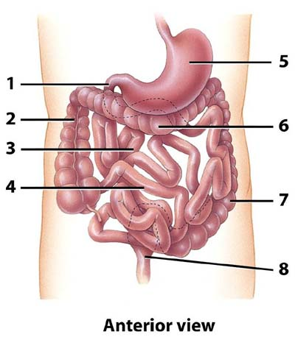

Slide 44
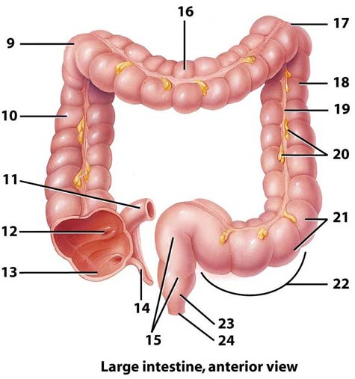

Slide 45
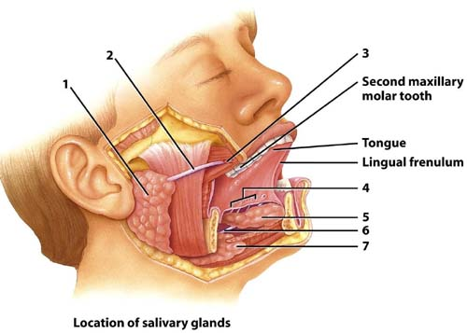

Slide 46
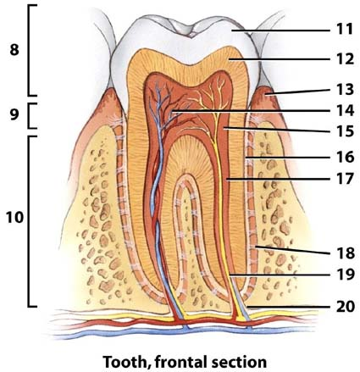

Slide 47
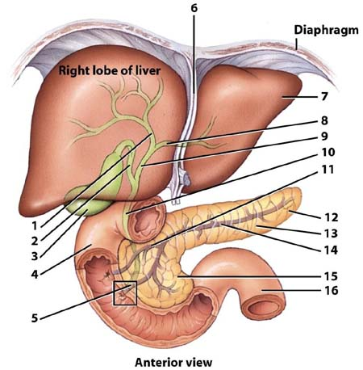

Slide 48
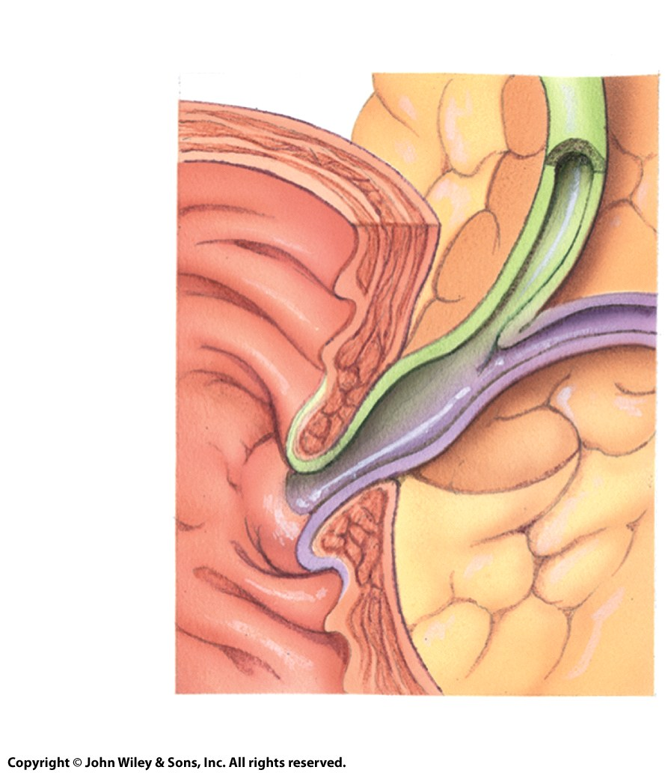
19
20
Mucosa of duodenum
18
17
(b) Hepatopancreatic ampulla

Slide 49
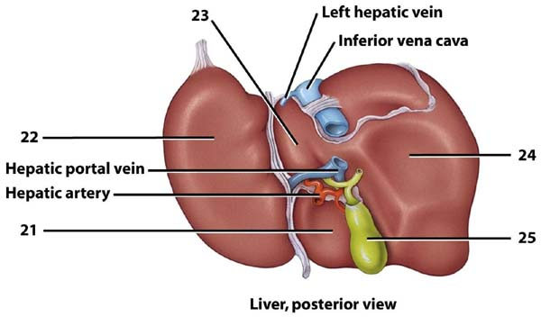

Slide 50
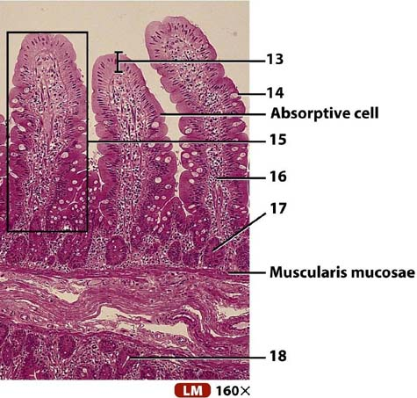

Slide 51
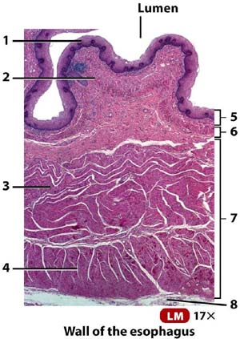

Slide 52
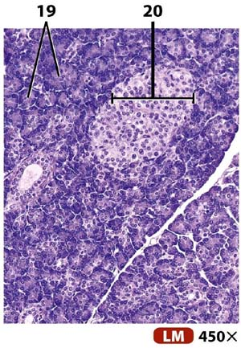

Slide 53
