Slide 1
Ch 2.2- Some basic Functions

Slide 2
2.2 Some basic Graphs
b = 3 a if b ³ = a
Absolute Value
Six Units
Six Units
-10 - 9 -8 -7 -6 -5 -4 -3 -2 -1 0 1 2 3 4 5 6 7 8 9 10
So absolute value of a number x as follows
x = x if x > 0
- x if x< 0

Slide 3
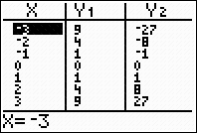
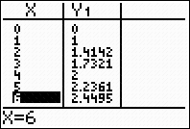
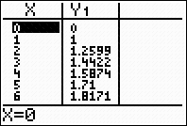
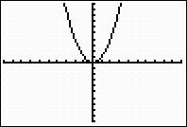
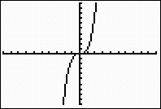
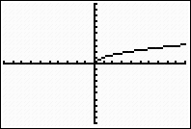
15 Parabola ,Cubic function 16. Square root function
2.2
f(x) = x² g(x) = x³ f(x) =

Slide 4
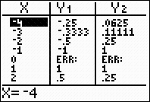
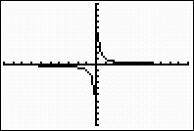
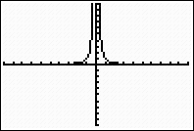
Asymptotes
f(x) = g(x) =
f(x) = g(x) =
0
0

Slide 5
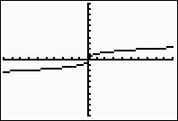
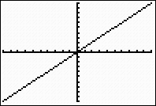
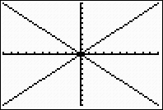
Graphs of Eight Basic Functions
y = x² g(x) = x³ f(x) = f(x) =
f(x) = g(x) = f(x) = x
g(x) = -x g(x) = x

Slide 6
f(x) = x³
Guide Point
Guide point
Guide point
-1 0 1
- 1 0 1

Slide 7
Function defined piecewise (Example 3, pg 146)
Graph the function defined by f(x) = x + 1 if x < 1
3 x > 1
f(x) = 3 , x > 1
3
-5
(0, 1)
- 5 5
- 1, 0
f(x) = x + 1, x < 1
Intercepts are (-1, 0) and (0, 1)
x = 1

Slide 8
Ex 2.2, Pg 152
No. 42
h(x) = -x + 2
h(x) = -x + 2 if x < -1
3 if x > - 1
3
h(x)= 3
-1 0 1
No. 50
m(x)= x²
m(x) = x
m(x) = x² if x<
x if x >

Slide 9
Ch 2.3- Transformation of Functions

Slide 10
Vertical Translations ( pg 154)
The graphs of f(x) = x² + 4 and g(x) = x² - 4 are variations of basic parabola
6
4
2
-4
x | -2 | -1 | 0 | 1 | 2
y = x² | 4 | 1 | 0 | 1 | 4
f(x) x² + 4 | 8 | 5 | 4 | 5 | 8
f(x) = x² + 4
y = x²
x | -2 | -1 | 0 | 1 | 2
y = x² | 4 | 1 | 0 | 1 | 4
g(x) x² - 4 | 0 | -3 | -4 | -3 | 0
g(x) = x² - 4
Example 1
The graph of y = f(x) + k ( k> 0) is shifted upward k units
The graph of y = f(x) – k ( k) 0) is shifted downward k units

Slide 11
Horizontal Translations (pg 156)
f(x) = (x + 2) ²
g(x) = (x – 2) ²
x | -3 | -2 1 | 0 | 1 | 2 3
y = x² | 9 | 4 1 | 0 | 1 | 4 9
f(x)= (x + 2)² | 1 | 0 1 | 4 | 9 | 16 25
f(x)
g(x)
x | -3 | -2 -1 | 0 | 1 | 2 3
y = x² | 9 | 4 1 | 0 | 1 | 4 9
g(x)= (x - 2)² | 25 | 16 9 | 4 | 1 | 0 1
The graph of y = f(x + h), ( h> 0) is shifted h
units to the left
The graph of y = f(x - h), ( h > 0) is shifted h
units to the right
- 3 3
0

Slide 12
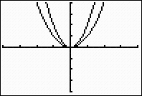
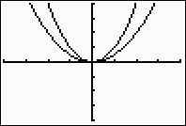
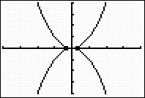
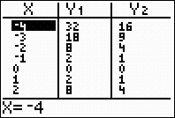
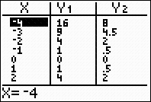
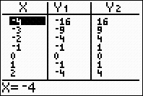
Scale Factors and Reflections (pg 160)
Compared with the graph of y = f(x), the graph of y = af(x), where a = 0, is
1. streched vertically by a factor of a if a > 1
2. compressed vertically by a factor of a if 0 < a < 1 and
3. reflected about the x-axis if a < 0
The constant a is called the Scale factor for the graph
y = x²
y = x²
g(x) = x²
h(x) = -x²
y = x² ,
f(x) = 2x²

Slide 13
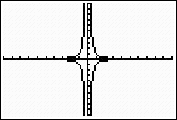
a) Identify the scale factor for each function and describe how it affects the graph of the corresponding basic function b) Using guiding points, sketch the basic graph and the graph of the given function on the same axes. Label the coordinates of three points on the graph of the given function
25) h(z) =
2
reflection
( -1, -2)
(1, -2)
h(x) =
-
Scale factor -2, y = - is reflected over the x axis and
streched vertically by a factor of 2

Slide 14
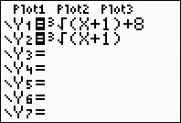
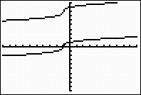
No 62, Sketch the basic graph and the graph of the given function on the same axes. Label the coordinates of three points on the graph of the given function + 8 and compare the graph with basic transformation
(-2, 7)
Translation by 8 units up and 1 unit left,

