Slide 1
Chapter 6 Quadratic Functions

Slide 2
Ch 6.1 Quadratic Equation
A quadratic equation involves the square of
the variable. It has the form
f(x) = ax ² + bx + c where a, b and c are
constants
If a = 0 ,
there is no x-squared term, so the equation
is not quadratic

Slide 3
Graph of the quadratic equation y = 2x² – 5
To solve the equation 2x² – 5 = 7
We first solve for x² to get
2x² = 12
x² = 6
x = + = + 2.45 and – 2.45
-
x | -3 | -2 | -1 | 0 | 1 | 2 | 3
y | 13 | 3 | -3 | -5 | -3 | 3 | 13
7
5
3
1
-3 -2 - 1 0 1 2 + 3

Slide 4
Zero – Factor Principle
The product of two factors equals zero if and only if one o
both of the factors equals zero. In symbols,
ab = 0 if and only if a = 0 or b = 0
Standard form of quadratic equation can be written as
ax ² + bx + c = 0
A quadratic equation can be written in factored form
a( x – r₁)(x – r₂) = 0

Slide 5
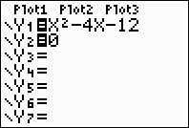
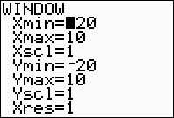
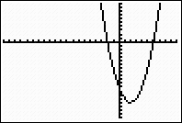
Solving Quadratic Equations by Factoring
Zero Factor Principle
The product of two factors equals zero if and only if one or
both of the factors equals zero.
In symbols ab = 0 if and only if a = o or b = 0
Example (x – 6) (x + 2) = 0
x – 6 = 0 or x + 2 = 0
x = 6 or x = -2
Check 6, and – 2 are two solutions and satisfy the original
equation
And x-intercepts of the graph are 6, -2
By calculator, draw the graph

Slide 6
To solve a quadratic Equation by Factoring
Write the equation in standard form
2. Factor the left side of the equation
3. Apply the zero-factor principle: See each factor equal to zero.
4. Solve each equation. There are two solutions
( which may be equal).

Slide 7
Some examples of Quadratic Models
Height of a Baseball
H = -16t ² + 64t + 4
Evaluate the formula to complete the table of values for the height of the baseball
Highest point
t | 0 | 1 | 2 | 3 | 4
h | 4 | 52 | 68 | 52 | 4
70
60
50
40
30
20
10
3) After ½ second base ball height h = -16(1/2) ² +
64(1/2) + 4 = 32 ft
4) 3.5 second height will be 32 ft
5) When the base ball height is 64 ft the time will be 1.5 sec and 2.5 sec
6) When 20 ft the time is 0.25 and 3.75 sec
7) The ball caught = 4 sec
0 1 2 3 4

Slide 8
Solving Quadratic Equation by factoring
The height h of a baseball t seconds after being hit is given by
h = - 16 t ² + 64t + 4. When will the baseball reach a height of
64 feet ?
64 = - 16 t ² + 64t + 4
Standard form 16 t ² – 64t + 60 = 0
4( 4 t ² – 16t + 15) = 0 Factor 4 from left side
4(2t – 3)(2t – 5) = 0 Factor the quadratic expression and use zero factor principle
2t – 3 = 0 or 2t – 5 = 0 Solve each equation
t = 3/2 or t = 5/2
h = - 16 t ² + 64t + 4
64
48
24
0 .5 1 1.5 2 2.5 3 4

Slide 9
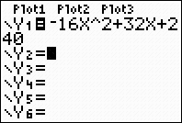
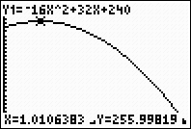
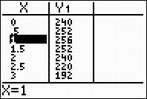
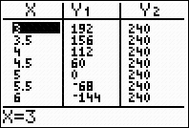
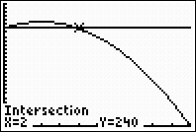
Ex 6.1, no 2 ( Pg 485) James bond stands on top of a 240 ft building and throws a film canister upward to a fellow agent I a helicopter 16 feet above the building. The height of the film above the ground t seconds later is given by the formula h = -16t² + 32t + 240 where h is in feet. a) use calculator to make a table of values for the height formula, with increments of 0.5 second b) Graph the height formula on calculator. Use table of values to help you choose appropriate window settings. c) How long will it take the film canister to reach the agent in the helicopter( What is the agent’s altitude?) Use the TRACE feature to find approximate answers first. Then use the table feature to improve your estimate d) If the agent misses the canister, when will it pass James Bond on the way down? Use the intersect command. e) How long will it take to hit the ground?
Solution
Y1 = - 16x² + 32x + 240
Canister reaches 256 feet after 1 second
a)
b) , c) Xmin= 0, Xmax= 5, Ymin = 0, Ymax= 300
e) From the graph h= 0 when t = 5
h = - 16(5) ² + 32(5) + 240
Canister will hit the ground
after 5 seconds
d) If the agent misses the canister,
it will pass James Bond after 2 seconds

Slide 10
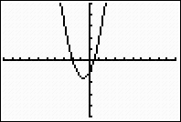
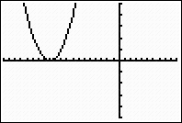
Use a graph to solve the equation y =0 ( Use Xmin = -9.4, Xmax = 9.4) Check your answer with the zero-factor principle.
4) y = (x +1) (4x -1) 10) y = (x + 6) ²
Ymin = -5, Ymax= 5
Ymin = -5, Ymax= 5
X-intercepts

Slide 11
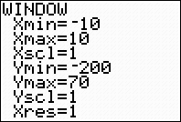
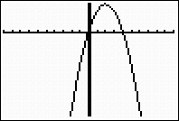
Example Using Graphing Calculator
Using Graphing Calculator
H = - 16 x² + 64x + 4
Press Y key TblStart = 0 and increment 1 Press 2nd , table
Enter equation
Press graph

Slide 12
Use Graphing Calculator
Y1 = x² – 4x + 3
Y2 = 4(x² – 4x + 3)
Enter window Xmin = -2, Xmax = 8
Ymin = -5 Ymax = 10
And enter graph
X-intercepts

Slide 13
Solve by factoring ( Pg 485)
12) 3b² -4b – 4= 0 22) (z – 1) ² = 2z² +3z – 5 24) (w + 1) (2w – 3) = 3
(3b + 2) (b – 2) ( Foil) (z – 1) (z – 1) = 2z² + 3z - 5 2w² -3w + 2w – 3= 3
3b+ 2=0, b-2 = 0( Zero factor Pr.) z² -2z +1= 2z² +3z -5 ( Distributive Prop.)
( Distributive Prop.) 2w² –w -6 = 0
3b = -2 b = 2 0 = z² +5z – 6 (2w + 3) (w – 2) = 0
b = -2/3, b = 2 0 = ( z – 1) (z + 6) 2w = - 3, w = 2 ( Zero
Factor)
z = 1, z = -6 ( zero factor) w = -3/2 , w= 2

Slide 14
6.2 Solving Quadratic Equations
Squares of Binomials
a( x – p) ² + r = 0
Where the left side of the equation includes the square
of a binomial, or a perfect square. We can write any
quadratic equation in this form by completing the square
Square of binomial ( x + p) ² p 2p p²
1. (x + 5) ² = x² + 10x + 25 5 2(5) = 10 5² = 25
2. (x – 3)² = x² -6x + 9 - 3 2( -3) = - 6 (-3)² = 9
3. ( x – 12)² = x² -24 x + 144 -12 2(-12) = -24 ( -12)² = 144
In each case , the square of the binomial is a quadratic trinomial,
(x + p) ² = x² + 2px + p²
We can find the constant term by taking one-half the coefficient of x and then squaring the result. Adding
a constant term obtained in this way is called completing square

Slide 15
Applications
We have now seen four different algebraic methods for
solving quadratic equations
Factoring
Extraction of roots
Completing the square
Quadratic Formula

Slide 16
Pythagorian Formula for Right angled triangle
A
Hypotenuse
Height
90 degree
C
B
Base
In a right triangle
(Hypotenuse) ² = (Base) ² +(Height) ²

Slide 17
What size of a square can be inscribed in a circle of radius 8 inches ?
8 in
16 inches
8in
s
s
s represent the length of a side of the square
s ² + s ² = 16 ²
2s = 256
s ² = 128
s = 128 = 11.3 inches

Slide 18
Extraction of roots
h
The formula
h= 20 - 16t²
when t = 0.5
= 20 – 16(0.5) ²
^{= 20 – 16(0.25)}
^{= 20 – 4}
^{= 16ft}
When h = 0 the equation to obtain
0 = 20 - 16t ²
16t ² = 20
t ^{2 = 20/16 = 1.25}
t = + = + 1. 118sec
⁻ ⁻
a (16, 0.5)
20
10
Height
b
0.5 1 1.5
t
Time

Slide 19
Compound Interest Formula
A = P(1 + r) ^{n}
Where A = amount, P = Principal, R = rate of Interest, n = No.of years

Slide 20
Quadratic Formula
The solutions to ax ² + bx + c = 0 with a = 0 are given by
- b + b² – 4ac
X =
2a

Slide 21
Quadratic Equations whose solutions are given
Example
Solutions are – 3 and ½, The equation should be in standard
form with integer coefficients
[ x – (-3)] (x – ½) = 0
(x + 3)(x – ½) = 0
x² – ½ x + 3x – 3/2 = 0
x² + 5 x – 3 = 0
2 2
2(x² + 5x – 3 ) = 2(0) ( Multiply 2 to remove fraction)
2 2
2 x² + 5x – 3 = 0

Slide 22
The Discriminant and Quadratic Equation
To determine the number of solutions to
ax² + bx + c = 0 , evaluate the discriminant
_{b} ² _{– 4ac} _{> 0,}
If _{b} ² _{– 4ac} _{> 0,} _{there are two real solutions}
If _{b} ² _{– 4ac} _{= 0,} _{there is one real solution}
_{If b} ² _{– 4ac} _{< 0,} there are no real solutions , but two complex
_{solution}

Slide 23
Solving Formulas
h
Volume of Cone V = 1 r² h
3
3V= r² h ( Divide both sides by h )
and find square root
r = + 3V
- h
r
r
h
Volume of Cylinder V= r² h
V = r²
h
r = + V
- h
(Dividing both sides
by h )

Slide 24
Solve by completing the square( pg 498)
6. x² - x - 20 = 0
x² – x = 20
One half of – 1 is – ½, so add ( -1/2) ² = ¼ to
both sides
x² – x + ¼ = 20 + ¼
( x – ½) ² = 81/4
x – ½ = +
-
x = ½ + 9/2
-
x = ½ + 9/2 or x = ½ - 9/2
x= 10/2 = 5, x = -8/2 = -4
11. 3x² + x = 4
(1/3)( 3x² + x) = (1/3) (4) ( Multiply 1/3)
x² + 1/3 (x) = 4/3
Since one-half of 1/3 is 1/6,
Add (1/6)² = 1/36 to both sides.
x² + 1/3x + 1/36 = 4/3 + 1/36
( x + 1/6) ² = 49/36
x + 1/6 = +
-
x = -1/6 + 7/6
-
x= -1/6 + 7/6 or x = -1/6 – 7/6
x = 1 x = -4/3

Slide 25
Use Quadratic Formula ( pg = 499)
34) 0 = - x² + (5/2) x – ½
a = 2, b = -5, c = 1
You can take
a = -2, b = 5, c = -1
By quadratic formula
_{x =} - ( - 5) +
2(2)
₌ 5 +
4
₌ 5 +
4
2

Slide 26
Ex 6.2 – 41( pg 500) Let w represent the width of a pen and l the length of the enclosure in feet
l
w
Then the amount of chain link fence is given by 4w + 2l = 100
b) 4w +2l = 100
2l = 100 – 4w
l = 50 – 2w ……( 1)
c) The area enclosed is A = wl = w(50 – 2w) = 50w –2w²
The area is 250 feet, so
50w – 2w² = 250
0 = w²– 25w + 125
Thus a = 1, b = -25 and c = 125
W = -(-25) +
-
The solutions are 18.09, 6.91 feet
d) l =50 – 2(18.09) = 13.82 feet when l = 18.09 and
l = 50 – 2(6.91) = 36.18 feet when l = 6.91 [Use (1)]
The length of each pen is one third the length of the whole enclosure,
so dimensions of each pen are 18.09 feet by 4.61 feet or 6.91 feet by 12.06 feet

Slide 27
Ex 42, Pg 500
r = ½ x
The area of the half circle = 1 r²
²
= 1/2 (1/2 x )²
⁼ 1/8 x²
The total area of the rectangle = x² – 2x
= 1 x² ₊ x² - 2x
8
h = x - 2
Total area = 120 square feet
120 = = 1 x² + x² - 2x
8
8(120) = 8 ( 1 x² + x² - 2x )
8
0 = x² + 8 x² - 16x – 960 , 0 = ( + 8) x² - 16x – 960
0 = 11.142 x² – 16x - 960
use quadratic formula , x = 10.03 ft , h = 10.03 – 2 = 8.03ft The overall height of the window is h + r = h + ½ x = 8.03 + ½ (10.03) = 13.05 ft
x

Slide 28
6.3 Graphing Parabolas Special cases
The graph of a quadratic equation is called a parabola
Vertex
y-intercept
x-intercept
x-intercept
x-intercept
y-intercept
x-intercept
Axis of symmetry
Axis of symmetry

Slide 29
Using Graphing Calculator
Enter Y
Y = x²
Y = 3 x²
Y = 0.1 x²
Graph
Enter equation
Enter Graph

Slide 30
6.3 To graph the quadratic equation
y = ax²+ bx +c
Use vertex formula x_{v =} -b
2a
Find the y-coordinate of the vertex by substituting x, into the equation of parabola
Locate x-intercepts by setting y= 0
Locate y-intercept by evaluating y for x = 0
Locate axis of symmetry
Vertex form for a Quadratic Formula where the vertex of the graph is x_{v ,} y_{v}
y = a(x – x_{v} ) ² + y_{v}

Slide 31
To graph the quadratic Function y = ax² + bx + c
1. Determine whether the parabola opens upward ( if a > 0) or downward (if a < 0)
2. Locate the vertex of the parabola.
a) The x-coordinate of the vertex is
x_{v =} -b
2a
b) Find the y-coordinate of the vertex by substituting x_{v} into the
equation of the parabola.
3) Locate the x-intercept (if any) by setting y = 0 and solving for x
4) Locate the y-intercept by evaluating y for x = 0
5) Locate the point symmetric to the y-intercept across the axis of symmetry

Slide 32
Example 3, Pg 504, Finding the vertex of the graph of y = -1.8x²– 16.2x Find the x-intercepts of the graph
The x-coordinate of the vertex is x_{v} = -b = -(-16.2)/2(-1.8)
2a
To find the y-coordinate of the vertex, evaluate y at x = - 4.5
y_{v} = -1.8(-4.5)2 – 16.2(-4.5) = 36.45
The vertex is (- 4.5, 36.45)
b) To find the x-intercepts of the graph, set y = 0 and solve
- 1.8 x² – 16.2x = 0 (Factor)
-x(1.8x + 16.2) = 0 (Set each factor equal to zero)
- x = 0 1.8x + 16.2 = 0 (Solve the equation)
x = 0 x = -9
The x-intercepts of the graph are (0,0) and (-9,0)
Vertex
36
24
12
- 10 - 5 0 2

Slide 33
Pg 505
The x- coordinate of the vertex of the graph of y = ax² + bx+ c
x_{v =} -b/2a
y = 2x²+ 8x + 6
x_{v =} - 8/2(2) Substitute – 2 for x
= - 2
y_{v} = 2(-2) + 8( -2) + 6
= 8 – 16 + 6 = -2
So the vertex is the point (-2, -2)
The x-intercepts of the graph by
_{setting y equal to zero}
0 = 2x²+ 8x + 6 = 2(x + 1)(x + 3)
x + 1 = 0 or x + 3 = 0
x = -1, x = -3
The x-intercepts are the points (-1, 0)
and (-3, 0)
And y-intercept = 6
y
6
x
-3 -2
-1
(-2, -2)
- 5
(-2, -8)

Slide 34
Transformations of Functions
Vertical Translations
The graphs of f(x) = x² + 4 and g(x) = x² - 4 are variations of basic parabola
6
4
2
-4
x | -2 | -1 | 0 | 1 | 2
y = x² | 4 | 1 | 0 | 1 | 4
f(x) x² + 4 | 8 | 5 | 4 | 5 | 8
f(x) = x² + 4
y = x²
x | -2 | -1 | 0 | 1 | 2
y = x² | 4 | 1 | 0 | 1 | 4
g(x) x² - 4 | 0 | -3 | -4 | -3 | 0
g(x) = x² - 4
Example 1
The graph of y = f(x) + k ( k> 0) is shifted upward k units
The graph of y = f(x) – k ( k) 0) is shifted downward k units

Slide 35
Horizontal Translations (pg 628)
f(x) = (x + 2) ²
g(x) = (x – 2) ²
x | -3 | -2 1 | 0 | 1 | 2 3
y = x² | 9 | 4 1 | 0 | 1 | 4 9
f(x)= (x + 2)² | 1 | 0 1 | 4 | 9 | 16 25
f(x)
g(x)
x | -3 | -2 -1 | 0 | 1 | 2 3
y = x² | 9 | 4 1 | 0 | 1 | 4 9
g(x)= (x - 2)² | 25 | 16 9 | 4 | 1 | 0 1
The graph of y = f(x + h), ( h> 0) is shifted h units to the left
The graph of y = f(x - h), ( h > 0) is shifted h units to the right
- 3 3
0

Slide 36
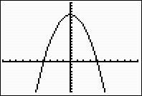
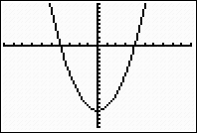
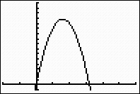
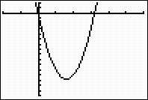
Find the vertex and the x-intercepts ( if there are any) of the graph. Then sketch the graph by hand Pg 510
3a) y = x ² - 16 = (x + 4) (x – 4) b) y =16 - x ² = ( 4- x) (4 – x)
c) y =16x - x ² d) y = x ² - 16x
(0, 16)
-4, 0) (4, 0) -4, 0) (4, 0)
(0, -16)
(8, 64) (0, 0) (16, 0)
(8, -64)
(0, 0) (16, 0)

Slide 37
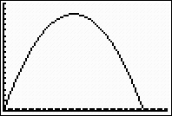
10. The annual increase, I, in the deer population in a national park depends on the size , x, of the population that year according to the formula I = 1.2x – 0.0002x² a) Find the vertex of the graph. What does it tell us about the deer population? b) Sketch the graph 0< x < 7000 c) For what values of x does the deer population decrease rather than increase ? Suggest a reason why the population might decrease
*
X= 3000 y = 1800
a = -0.0002 and b = 1.2, so the x-coordinate of the vertex is
x_{v} = -b/2a = -1.2/2(-0.0002) = 3000
The y coordinate is
y_{v} = 1.2( 3000) – 0.0002( 3000)2 = 1800
The vertex is ( 3000, 1800). The largest annual increase in the deer population is
1800 deer/yr, and this occurs for a deer population of 3000
d) The deer population decreases for x> 1800. If the population decreases for x> 1800.
If the population becomes too large, its supply of food may be adequate or it may
become easy prey for its predators

Slide 38
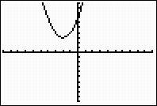
21. a) Find the coordinates of the intercepts and the vertex b) Sketch the graph
y = x² + 4x + 7, a= 1, b= 4 and c = 7. The vertex is where
x = - 4/ 2(1) = -2
When x = -2
y = ( -2) 2 + 4(-2) + 7 = 3
So the vertex is at ( -2, 3) . The y-intercept is at ( 0, 7) . Note that the parabola open
upward since a > 0 and that the vertex is above the x-axis. Therefore there are no
x-intercepts
b,c
8
-4 4

Slide 39
Use the discriminant to determine the nature of the solutions of each equation and by factoring
30. 4x² + 23x = 19 36. 6x² – 11x – 7 = 0
4x² + 23x – 19 = 0 D = b² – 4ac = ( -11) ² – 4(6)(-7) = 289
> 0
D = b² – 4ac = (23) ² – 4( 4) (-19) 289= (17) ² is a perfect square
= 833 > 0
Hence there will be two distinct Two distinct real solution
real solutions Can be solved by factoring

Slide 40
6.3 ,No 10, Page 511
I = kCx – k x²
= 0.0002 (6000)x – 0.0002x² = 1.2x – 0.0002x²
x – intercept is 6000
i.e neither decrease nor increase
Larger Increase
x | 0 | 500 | 1000 | 1500 | 2000 | 2500 | 3000 | 3500 | 4000 | 4500 | 5000 | 5500 | 6000 | 6500 | 7000
I | 0 | 550 | 1000 | 1350 | 1600 | 1750 | 1800 | 1750 | 1600 | 1350 | 1000 | 550 | 0 | -650 | -1400
Population 2000 will increase by 1600
1800
1750
1600
1350
1000
500
0
Population 7000 will decrease by 1400
0 500 1000 1500 2000 2500 3000 3500 4000 4500 5000 5500 6000 6500 7000

Slide 41
Quadratic Equation
The solutions of the quadratic equation
ax² + bx + c = 0, where a, b, c are real numbers with a = 0
No x intercepts One x – intercepts Two x - intercepts
x- intercepts
x- intercepts

Slide 42
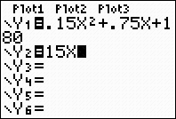
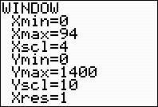
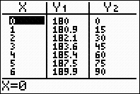
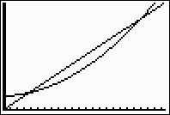
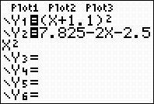
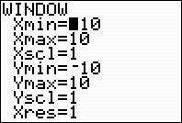
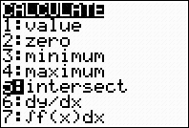
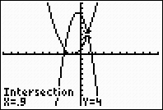
Solving Systems with the Graphing Calculator Example 5 Page 520
Enter Y1= Enter Window Press 2nd , table press graph
Pg 521
Enter Y1, Y2 Press window Press 2nd and calc
Press graph

Slide 43
Vertex Form for a Quadratic Function y = ax² + bx + c
The vertex form of a parabola with vertex (h, k) is
y = a (x – x_{v} )² + y_{v}, where a = 0 is a constant.
If a > 0, the parabola opens upward;
if a < 0, the parabola opens downward.
Where the vertex of the graph is (x_{v,} y_{v} )

Slide 44
6.4, Example 1(pg 516) Maximum and Minimum Values
Example 1
a) Revenue = (price of one item) (number of items sold)
R = x(600 – 15x)
R = 600x – 15x ²
^{b) Graph is a parabola}
^{c)} x_{v} = - b/2a = -600/2(-15) = 20
R_{v}= 600(20) – 15(20) ² = 6000
Maximum
6000
5000
R = 600x – 15x ²
20 40
Late Nite Blues should charge $20 for a pair of jeans in order to maximize revenue at
$6000 a week

Slide 45
Problem 1, Pg 523 a b). The price of a room is 20 + 2x, the number of rooms rented is 60 – 3x The total revenue earned at that price is (20 + 2x) (60 – 3x) c). Enter Y1 = 20 + 2x Y2 = 60 – 3x Y3 = (20 + 2x)(60 – 3x) in your calculator Tbl start = 0 Tb1 = 1 The values in the calculator’s table should match with table d). If x = 20, the total revenue is 0 e). Graph f). The owner must charge atleast $24 but no more than $36 per room to make a revenue atleast $1296 per night g). The maximum revenue from night is $1350, which is obtained by charging $30 per room and renting 45 rooms at this price
1500
0
20

Slide 46
6.4 pg 523, x be the no of price increases Price of room = 20 + 2x No. of rooms rented = 60 – 3x Total revenue = (20 + 2x)(60 – 3x)
No of price Price of room No. of rooms rented Total revenue
increases
0 20 60 1200
1 22 57 1254
2 24 54 1296
3 26 51 1326
4 28 48 1344
5 30 45 1350
6 32 42 1344
7 34 39 1326
8 36 36 1296
10 40 30 1200
12 44 24 1056
16 52 12 624
20 60 0 0
Lowest
Highest
Max. Revenue

Slide 47
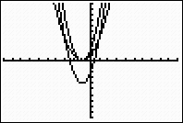
18 Transformations of graph
a ) y = (x + 1) ²
b) y = 2(x + 1) ²
c) y = 2(x + 1) ² – 4

Slide 48
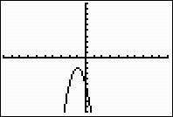
22 a) Find the vertex of a parabola b) Use transformations to sketch the graph c) Write the equation in standard form
y = - 3(x + 1) ² – 2
y = -3( x² + 2x +1 ) -2
y = -3x² -6x -3-2
y = -3x² -6x -5
Shifted left 1 unit, streched
vertically by a factor of 3,
reflected about the x-axis, and
then shifted down 2 units.
Vertex ( -1, -2)

Slide 49
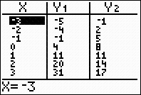
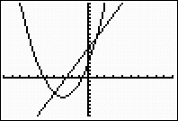
Solve the system algebraically, Use calculate to graph both equations and verify solution y = x² + 6x + 4 y = 3x + 8
Xmin = -10, Xmax = 10
, Ymin = -20 and Ymax = 20
y = x² + 6x + 4 and y = 3x + 8
Equate the expressions for y:
x² + 6x + 4 = 3x + 8
x² + 3x -4 = 0
(x+4)(x-1)= 0
So x = -4, and x= 1,
When x = - 4, y = 3(-4) + 8= - 4
When x = 1, y= 3(1) + 8 = 11
So the solution points are ( -4, -4) and (1, 11)
(1, 11)
( -4, -4)

Slide 50
6.6
Follow the steps to solve the system of equations
Step 1 Eliminate c from Equations (1) and (2) to
obtain a new equation (4)
Step 2 Eliminate c from Equations (2) and (3) to
obtain a new Equation (5)
Step 3 Solve the system of Equations (4) and (5)
Step 4 Substitute the values of a and b into one of
the original equations to find c

Slide 51
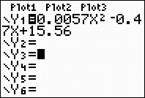
6.6 Using Calculator for Quadratic Regression Pg 543, Ex 5
STAT Enter datas
Store in Y1by pressing STAT right 5 VARS right 1, 1 Enter
Press Y = and select Plot 1 then press ZOOM 9
Graph

Slide 52
likec29 Ex 6.6, Page 549
500
Tower
Tower
Cable
Vertex ( 2000, 20
20
0 2000 4000
The vertex is (2000, 20) and another point on the cable is (0, 500).
Using vertex form, y = a(x – 2000) ²+ 20
Use point (0, 500)
500 = a(0 – 2000) ² + 20,
500 = 4,000,000a + 20
480 = 4,000,000a a = 0.000012 The shape of the cable is given by the equation y = 0.00012(x – 2000) ² + 20

